Slide 1
Causes of the French Revolution
How the inequality of France's Estates system set the French Revolution in motion
© More Lessons Less Planning | morelessonslessplanning.com
Notes:
Open with the lesson question: why would a country where almost everyone belonged to one group let a tiny few pay no taxes and hold all the privileges? Preview the answer: the unfairness of the Old Regime's three estates, plus a financial crisis and new Enlightenment ideas, pushed France toward revolution in 1789.

Slide 2
Learning Targets
Describe the Old Regime and France's three estates
★
Explain the inequality of privilege versus the tax burden
★
Explain the Estates-General and the fight over vote by order
★
Analyze Sieyes's What Is the Third Estate? as a persuasive argument
★
Explain how crisis, inequality, and ideas pushed France to revolution
★
© More Lessons Less Planning | morelessonslessplanning.com
Notes:
The five targets keep the lesson centered: the structure of the Old Regime, the inequality inside it, the calling of the Estates-General and the fight over voting, Sieyes's argument, and the big picture of how these causes combined.

Slide 3
The Old Regime: France's Three Estates
Before the Revolution, France's social system was called the Old Regime.
It divided everyone into three estates, or legal classes.
The First Estate was the clergy - the leaders of the Catholic Church.
The Second Estate was the nobility - wealthy landowning aristocrats.
The Third Estate was everyone else, from poor peasants to the middle class.
Key Concept: The Old Regime split French society into three estates - the clergy, the nobility, and everyone else.
© More Lessons Less Planning | morelessonslessplanning.com
Notes:
Before the Revolution, France's social system was called the Old Regime, and it divided everyone into three estates, or legal classes. The First Estate was the clergy, the leaders of the Catholic Church. The Second Estate was the nobility, wealthy landowning aristocrats. The Third Estate was everyone else, from poor peasants to the middle class.

Slide 4
A System of Inequality: Privilege vs. Tax Burden
Privilege for the Few
Taxes for the Many
The First and Second Estates held special privileges
Their biggest privilege was being largely exempt from taxes
They owned much of the land and held the top positions
The Third Estate paid most of the taxes
The main land tax, the taille, fell on the Third Estate
Peasants owed taxes to the king, the church, and their lords
Key Concept: The First and Second Estates held privileges and paid few taxes, while the Third Estate carried the tax burden.
© More Lessons Less Planning | morelessonslessplanning.com
Notes:
The First and Second Estates held special privileges, and their biggest privilege was being largely exempt from taxes; they also owned much of the land and held the top positions. The Third Estate paid most of the taxes. The main land tax, called the taille, fell on the Third Estate, and peasants owed taxes to the king, the church, and their lords.

Slide 5
The Third Estate: Almost Everyone
The Third Estate was about 97% of France's people.
It included poor peasants who worked the land.
It included city workers and craftspeople.
It also included the bourgeoisie, the middle class.
The bourgeoisie were merchants, lawyers, and professionals.
Key Concept: The Third Estate was about 97% of France, from poor peasants to the middle-class bourgeoisie.
© More Lessons Less Planning | morelessonslessplanning.com
Notes:
The Third Estate was about 97 percent of France's people. It included poor peasants who worked the land, city workers, and craftspeople. It also included the bourgeoisie, the middle class, who were merchants, lawyers, and professionals. Even wealthy, educated members of the bourgeoisie were still shut out of the privileges the top two estates enjoyed.

Slide 6
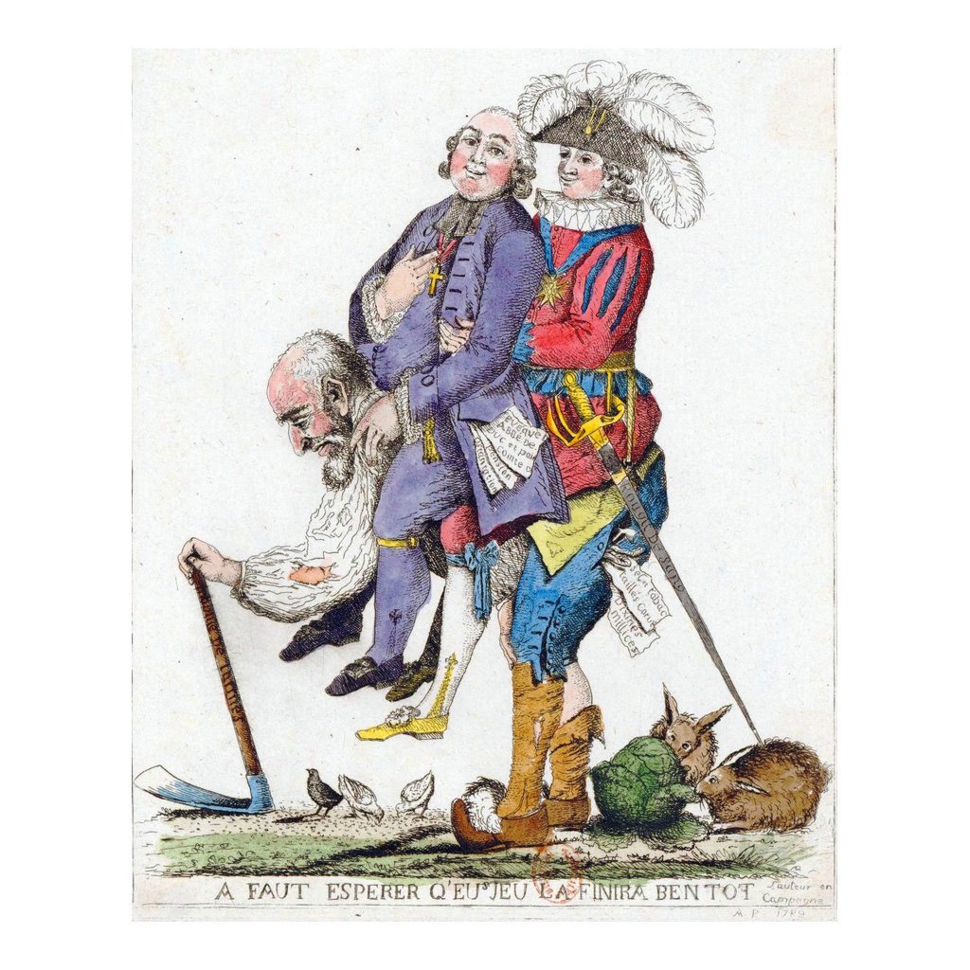
A 1789 caricature of the three estates
1789 cartoon: a Third Estate commoner carries the clergy and nobility
© More Lessons Less Planning | morelessonslessplanning.com
Notes:
This is a French political cartoon from 1789. It shows a bent-over commoner of the Third Estate carrying a clergyman and a noble on his back, an image of how the Third Estate supported the privileged estates. Use it as a historical reference image, not as evidence for any single fact.

Slide 7
A Kingdom in Financial Crisis
By the 1780s the French government was deeply in debt.
It ran a deficit, spending far more than it collected.
Costly wars, including helping the American Revolution, drained the treasury.
Bad harvests in 1788 made bread scarce and expensive.
Hungry, overtaxed people grew angrier at the unfair system.
Key Concept: Debt, a growing deficit, and bad harvests in 1788 pushed France into a crisis the old tax system could not fix.
© More Lessons Less Planning | morelessonslessplanning.com
Notes:
By the 1780s the French government was deeply in debt and ran a deficit, spending far more than it collected. Costly wars, including helping the American Revolution, drained the treasury. Bad harvests in 1788 made bread scarce and expensive. Hungry, overtaxed people grew angrier at the unfair system.

Slide 8
Enlightenment Ideas Question the Old Order
New Ideas Spread
A Challenge to Privilege
Enlightenment thinkers questioned kings and inherited privilege
Locke argued government should protect people's natural rights
Rousseau argued that power should come from the people
These ideas made inequality look unjust, not natural
Educated members of the Third Estate read and shared them
They asked why birth alone should decide power and privilege
Key Concept: Enlightenment ideas about rights and equality made the inequality of the Old Regime look unjust.
© More Lessons Less Planning | morelessonslessplanning.com
Notes:
Enlightenment thinkers questioned kings and inherited privilege. Locke argued that government should protect people's natural rights, and Rousseau argued that power should come from the people. These ideas made inequality look unjust rather than natural. Educated members of the Third Estate read and shared them, asking why birth alone should decide power and privilege.

Slide 9
The King Calls the Estates-General, 1789
Desperate for money, King Louis XVI called the Estates-General.
The Estates-General was an assembly of all three estates.
It had not met since 1614, about 175 years earlier.
Each estate sent representatives to meet in 1789.
The king hoped they would approve new taxes.
Key Concept: In 1789 Louis XVI called the Estates-General, which had not met since 1614, to solve the money crisis.
© More Lessons Less Planning | morelessonslessplanning.com
Notes:
Desperate for money, King Louis XVI called the Estates-General, an assembly of all three estates. It had not met since 1614, about 175 years earlier. Each estate sent representatives to meet in 1789, and the king hoped they would approve new taxes.

Slide 10
An Unfair Vote: Vote by Order
How Voting Worked
Why It Was Unfair
The Estates-General voted by order
In vote by order, each estate cast one vote
So there were three votes total, one per estate
The First and Second Estates usually voted together
That let the two privileged estates outvote the Third, 2 to 1
The Third Estate spoke for 97% but could always be defeated
Key Concept: Vote by order gave each estate one vote, so the two privileged estates could always outvote the Third.
© More Lessons Less Planning | morelessonslessplanning.com
Notes:
The Estates-General voted by order. In vote by order, each estate cast one vote, so there were three votes total, one per estate. The First and Second Estates usually voted together, which let the two privileged estates outvote the Third, two to one. The Third Estate spoke for about 97 percent of France but could always be defeated.

Slide 11
"What Is the Third Estate?" Sieyes's Argument
In early 1789 Abbe Sieyes wrote a pamphlet, What Is the Third Estate?
He asked: What is the Third Estate? He answered, Everything.
He asked what it had been until now: Nothing.
He asked what it wanted: to become something.
The pamphlet was an argument, not a neutral description.
Key Concept: Sieyes argued the Third Estate was 'everything' yet treated as 'nothing,' and demanded to become 'something.'
© More Lessons Less Planning | morelessonslessplanning.com
Notes:
In early 1789 the Abbe Sieyes wrote a pamphlet called What Is the Third Estate? He asked, What is the Third Estate? and answered, Everything. He asked what it had been until now in the political order, and answered, Nothing. He asked what it wanted, and answered, to become something. The pamphlet was a persuasive argument, not a neutral description, and it made the Third Estate's case for equality and real representation.

Slide 12
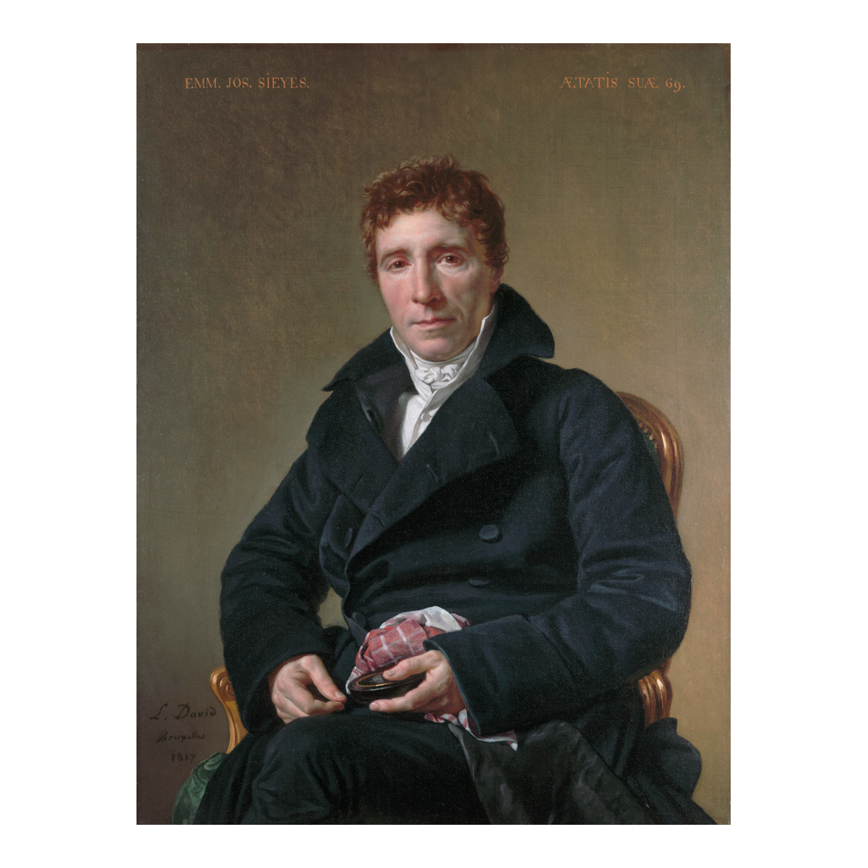
Emmanuel-Joseph Sieyes, author of the pamphlet
Emmanuel-Joseph Sieyes, portrait by Jacques-Louis David (1817)
© More Lessons Less Planning | morelessonslessplanning.com
Notes:
This is a portrait of Emmanuel-Joseph Sieyes, painted by Jacques-Louis David in 1817. Sieyes was the clergyman and political writer who published What Is the Third Estate? in 1789. Use the portrait as a reference image to picture the author, not as evidence for any idea.

Slide 13
From Exclusion Toward Revolution
At the Estates-General, the Third Estate demanded a fairer vote.
The king and privileged estates resisted their demands.
Feeling shut out, the Third Estate refused to back down.
This standoff over inequality set the Revolution in motion.
The next steps - the National Assembly and the Bastille - came in mid-1789.
Key Concept: The Third Estate's exclusion at the Estates-General turned frustration into the start of revolution in 1789.
© More Lessons Less Planning | morelessonslessplanning.com
Notes:
At the Estates-General, the Third Estate demanded a fairer vote, but the king and the privileged estates resisted. Feeling shut out, the Third Estate refused to back down, and this standoff over inequality set the Revolution in motion. The next steps, the National Assembly and the storming of the Bastille, came in mid-1789 and are the story of the next lesson.

Slide 14
Reference Guide: The Old Regime and Its Estates
Estates-General
The assembly of representatives from France's three estates, called by the king in 1789.
First Estate
The clergy; the smallest estate, largely exempt from taxes.
Second Estate
The nobility; landowning aristocrats with special privileges and few taxes.
Third Estate
The commoners, about 97% of France, who paid most of the taxes.
Old Regime
France's system before the Revolution, built on the three estates and privilege.
Tip: These five terms name the assembly, the three estates, and the whole system they belonged to.
© More Lessons Less Planning | morelessonslessplanning.com
Notes:
Review the five terms exactly as defined: Estates-General, First Estate, Second Estate, Third Estate, and Old Regime. Students use these definitions to complete the Reference Guide in the Activity.

Slide 15
Reference Guide: Inequality and Crisis
bourgeoisie
The middle class of the Third Estate, such as merchants, lawyers, and professionals.
privilege
A special right or advantage, such as tax exemption, held by the top two estates.
taille
The main direct land tax, paid by the Third Estate but not the nobility or clergy.
vote by order
Each estate cast one vote, so the two privileged estates outvote the Third.
deficit
A shortfall in which the government spends far more money than it takes in.
Tip: These five terms name the middle class, the unfair advantages, the tax, the voting rule, and the money crisis.
© More Lessons Less Planning | morelessonslessplanning.com
Notes:
Review the five terms exactly as defined: bourgeoisie, privilege, taille, vote by order, and deficit. Students use these definitions to complete the Reference Guide in the Activity.

Slide 16
Key Takeaways
The Old Regime split France into three estates, with privilege for the few.
★
The Third Estate was about 97% of France but paid most of the taxes.
★
Debt, a deficit, and bad harvests forced the king to call the Estates-General.
★
Vote by order let the two privileged estates outvote the Third Estate.
★
Inequality, crisis, and new ideas together pushed France toward revolution.
★
© More Lessons Less Planning | morelessonslessplanning.com
Notes:
Close with the essential question. Each takeaway connects the inequality of the estates, the financial crisis, the fight over voting, and the Enlightenment ideas to the coming of the French Revolution in 1789.

