Slide 1
Cartels and Collusion: How OPEC Controls Oil
How OPEC controls global oil prices through production quotas - and why members keep cheating.
© More Lessons Less Planning | morelessonslessplanning.com
Notes:
Open with a question: when gas prices spike, who do most people blame? The answer is usually OPEC. Today we walk how OPEC actually works - the 1960 founding, the 12 members, the quota system, and the constant cheating that has nearly destroyed the cartel three times.

Slide 2
Learning Targets
Define CARTEL and identify OPEC's founding, HQ, and 12 members
★
Define PRODUCTION QUOTA + CARTEL CHEATING + EXPLICIT vs TACIT COLLUSION + OPEC+
★
Read 3 charts; write a Briefing Memo on what the U.S. should do about OPEC
★
© More Lessons Less Planning | morelessonslessplanning.com
Notes:
Read the three targets aloud. Target 1 is the WHAT (cartel definition + OPEC facts). Target 2 is the vocabulary. Target 3 is the synthesis - what should U.S. policy be toward OPEC.

Slide 3
OPEC: The World's Most Famous Cartel
What OPEC Is
Why OPEC Matters
Founded September 14, 1960 in Baghdad
Headquartered in Vienna, Austria
12 member nations control ~37% of global crude
Saudi Arabia is the biggest producer in OPEC
OPEC sets production QUOTAS that affect world oil prices
Triggered 1973 stagflation in the US and Europe
Still the largest organized cartel in the world
OPEC+ (with Russia) controls ~48% of global supply
Big Idea: OPEC is a CARTEL - a formal agreement among competing producers to limit output and raise prices.
© More Lessons Less Planning | morelessonslessplanning.com
Notes:
Frame the lesson. OPEC is the world's most famous cartel and it has shaped U.S. economic policy for 50 years. The 1973 embargo created the modern energy economy.

Slide 4
What is a CARTEL?
Cartel (definition)
A formal agreement among competing producers to LIMIT OUTPUT, set production quotas for each member, and RAISE the market price above the competitive level
How it works
Each member agrees to produce no more than a set amount; reduced total supply pushes the market price UP; members split the higher profits
Why it usually fails
Each member has a strong incentive to CHEAT (produce above quota) and grab extra revenue - cartels are inherently UNSTABLE
Key Point: a cartel is competing producers ACTING LIKE A MONOPOLY by agreement - which is why most cartels are ILLEGAL under U.S. antitrust law.
© More Lessons Less Planning | morelessonslessplanning.com
Notes:
Drill the cartel definition. Limited output, set quotas, raise prices. The cheating incentive is what makes cartels unstable. Most cartels are illegal in the US under the Sherman Act.

Slide 5
Why Cartels Are Inherently UNSTABLE
The cheating incentive
If everyone else cuts output and price rises, ONE member can secretly produce more and capture extra revenue - the prisoner's dilemma applied to producers
What enforces the cartel
Nothing in U.S. law - cartels here are ILLEGAL; in OPEC, only Saudi Arabia's willingness to cut production (the swing producer role) holds the cartel together
What breaks the cartel
When the swing producer STOPS absorbing cheating (Saudi flood 1985, shale price war 2014), prices CRASH and the cartel temporarily collapses
Key Point: OPEC has only survived 65 years because Saudi Arabia is willing to take the losses when other members cheat.
© More Lessons Less Planning | morelessonslessplanning.com
Notes:
The cheating incentive is the central economic problem of cartels. Each member has a strong reason to violate the quota. Saudi Arabia keeps OPEC alive by absorbing the cheating - when it stops, prices crash.

Slide 6
OPEC Structure - 1960 to 2025
The Founding (1960)
Today (12 members)
Founded September 14, 1960 in Baghdad
5 original members: Saudi Arabia, Iran, Iraq, Kuwait, Venezuela
Headquartered in Vienna, Austria since 1965
Twice-yearly ministerial meetings set production targets
Adds: UAE, Nigeria, Algeria, Libya, Congo, Equatorial Guinea, Gabon
Saudi Arabia is the largest producer (~9 mbd)
Controls ~37% of global crude oil (peaked at 53% in 1973)
OPEC+ (with Russia, 2016) controls ~48% combined
Tip: OPEC was founded in Baghdad but moved to neutral Vienna in 1965 - members needed a place outside any single country's politics.
© More Lessons Less Planning | morelessonslessplanning.com
Notes:
Walk OPEC structure. 1960 founding in Baghdad. 5 original members. Moved to Vienna in 1965 (neutral ground). 12 current members. Saudi Arabia is the swing producer.

Slide 7
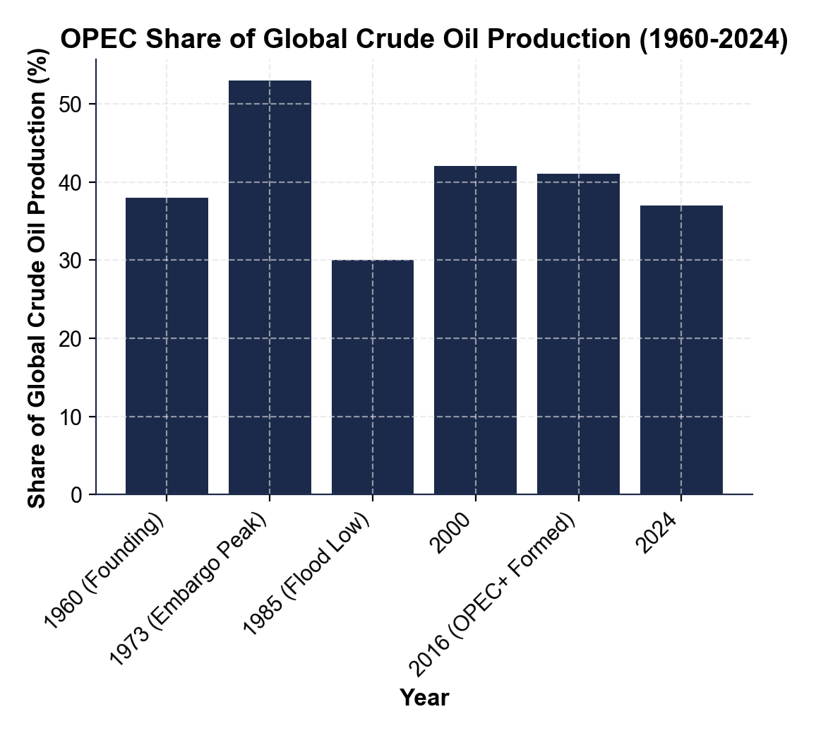
OPEC Global Market Share - Visualized
OPEC share: 38% (1960) to 53% peak (1973) to 30% low (1985) to 37% (2024).
© More Lessons Less Planning | morelessonslessplanning.com
Notes:
Display the chart full-bleed. Walk each bar. Stress the 1973 peak and the 1985 collapse. OPEC has never returned to its 1973 peak market share.
Reference labels (point to these chart features when teaching): Chart 1

Slide 8
The OPEC Production QUOTA System
Production quota (definition)
Each member's assigned MAXIMUM daily output - measured in millions of barrels per day (mbd) and negotiated at twice-yearly Vienna meetings
How OPEC sets the total
Ministers add up forecasted world demand, subtract non-OPEC supply, and set each member's quota to match the gap - producing LESS than the world wants raises prices
Cartel cheating
When an individual member produces ABOVE its assigned quota - cartel cheating is the central reason cartels are inherently unstable
Big Idea: cheating captures extra revenue at the cartel's expense - this central reason cartels collapse.
© More Lessons Less Planning | morelessonslessplanning.com
Notes:
Walk the quota system. Quotas measured in mbd. Set at twice-yearly Vienna meetings. The cheating pattern is real and constant - Iraq and UAE above quota, Saudi Arabia below as the swing producer.

Slide 9
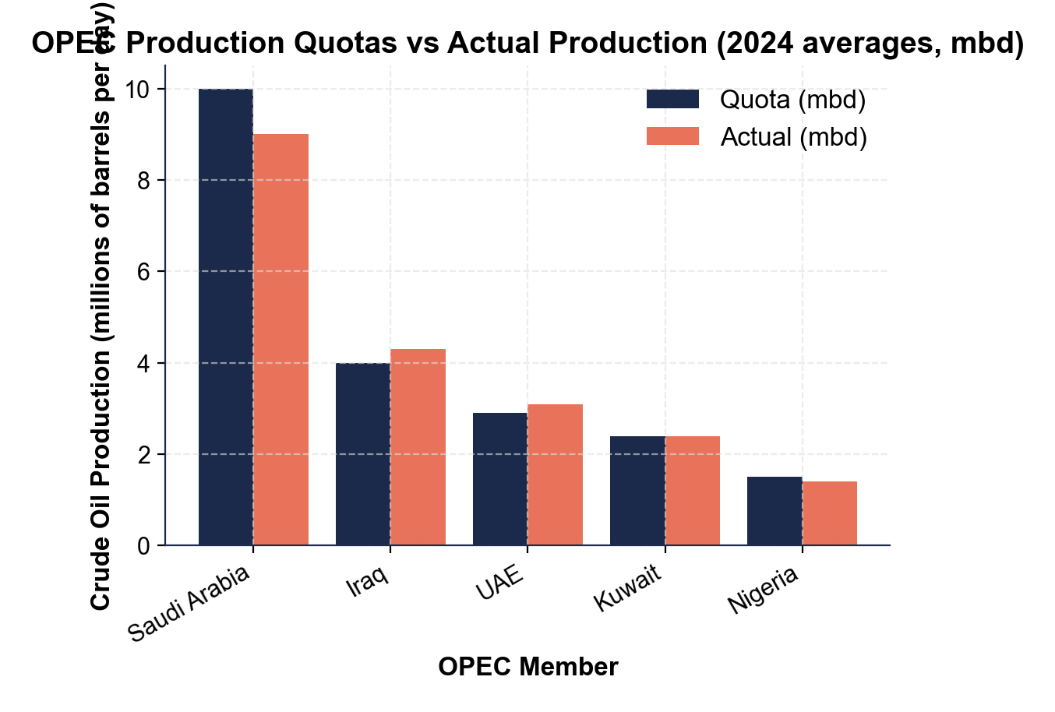
OPEC Quotas vs Actual Production (2024)
Iraq +0.3 and UAE +0.2 are CHEATING; Saudi -1.0 swings; Kuwait flat.
© More Lessons Less Planning | morelessonslessplanning.com
Notes:
Display the chart. Walk each country pair. Iraq and UAE are visibly above quota (cheating). Saudi Arabia is 1.0 mbd below as the swing producer absorbing the cuts. This is cartel instability in real time.
Reference labels (point to these chart features when teaching): Chart 2

Slide 10
1973 Oil Embargo - OPEC's Peak Moment
What Happened
The U.S. Impact
October 17, 1973: Arab OPEC members halt exports to U.S.
Trigger: U.S. support for Israel in Yom Kippur War
Technically an OAPEC action (the Arab subset)
Embargo lifted in March 1974 - but prices stayed high
Oil tripled: $3 (1972) to $11 (1974) per barrel
Gas rationing, odd-even license plate days
Triggered STAGFLATION (high inflation + high unemployment)
Strategic Petroleum Reserve (emergency oil stockpile) created 1975
Tip: the SPR is the U.S. emergency oil stockpile Congress created in 1975 to be released later to counter OPEC supply cuts.
© More Lessons Less Planning | morelessonslessplanning.com
Notes:
Walk the 1973 embargo. October 17, 1973 trigger - Yom Kippur War support. OAPEC (Arab subset) action. Oil tripled in 2 years. SPR created in 1975 as the direct response.

Slide 11
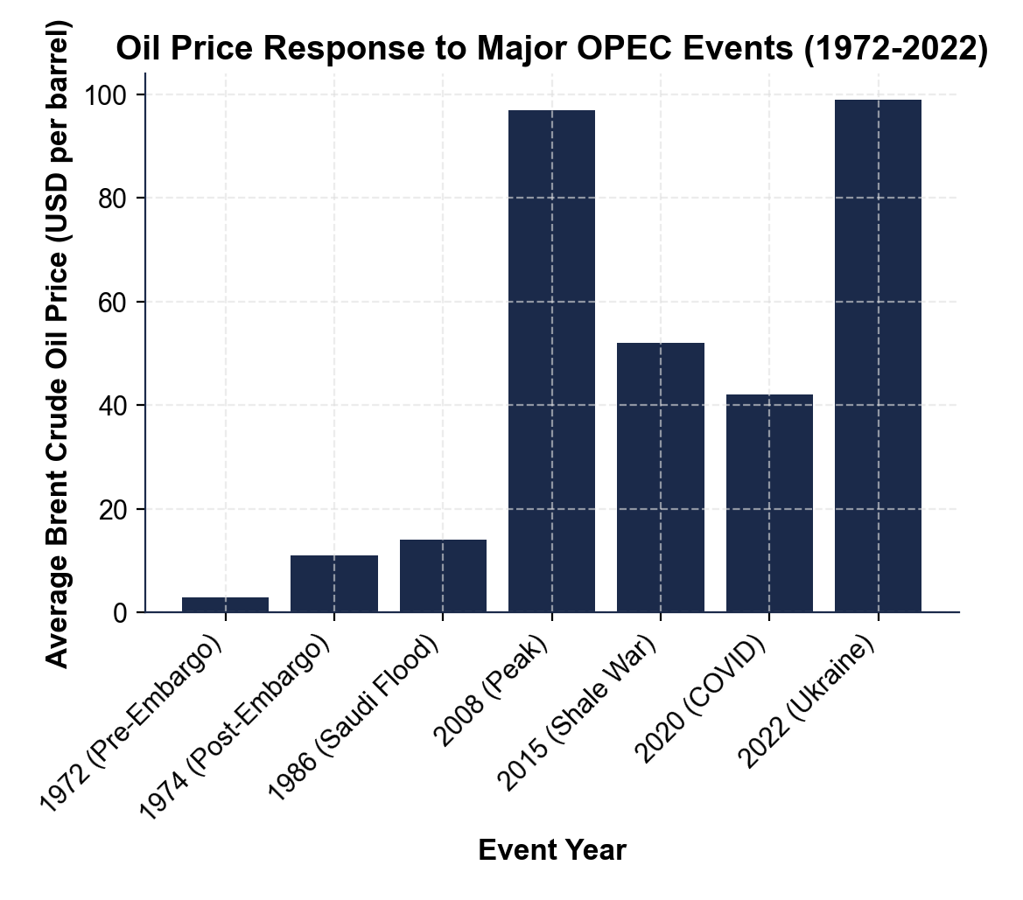
Oil Prices at Major OPEC Events
$3 (1972) to $11 (1974 embargo) to $14 (1986) to $97 (2008) to $99 (2022).
© More Lessons Less Planning | morelessonslessplanning.com
Notes:
Display the chart full-bleed. Walk each bar. Stress the 1972-1974 embargo jump, the 1986 Saudi flood collapse, the 2020 COVID crash, and the 2022 Ukraine rebound. OPEC's pricing power is real but unreliable.
Reference labels (point to these chart features when teaching): Chart 3

Slide 12
1985-1986 Saudi Flood - Cartel Discipline Breaks
What Saudi Arabia Did
What Happened
Frustrated with constant cheating by other members
Late 1985: abandoned swing-producer role
Ramped production from 2 mbd up to 5+ mbd
Strategy: discipline the cheaters by crashing prices
Prices crashed from ~$30 to ~$10 per barrel
Nearly bankrupted the Soviet Union (oil exporter)
Several OPEC members nearly bankrupted too
First demonstration cartel discipline cannot be permanently enforced
Key Point: the Saudi flood proved that when the swing producer STOPS absorbing cheating, the cartel temporarily collapses.
© More Lessons Less Planning | morelessonslessplanning.com
Notes:
The 1985-1986 Saudi flood is the first big cartel-discipline failure. Saudi Arabia abandoned the swing producer role to discipline cheaters. Prices collapsed. Nearly bankrupted the Soviet Union and several OPEC members.

Slide 13
2014-2016 Shale Price War - U.S. Shale Wins
WHAT SAUDI ARABIA DID (AGAIN) - Late 2014 - with U.S. shale production exploding from 5 to 9 mbd, Saudi Arabia pumped at maximum to bankrupt shale firms; oil prices fell from ~$100 to ~$30 per barrel
WHY IT FAILED - U.S. shale firms CUT COSTS aggressively (drilling efficiency 2x); shale production kept growing despite low prices; Saudi Arabia gave up in 2016
WHAT CAME NEXT - OPEC+ formed (with Russia) to manage supply better - the cartel realized it could not control prices alone against U.S. shale
Big Idea: U.S. SHALE is the single most important development limiting OPEC's pricing power since the 1970s.
© More Lessons Less Planning | morelessonslessplanning.com
Notes:
The 2014-2016 shale price war is the second big cartel-discipline failure. Saudi Arabia tried to bankrupt U.S. shale producers; shale survived by cutting costs. This is when OPEC realized it needed Russia (OPEC+) to manage supply.

Slide 14
OPEC+ Era (2016 to Today)
What is OPEC+
Expanded coordination group formed December 2016 - OPEC (12 members) plus Russia and 9 other non-OPEC producers (Azerbaijan, Bahrain, Kazakhstan, Mexico, Oman, others)
Combined size
OPEC+ controls about 48% of global oil supply - meaningfully more than OPEC alone at 37%; Russia and Saudi Arabia are the de facto co-leaders
Why it formed
After the 2014-2016 shale price war, OPEC realized it could not manage prices alone - needed Russia's 11 mbd to make production cuts meaningful
Tip: OPEC+ is OPEC's modern adaptation - the original 12-member cartel was too small to control prices against U.S. shale.
© More Lessons Less Planning | morelessonslessplanning.com
Notes:
Walk OPEC+. Formed December 2016 after the shale war. Adds Russia + 9 other producers. Controls 48% of global supply combined. Russia and Saudi Arabia are co-leaders.

Slide 15
2020 COVID Cut - The Biggest in OPEC History
What Happened
Why It Was Not Enough
March 2020: global oil demand collapsed (lockdowns)
April 12, 2020: OPEC+ cuts 9.7 mbd (largest ever)
About 10% of global supply removed in one decision
Cut was 4 times the size of the 1973 embargo's effective cut
Demand fell faster than supply could be cut
U.S. oil prices briefly went NEGATIVE in April 2020
Storage was full - producers paid buyers to take oil
Showed that even maximum cartel action has limits
Key Point: the 2020 COVID cut was the largest in OPEC history - and even THAT could not prevent prices from briefly going negative.
© More Lessons Less Planning | morelessonslessplanning.com
Notes:
The 2020 COVID cut is the largest in OPEC history (9.7 mbd, about 10% of global supply). Even this could not prevent prices from briefly going negative because demand fell faster and storage was full.

Slide 16
Collusion - Explicit vs Tacit
Collusion (broad)
Any coordination among competitors to fix prices, divide markets, or restrict output - contains cartels
Explicit collusion
Coordination through FORMAL agreement - cartels (OPEC) are the extreme form; ILLEGAL in the U.S.
Tacit collusion
Coordination WITHOUT a formal agreement - silent price-matching by airlines, gas stations, cell phones
Big Idea: OPEC is the textbook example of EXPLICIT collusion; gas stations matching prices is TACIT collusion.
© More Lessons Less Planning | morelessonslessplanning.com
Notes:
Drill the explicit vs tacit distinction. Explicit = formal agreement (OPEC); illegal in US. Tacit = silent coordination (airline price-matching); harder to prosecute.

Slide 17
Why Cartels Are ILLEGAL in the United States
Sherman Antitrust Act of 1890
The 1890 federal law makes most cartels ILLEGAL within the United States - OPEC operates from Vienna soil, no U.S. companies can join
Why OPEC works anyway
OPEC is headquartered in VIENNA and consists of foreign GOVERNMENTS - U.S. law does not reach foreign sovereigns acting abroad
Why no U.S. firm can join
ExxonMobil and Chevron (Standard Oil successors) cannot legally coordinate with OPEC on production - the DOJ would prosecute under the Sherman Act
Tip: OPEC operates from Vienna SPECIFICALLY because organizing a cartel on U.S. soil would be a federal crime.
© More Lessons Less Planning | morelessonslessplanning.com
Notes:
Walk the U.S. antitrust position. Sherman Act 1890 makes cartels illegal. OPEC works because it is foreign governments acting abroad. ExxonMobil and Chevron cannot legally coordinate with OPEC.

Slide 18
Modern OPEC Influence - What It Can and Cannot Do
What OPEC CAN Do
What OPEC CANNOT Do
Cut supply by 1-3 mbd and move prices by $5-15/bbl
Set the global price floor through cartel coordination
Influence U.S. gas prices within a few weeks
Coordinate with Russia (OPEC+) on cuts
Permanently defend a price above shale break-even (~$60)
Stop U.S. shale production from growing long-term
Force every member to stick to its quota
Replace the swing producer role if Saudi Arabia quits it
Big Idea: modern OPEC is a PRICE INFLUENCER, not a price setter - shale and consumer-nation policy limit how high it can push.
© More Lessons Less Planning | morelessonslessplanning.com
Notes:
Walk what OPEC can and cannot do today. CAN: move prices $5-15 with 1-3 mbd cuts; coordinate with Russia. CANNOT: defend prices above shale break-even; stop shale growth; enforce quotas perfectly.

Slide 19
Key Takeaways
A CARTEL is a formal agreement to limit output and raise prices
OPEC: founded 1960, Vienna HQ, 12 members, ~37% global crude
Members CHEAT constantly - Iraq +0.3, UAE +0.2, Saudi -1.0 (swing)
OPEC has lost discipline 3 times: 1985 flood, 2014 shale war, 2020 COVID
OPEC+ (with Russia, 2016) controls 48% of global supply combined
Big Idea: OPEC is the world's most famous cartel - founded 1960, 12 members, 37% global share, constantly cheating, kept alive by Saudi Arabia.
© More Lessons Less Planning | morelessonslessplanning.com
Notes:
Synthesize the lesson. The cartel concept, the OPEC structure, the cheating problem, the historical episodes, and the modern limits.

