Slide 1
Building Your First Budget: From Paycheck to Plan
Turn a take-home paycheck into a written plan where every single dollar has a job - a zero-based budget that balances to exactly zero.
© More Lessons Less Planning | morelessonslessplanning.com
Notes:
Open with the hook: a paycheck without a plan just disappears. A budget is a plan you write BEFORE the money arrives. Today students follow Maya, a recent grad with a $2,600 monthly take-home, and build a zero-based budget where income minus every expense equals $0.

Slide 2
Learning Targets
Explain what a zero-based budget is and why every dollar gets a job
★
List monthly income and every monthly expense on a budget worksheet
★
Build a budget where income minus total expenses equals zero
★
Read an income-vs-expenses bar chart and confirm the budget is balanced
★
© More Lessons Less Planning | morelessonslessplanning.com
Notes:
Read the four targets aloud. Tell students the activity puts them in Maya's shoes: listing income and expenses, building a complete zero-based budget that balances to $0, and reading a bar chart that proves it is balanced.

Slide 3
From Paycheck to Plan
A Paycheck With No Plan
A Paycheck With a Budget
Money comes in, then just disappears
You hit the end of the month with nothing left
You cannot say where it all went
Surprise bills become a crisis every time
A BUDGET is a written plan for your money
You decide where money goes before you spend it
Every dollar is assigned on purpose
You always know what you can spend and save
Key Concept: A BUDGET is a written plan for how you will spend and save your take-home pay each month, made before the money arrives.
© More Lessons Less Planning | morelessonslessplanning.com
Notes:
Frame the problem: a paycheck with no plan disappears and you cannot say where it went. A BUDGET is a written plan for how you will spend and save your take-home pay each month, made before the money arrives. With a budget you decide where money goes on purpose instead of wondering where it went.

Slide 4
Zero-Based Budgeting
Zero-based budget
A budget where income minus every assigned expense equals zero - every dollar has a job
The big idea
You assign 100% of your take-home pay, not just the bills; leftover money still gets a job
Zero does NOT mean broke
Hitting zero means every dollar is assigned, including dollars assigned to savings
Why it works
No dollar slips through unassigned, so money stops quietly disappearing
Key Concept: In a ZERO-BASED BUDGET, income minus every assigned expense equals zero. Reaching zero means every dollar has a job - including savings.
© More Lessons Less Planning | morelessonslessplanning.com
Notes:
Teach the core idea. A ZERO-BASED BUDGET is a budget where income minus every assigned expense equals zero, so every dollar has a job. Stress that zero does NOT mean broke - it means every dollar is assigned, including the dollars you assign to savings. You assign 100% of take-home pay, not just the bills. Because no dollar slips through unassigned, money stops disappearing.

Slide 5
List Your Income
Start with take-home pay
INCOME is money coming in each month; use your NET (take-home) pay, not gross
✔
Maya's income
Maya's first job pays $2,600 a month take-home - that is the top of her worksheet
✔
Add any other income
Side-gig pay or regular cash gifts count too; Maya has none, so income is $2,600
✔
This is the number to assign
The whole budget assigns this $2,600 - every dollar of it gets a job
✔
Tip: Always budget your TAKE-HOME pay, not your gross. Taxes are already gone - you can only assign the money you actually receive.
© More Lessons Less Planning | morelessonslessplanning.com
Notes:
Teach step one of the worksheet: list income. INCOME is money coming in each month, mainly your take-home pay from a job. TAKE-HOME PAY is your monthly net income, the money actually deposited after taxes and deductions, which you budget. Maya's take-home is $2,600 a month - that goes at the top of the worksheet and is the number the whole budget assigns. Always budget net, not gross.

Slide 6
List Every Expense
Fixed Expenses
Variable Expenses
A FIXED EXPENSE stays about the same each month
Rent, car insurance, a loan payment
Maya's rent is $950, the same every month
Easy to plan - the number does not move
A VARIABLE EXPENSE changes month to month
Groceries, gas, eating out
Maya's groceries run about $350 a month
Use a typical month, then adjust as you learn
Did You Know? An EXPENSE is any money going out. The trick to a real budget is listing EVERY expense - the small ones add up fast.
© More Lessons Less Planning | morelessonslessplanning.com
Notes:
Teach step two: list every expense. An EXPENSE is money going out for something you spend on, like rent, groceries, or a subscription. Split expenses into two kinds. A FIXED EXPENSE stays about the same every month (rent, car insurance, a loan payment) - Maya's rent is $950. A VARIABLE EXPENSE changes month to month (groceries, gas, eating out) - Maya's groceries run about $350. The trick to a real budget is listing EVERY expense, because small ones add up fast.

Slide 7
Give Every Dollar a Job
Assign down the list
Cover needs first (rent, groceries, utilities, transportation, minimum payments)
✔
Then fund wants
Maya assigns $210 to eating out and fun and $40 to subscriptions
✔
Then assign savings
Savings is a JOB too: Maya assigns $250 to an emergency fund and $200 to a savings goal
✔
Leftover money still gets a job
UNASSIGNED money is leftover pay with no job yet; a zero-based budget assigns it
✔
Key Concept: Savings is a job, not 'leftover.' Assign money to savings on purpose, the same way you assign rent.
© More Lessons Less Planning | morelessonslessplanning.com
Notes:
Teach step three: give every dollar a job, assigning down the worksheet. Cover needs first (rent, groceries, utilities, transportation, minimum loan payment), then fund wants (Maya: $210 eating out and fun, $40 subscriptions), then assign savings as its own job (Maya: $250 emergency fund, $200 savings goal). UNASSIGNED MONEY is take-home pay left over after expenses that has not been given a job yet - a zero-based budget assigns it instead of letting it drift. Savings is a job, not 'leftover.'

Slide 8
Balancing to Zero
Maya's First Draft Is Off
Give the $250 a Job
Maya assigns only $2,350 of her $2,600
Income $2,600 minus assigned $2,350 = $250 left
That $250 is UNASSIGNED - it has no job
Unassigned money is exactly how cash disappears
Assign the leftover $250 to the emergency fund
Emergency fund goes from $0 to $250
New total assigned: $2,350 + $250 = $2,600
Income $2,600 minus $2,600 = $0 - balanced
Did You Know? Leftover money is not a win until you assign it. Maya's $250 leftover only counts once it gets a job - here, the emergency fund.
© More Lessons Less Planning | morelessonslessplanning.com
Notes:
Show how to balance to zero by diagnosing and fixing Maya's first draft. The first draft assigns only $2,350 of the $2,600, leaving $250 UNASSIGNED ($2,600 - $2,350 = $250). Unassigned money is exactly how cash disappears. The fix: give the $250 a job by assigning it to the emergency fund, which rises from $0 to $250. New total = $2,350 + $250 = $2,600, so income $2,600 minus expenses $2,600 = $0 - a BALANCED BUDGET where total expenses equal total income. A zero-based budget is not done until it hits zero.

Slide 9
Build a Complete Monthly Budget
Income at the top of the worksheet
A BUDGET WORKSHEET lists income at the top: take-home pay $2,600, the number every expense below must add up to
✔
Needs assigned
Rent $950, groceries $350, utilities/phone $180, transportation $160, car insurance $110, student loan $150
✔
Wants and savings assigned
Wants: eating out and fun $210, subscriptions $40. Savings: emergency fund $250, savings goal $200
✔
Check the total
All expenses add to $2,600; income $2,600 minus $2,600 = $0 - balanced
✔
Tip: The final check is always the same: add up every expense and subtract from income. A zero-based budget is done only when the answer is $0.
© More Lessons Less Planning | morelessonslessplanning.com
Notes:
Put the whole BUDGET WORKSHEET together. Income at the top: $2,600 take-home. Needs: rent $950, groceries $350, utilities/phone $180, transportation $160, car insurance $110, student loan minimum $150. Wants: eating out and fun $210, subscriptions $40. Savings: emergency fund $250, savings goal $200. Add every expense: it totals $2,600. Check: income $2,600 minus expenses $2,600 = $0. A BUDGET WORKSHEET is the form you fill in - income at the top, every expense below. This is the exact budget the Activity builds and the chart shows.

Slide 10
Income vs Expenses: A Balanced Budget
The income bar
Total income = Maya's $2,600 take-home pay
✔
The expense bar
Total expenses = all assigned dollars = $2,600
✔
Equal heights = balanced
Same height means income minus expenses = $0
✔
What unbalanced looks like
Shorter expense bar = money unassigned; taller = overspent
✔
Key Concept: When a budget is balanced, the income bar and the expense bar are exactly the same height - that equal picture IS a zero-based budget.
© More Lessons Less Planning | morelessonslessplanning.com
Notes:
Set up the income-vs-expenses bar chart on the next slide. Maya's balanced zero-based budget has total income $2,600 and total expenses $2,600 - two equal bars. Frame the visual signature of a balanced budget: when the income bar and the expense bar are the same height, income minus expenses is zero. If the expense bar were shorter, money would be unassigned; if taller, the budget would be overspent.

Slide 11
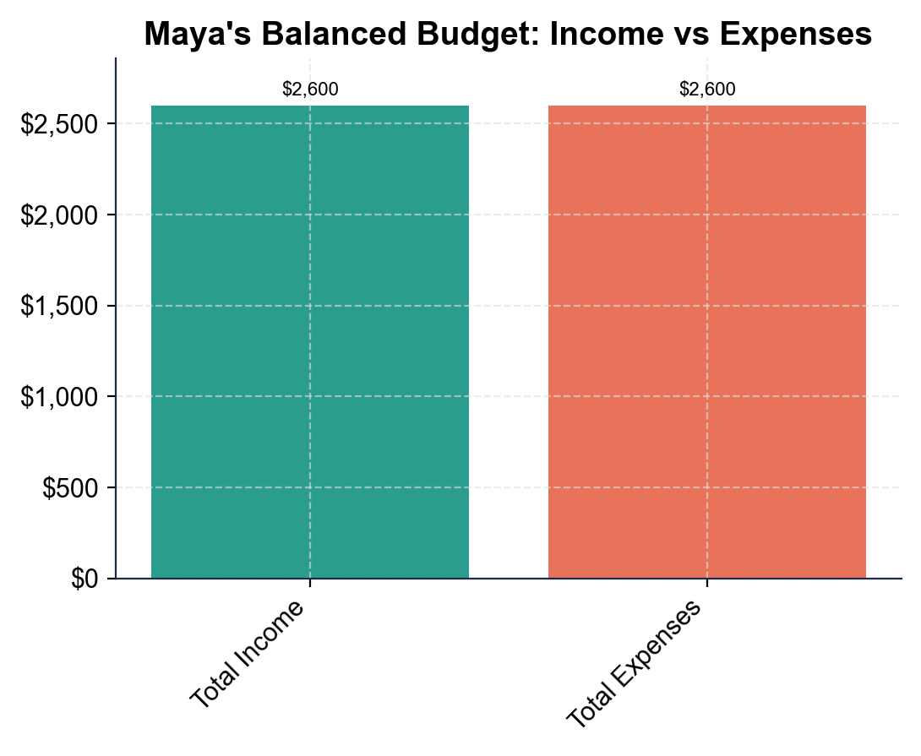
Note: Income vs Expenses in Maya's Balanced Budget
Maya's budget: income $2,600 and expenses $2,600 - two equal bars.
© More Lessons Less Planning | morelessonslessplanning.com
Notes:
Have students read the income-vs-expenses bar chart. The income bar is $2,600 and the expense bar is $2,600 - exactly equal heights. Equal bars mean income minus expenses is $0, so the budget is balanced and zero-based. This is the chart Activity Part 3 reads.
Reference labels (point to these chart features when teaching): Income: $2,600; Expenses: $2,600

Slide 12
Key Takeaways
A budget is a written plan for your money, made before the paycheck arrives
★
A zero-based budget assigns every dollar a job: income minus every expense = $0
★
List income at the top, then every expense - fixed and variable - below it
★
Savings is a job, not leftover; assign it on purpose like any other expense
★
Balanced means equal income and expense bars; leftover money still gets a job
★
© More Lessons Less Planning | morelessonslessplanning.com
Notes:
Read each takeaway and connect to the learning targets. T1 (explain zero-based) -> Activity Parts 1-2. T2 (list income/expenses) -> Part 4 setup. T3 (build to zero) -> Part 4. T4 (read the chart) -> Part 3. Tell students the activity puts them in Maya's shoes building a complete zero-based budget and proving it balances to zero.

