Slide 1
Budgeting Apps: Mint, YNAB & Your Phone
Your phone can track every dollar for you - learn what budgeting apps do, how they are different, what they cost, and how to choose one that fits your money.
© More Lessons Less Planning | morelessonslessplanning.com
Notes:
Open with the hook: almost every student already carries the most powerful budgeting tool ever made - a smartphone. A budgeting app can watch your spending, sort it into categories, warn you before a bill is due, and show you whether you are on track, all automatically. Today students learn what budgeting apps do, how they differ, how to turn a monthly fee into an annual cost, and how to pick one that fits a real budget. Note up front: Mint, a famous free app, shut down in 2024 - this lesson teaches what people use now.

Slide 2
Learning Targets
Explain how a budgeting app makes tracking spending easier than paper
★
Describe the main features that make budgeting apps different
★
Turn a monthly fee into an annual cost and read a chart comparing app costs
★
Compare budgeting tools and choose one that fits a personal situation
★
© More Lessons Less Planning | morelessonslessplanning.com
Notes:
Read the four targets aloud. Tell students the activity puts them in the role of Devon, a young worker with $2,400 a month in net pay, comparing budgeting apps, reading a bar chart of what each one costs per year, and choosing the app that best fits Devon's situation. Target 3 is the math skill - turning a monthly subscription fee into an annual cost by multiplying by 12 - and Target 4 is the decision the whole lesson builds toward.

Slide 3
Your Bank in Your Pocket
What a Budgeting App Does
Why It Beats Guessing
A BUDGETING APP tracks spending and sets a budget
It does EXPENSE TRACKING - recording where money goes
Many apps connect to your accounts to do it for you
Your phone becomes a money dashboard you check daily
You see your real spending, not what you assume
It catches problems early, before the account is empty
It keeps your budget in one place you always have
It turns a chore into a few taps a day
Key Concept: A BUDGETING APP is a phone or web tool that helps you track spending, set a budget, and reach money goals.
© More Lessons Less Planning | morelessonslessplanning.com
Notes:
Frame the big idea. A BUDGETING APP is a phone or web tool that helps you track spending, set a budget, and reach money goals. Its core job is EXPENSE TRACKING - recording where your money actually goes so you can see your spending and stick to a budget. Many apps connect to your accounts so the tracking happens for you. The payoff is that you see your real spending instead of guessing, you catch problems early instead of after the account is empty, and your whole budget lives in one place you carry everywhere.

Slide 4
Why Apps Beat Paper
Manual entry (paper or app)
MANUAL ENTRY means typing each transaction yourself; it takes effort but keeps you aware of every purchase and shares no bank login
Bank syncing (automatic)
BANK SYNCING securely connects an app to your bank or card so transactions import automatically instead of being typed in by hand
The trade-off
Syncing saves time but shares account access; manual entry costs time but keeps your data private - neither is wrong, they fit different people
Why paper falls behind
A paper budget is out of date the moment you spend; an app updates in real time, so you always know what is left to spend
Did You Know? BANK SYNCING imports your transactions automatically, while MANUAL ENTRY means you type each one in yourself.
© More Lessons Less Planning | morelessonslessplanning.com
Notes:
Teach the two ways to get spending into a budget. MANUAL ENTRY means typing each transaction into the app (or onto paper) yourself - it takes more effort but it keeps you aware of every purchase and shares no bank login. BANK SYNCING securely connects the app to your bank or card so your transactions import automatically instead of being typed by hand. The trade-off: syncing saves time but shares account access, while manual entry costs time but keeps your data private - neither is wrong, they fit different people. Paper falls behind because it is out of date the moment you spend, while an app updates in real time so you always know what is left.

Slide 5
Mint, YNAB, and Others
Mint (shut down in 2024)
Mint was a famous FREE app, but Intuit shut it down in 2024 and pointed users to Credit Karma - do not count on Mint today
Credit Karma (free)
A free tool that took in many Mint users, but it focuses on credit monitoring, not real budgeting, so it is a weaker budget app
YNAB and EveryDollar (paid)
Zero-based budget apps where every dollar gets a job; YNAB and EveryDollar Premium charge a SUBSCRIPTION FEE for full features
Goodbudget and Rocket Money
Goodbudget uses digital envelopes and has a FREE TIER; Rocket Money tracks spending and finds subscriptions, with free and paid tiers
Key Concept: Mint shut down in 2024. Today's tools include free apps (Goodbudget, Credit Karma) and paid apps (YNAB, EveryDollar, Rocket Money).
© More Lessons Less Planning | morelessonslessplanning.com
Notes:
Map the landscape and handle Mint honestly. Mint was a famous FREE budgeting app, but Intuit shut it down in 2024 and pointed users to Credit Karma - so do not count on Mint today. Credit Karma is free and absorbed many Mint users, but it focuses on credit monitoring, not real budgeting, so it is a weaker budget app. YNAB and EveryDollar are zero-based budget apps - every dollar gets a job - and charge a SUBSCRIPTION FEE for full features. Goodbudget uses digital envelopes and has a FREE TIER, while Rocket Money tracks spending and finds forgotten subscriptions, with both free and paid tiers. The point: there is a tool at every price, including $0.

Slide 6
Automatic Categorizing
How Apps Sort Your Spending
Why It Matters
AUTOMATIC CATEGORIZING sorts each purchase for you
A coffee shop charge lands in 'Food' on its own
You see spending by category without tagging it
It turns a messy bank feed into a clear picture
You spot the category that is eating your budget
Fix the categories the app guesses wrong
Less effort means you actually keep using the app
Manual apps make you categorize each one yourself
Key Concept: AUTOMATIC CATEGORIZING sorts each transaction into a spending category, like groceries or gas, without you tagging it yourself.
© More Lessons Less Planning | morelessonslessplanning.com
Notes:
Teach how apps make sense of your spending. AUTOMATIC CATEGORIZING is when an app sorts each transaction into a spending category - like groceries, gas, or rent - without you tagging it yourself. A coffee shop charge lands in 'Food' on its own, so you can see spending by category without doing the work. It turns a messy bank feed into a clear picture and helps you spot the one category that is quietly eating your budget. You should still check and fix the categories the app guesses wrong. The less effort an app takes, the more likely you are to keep using it - manual apps require you to categorize each transaction yourself.

Slide 7
Alerts and Goals
Spending alerts
A SPENDING ALERT notifies you when a bill is due, a balance is low, or an unusual charge appears, so you can react in time
✔
Goal tracking
Apps let you set goals - like a $1,000 emergency fund - and show a progress bar so saving feels visible and motivating
✔
Bill and subscription finder
Some apps scan your accounts for recurring charges and surface forgotten subscriptions you could cancel to save money
✔
Why features change the price
A SUBSCRIPTION FEE is the recurring monthly or yearly price you pay to use a paid app; more automatic features usually mean a higher fee
✔
Tip: A SPENDING ALERT warns you before a bill is due or when a balance runs low - it is like a smoke detector for your money.
© More Lessons Less Planning | morelessonslessplanning.com
Notes:
Teach the features that make an app worth using. A SPENDING ALERT notifies you when a bill is due, a balance is low, or an unusual charge appears, so you can react in time instead of finding out too late. Goal tracking lets you set a goal - like a $1,000 emergency fund - and shows a progress bar so saving feels visible and motivating. Some apps include a bill or subscription finder that scans your accounts for recurring charges and surfaces forgotten subscriptions you could cancel. A SUBSCRIPTION FEE is the recurring monthly or yearly price you pay to use a paid app, which you can annualize (monthly fee times 12) to compare tools; the more automatic features an app has, the higher the fee usually is.

Slide 8
Privacy and Security
The Cost of Convenience
How to Stay Safe
Bank syncing shares account access with the app
DATA PRIVACY means protecting your financial info
A linked account is convenient but a real trade-off
MANUAL ENTRY shares no bank login at all
Use a strong, unique password and two-factor login
Pick well-known apps with clear privacy policies
Know what data the app collects and sells
If privacy worries you, choose a manual app
Key Concept: DATA PRIVACY is protecting your financial information - linking a bank account is convenient but shares login access, a real trade-off.
© More Lessons Less Planning | morelessonslessplanning.com
Notes:
Teach the privacy trade-off honestly. When you use BANK SYNCING, you share account access with the app, so DATA PRIVACY - protecting your financial information - becomes a real concern. A linked account is convenient but it is a genuine trade-off: you are trusting a company with access to your transactions. MANUAL ENTRY shares no bank login at all, which is why some people prefer it. To stay safe with any app, use a strong, unique password and two-factor login, pick well-known apps with clear privacy policies, and know what data the app collects and sells. If privacy worries you, choosing a manual app is a completely valid answer.

Slide 9
Compare the Cost: Monthly Fee to Annual Cost
The formula
ANNUAL COST = monthly SUBSCRIPTION FEE x 12 - multiply the monthly price by 12 to compare apps fairly
✔
Free apps
Goodbudget's free tier and Credit Karma cost $0 a month, so $0 a year - budgeting is possible at no cost
✔
Rocket Money and EveryDollar
Rocket Money Premium is about $7/mo = $84/yr; EveryDollar Premium is about $8/mo = $96/yr
✔
YNAB
YNAB is about $15/mo, which is $180/yr - the most expensive of the four, because it does the most
✔
Key Concept: ANNUAL COST = monthly SUBSCRIPTION FEE x 12. Free apps cost $0/yr; YNAB at $15/mo costs $180/yr.
© More Lessons Less Planning | morelessonslessplanning.com
Notes:
Set up the cost bar chart on the next slide. To compare paid apps fairly, turn each one's monthly SUBSCRIPTION FEE into an ANNUAL COST by multiplying by 12. Free apps (Goodbudget free tier, Credit Karma) cost $0 a year. Rocket Money Premium at about $7 a month is $84 a year. EveryDollar Premium at about $8 a month is $96 a year. YNAB at about $15 a month is $180 a year. The chart shows that free tools cost nothing while premium tools run $84 to $180 a year - the central trade-off when choosing an app. All figures are derived in gen_money.py and pinned in money_provenance.json (prices are approximate - tell students to check current pricing).

Slide 10
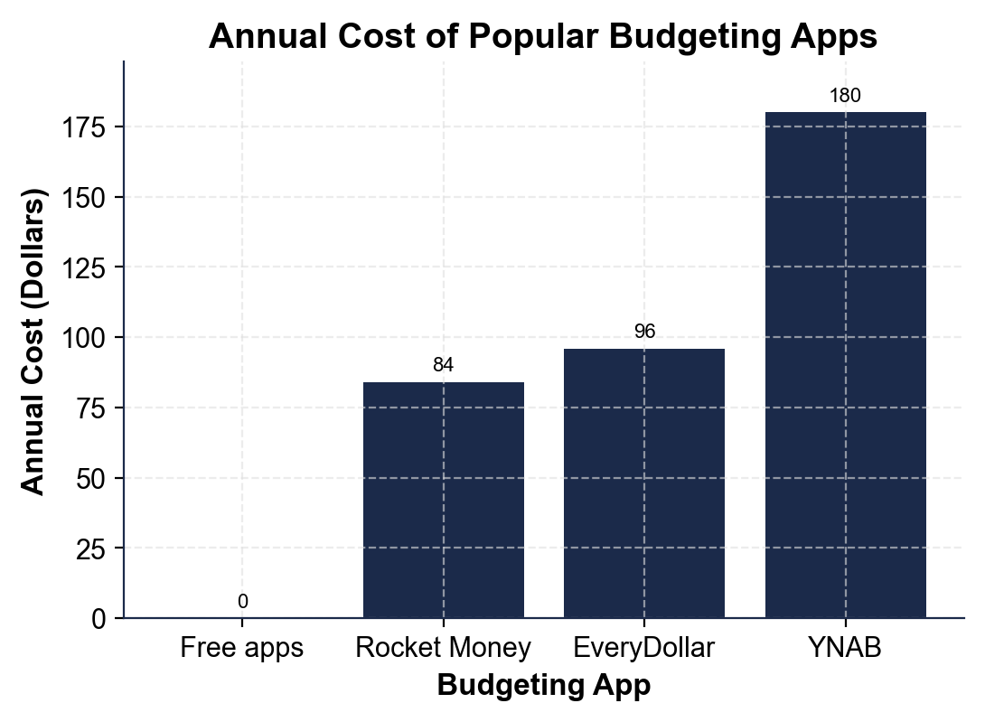
Note: Annual Cost of Popular Budgeting Apps
Annual cost (monthly fee x 12) of four current budgeting tools.
© More Lessons Less Planning | morelessonslessplanning.com
Notes:
Have students read the cost bar chart. The bars show the annual cost (monthly fee x 12) of four current budgeting tools: Free apps (Goodbudget free / Credit Karma) = $0/yr, Rocket Money Premium = $84/yr, EveryDollar Premium = $96/yr, and YNAB = $180/yr. The bars get taller as the monthly fee grows, because annual cost = monthly fee x 12. Mint is not on the chart because it shut down in 2024. This is the chart Activity Part 3 reads.
Reference labels (point to these chart features when teaching): Free apps = $0/yr; YNAB = $180/yr

Slide 11
Choose an App for Your Situation
Step 1: Name your need
Decide what matters most: automatic tracking, a free price, strong DATA PRIVACY, or finding forgotten subscriptions
✔
Step 2: Check your budget
Turn each app's SUBSCRIPTION FEE into an ANNUAL COST (x 12) and ask if the features are worth that yearly price
✔
Step 3: Match the app to the person
Want it free and private - choose a manual app like Goodbudget free; want full automation - a paid app like YNAB may be worth it
✔
Step 4: Try before you commit
Most paid apps offer a free trial - test the app for a few weeks before paying the annual cost
✔
Key Concept: The best app is the one that fits YOUR situation - your need, your budget, and your comfort with linking a bank account.
© More Lessons Less Planning | morelessonslessplanning.com
Notes:
Teach students to choose. Step 1: name your need - automatic tracking, a free price, strong DATA PRIVACY, or finding forgotten subscriptions. Step 2: check your budget by turning each app's SUBSCRIPTION FEE into an ANNUAL COST (monthly fee x 12) and asking whether the features are worth that yearly price. Step 3: match the app to the person - if you want it free and private, a manual app like Goodbudget's free tier fits; if you want full automation, a paid app like YNAB may be worth $180 a year. Step 4: try before you commit - most paid apps offer a free trial, so test for a few weeks before paying. The best app is the one that fits YOUR situation. This is exactly what students do in Activity Part 5.

Slide 12
Key Takeaways
A BUDGETING APP makes EXPENSE TRACKING easier than paper, often automatically
★
BANK SYNCING imports transactions for you; MANUAL ENTRY keeps data private
★
Mint shut down in 2024 - today's tools include YNAB, Rocket Money, Goodbudget
★
ANNUAL COST = monthly SUBSCRIPTION FEE x 12 (free apps $0; YNAB $180/yr)
★
The best app fits YOUR need, budget, and comfort with DATA PRIVACY
★
© More Lessons Less Planning | morelessonslessplanning.com
Notes:
Read each takeaway and connect to the learning targets. T1 (apps make tracking easier) -> Activity Parts 1-2. T2 (features differ) -> Parts 2-3. T3 (annual cost + read the chart) -> Parts 3-4. T4 (compare and choose) -> Part 5. Remind students Mint is history - the lesson taught the current tools - and that the real skill is comparing features and annual cost to choose an app that fits a real budget and situation.

