Slide 1
Buddhism and the Four Noble Truths
How a reform within the Vedic tradition became a path out of suffering - the life of Siddhartha Gautama, the Four Noble Truths, and the Eightfold Path.
© More Lessons Less Planning | morelessonslessplanning.com
Notes:
Opening slide. This lesson studies Buddhism academically - describing what the tradition teaches, never judging it as true or false. Students learn that Buddhism began in ancient India as a reform within the older Vedic (Brahmanic) tradition, that it is traditionally founded by Siddhartha Gautama (the Buddha), and that its central teaching is the Four Noble Truths, which diagnose suffering and offer the Eightfold Path as the way out. Set a respectful, neutral tone from the first minute: we describe what Buddhists believe and practice; we do not rank or judge.

Slide 2
Learning Targets
Explain Buddhism's origins as a reform within the Vedic tradition.
★
Describe the Middle Way and the Four Noble Truths.
★
Define dukkha, tanha, nirvana, and the Eightfold Path.
★
Compare Buddhism with Hinduism and analyze a Dhammapada passage.
★
© More Lessons Less Planning | morelessonslessplanning.com
Notes:
Read the four learning targets. Today pairs a big idea - that Buddhism arose as a reform within an older tradition - with a concrete teaching students can define and connect: the Four Noble Truths and the Eightfold Path. Keep the neutral, academic stance in mind throughout: our goal is to understand and describe what the tradition teaches, not to decide whether it is right.

Slide 3
The Origins of Buddhism: A Reform Within the Vedic Tradition
Rooted in ancient India
What it kept and what it changed
Buddhism began in northern India in roughly the 500s BCE.
It grew out of and reformed the older Vedic (Brahmanic) tradition.
It kept shared ideas like samsara and karma from that tradition.
samsara - the cycle of birth, death, and rebirth - shared with Hinduism.
karma is the moral law of cause and effect it also shares.
But it rejected the ritual authority of the Brahmin priests and the Vedas.
Key Concept: Buddhism REFORMED the VEDIC tradition - it kept SAMSARA and KARMA but rejected the Brahmin priests and the Vedas.
© More Lessons Less Planning | morelessonslessplanning.com
Notes:
Let's begin with origins. Buddhism began in northern India around the 500s BCE, and it did not appear out of nowhere: it grew out of, and reformed, the older VEDIC (or Brahmanic) tradition that later developed into Hinduism. Because of that shared root, Buddhism kept several ideas from the earlier tradition. SAMSARA is the cycle of birth, death, and rebirth that Buddhism shares with the Hindu tradition. KARMA is the moral law of cause and effect - that a person's actions shape their future rebirths - which Buddhism also shares. But Buddhism also diverged: it rejected the ritual authority of the Brahmin priests and the supreme authority of the Vedas, teaching instead that anyone, of any caste, could follow the path. Describe this neutrally: Buddhism reformed the tradition it grew from - it did not simply reject it.

Slide 4
Siddhartha Gautama: The Traditional Founder
Who he was
Siddhartha Gautama is the man traditionally identified as the founder of Buddhism, born a prince in northern India.
✔
Traditional dates
Tradition places his life around 563-483 BCE, though the exact dates are debated by historians.
✔
'The Buddha'
After his enlightenment he became known as the Buddha, which means 'the awakened one.'
✔
Key Concept: SIDDHARTHA GAUTAMA is traditionally the founder of Buddhism, later called the Buddha, 'the awakened one.'
© More Lessons Less Planning | morelessonslessplanning.com
Notes:
The tradition identifies one founder: SIDDHARTHA GAUTAMA. According to tradition, he was born a prince in northern India, and his life is usually dated to around 563-483 BCE - though historians note the exact dates are debated. We say 'traditionally' because the detailed life story comes from later Buddhist accounts written down generations after his death. After a long search, the tradition holds, he reached enlightenment and became known as the BUDDHA, a title meaning 'the awakened one.' Note that 'the Buddha' is a title, not a personal name. Describe the life story as what the tradition teaches, and mark the traditional details as traditional rather than as settled fact.

Slide 5
The Great Search and the Middle Way
The traditional story
A balanced path
Tradition says the sheltered prince first saw suffering, sickness, and death.
He left his palace to search for the cause of suffering and how to end it.
He first tried extreme self-denial (severe fasting) but found it did not work.
The Middle Way: the balanced path between self-indulgence and self-denial.
Neither a life of luxury nor harsh self-punishment leads to peace.
The tradition holds he reached enlightenment following this balanced path.
Key Concept: The MIDDLE WAY is the balanced path the Buddha taught between extreme self-indulgence and extreme self-denial.
© More Lessons Less Planning | morelessonslessplanning.com
Notes:
How did Siddhartha arrive at his teaching? The traditional story says the sheltered young prince, seeing suffering - old age, sickness, and death - for the first time, left his comfortable palace to search for the cause of suffering and a way to end it. Note this is the traditional account. He first tried extreme self-denial, fasting so severely that he nearly starved, but found that punishing the body did not bring the answer. So he taught what is called the MIDDLE WAY: the balanced path between extreme self-indulgence, a life of luxury and craving, and extreme self-denial, a life of harsh self-punishment. Neither extreme, the tradition teaches, leads to peace. Following this balanced path, tradition holds, he reached enlightenment. The Middle Way becomes the practical spirit of the whole teaching.

Slide 6
The Four Noble Truths: An Overview
1. There is suffering
Life involves suffering, or dukkha - the First Noble Truth.
✔
2. Suffering has a cause
Suffering is caused by craving, or tanha - the Second Noble Truth.
✔
3. Suffering can end
Suffering can end when craving is let go - this end is called nirvana (the Third Noble Truth).
✔
4. There is a path
The Eightfold Path is the way to end suffering - the Fourth Noble Truth.
✔
Key Concept: The FOUR NOBLE TRUTHS: suffering (dukkha), its cause craving (tanha), its end (nirvana), and the Eightfold Path.
© More Lessons Less Planning | morelessonslessplanning.com
Notes:
At the center of Buddhist teaching are the FOUR NOBLE TRUTHS. Think of them as a single connected argument, like a doctor's diagnosis and cure. The First Noble Truth is that life involves suffering, or dukkha. The Second is that this suffering has a cause: craving, or tanha. The Third is that suffering can end - when craving is let go - and this end is called nirvana. The Fourth is that there is a path to that end: the Eightfold Path. So the Four Noble Truths move from problem to cause to solution to method. Buddhists teach these Truths as the core of the tradition. We will look at each Truth in turn on the next slides. Describe them academically, as what the tradition teaches.

Slide 7
The First Noble Truth: Dukkha
What dukkha is
Why it matters
dukkha means suffering, dissatisfaction, or unease.
The First Noble Truth teaches that dukkha is a basic part of ordinary life.
It includes obvious pain but also everyday restlessness and change.
Naming the problem clearly is the first step of the teaching.
Because things change, even good moments do not last.
The tradition begins by facing suffering honestly, not denying it.
Key Concept: DUKKHA is suffering, dissatisfaction, or unease; the First Noble Truth teaches that dukkha is a basic part of ordinary life.
© More Lessons Less Planning | morelessonslessplanning.com
Notes:
The First Noble Truth names the problem: DUKKHA. Dukkha is often translated as suffering, but it means more than sharp pain - it also covers dissatisfaction, restlessness, and unease. The First Noble Truth teaches that dukkha is a basic part of ordinary life. This includes obvious suffering, like sickness, loss, and death, but also the quieter dissatisfaction that comes because everything changes and nothing stays the same - even happy moments end. The tradition begins here, by facing suffering honestly rather than pretending it is not there. Describe this neutrally, as what the tradition teaches: the first step is to name the problem clearly, so the rest of the teaching can address it.

Slide 8
The Second Noble Truth: Tanha
What tanha is
tanha means craving, desire, or 'thirst.'
✔
The Second Noble Truth
It teaches that tanha - craving - is the main cause of suffering.
✔
How it works
Constantly wanting more, or clinging to things that change, keeps a person unsatisfied.
✔
Key Concept: TANHA is craving, desire, or 'thirst'; the Second Noble Truth teaches that tanha is the main cause of suffering.
© More Lessons Less Planning | morelessonslessplanning.com
Notes:
If the First Noble Truth names the problem, the Second names its cause: TANHA. Tanha means craving, desire, or 'thirst.' The Second Noble Truth teaches that tanha - craving - is the main cause of suffering. The idea is that constantly wanting more, or clinging tightly to things that inevitably change, keeps a person restless and unsatisfied. When we crave and grasp, we set ourselves up for disappointment, because nothing we cling to lasts. Notice how this connects to the First Truth: the dissatisfaction of dukkha comes largely from this craving. Describe it academically, as what the tradition teaches. This diagnosis - that craving causes suffering - is what makes the next two Truths possible: if craving is the cause, then letting go of craving can be the cure.

Slide 9
The Third Noble Truth: Nirvana
What nirvana is
The Third Noble Truth
nirvana means the 'blowing out' of craving, like a flame going out.
It is the end of suffering and of the cycle of rebirth.
It is described as the ultimate goal of the path.
Suffering can end when craving is let go.
That end - freedom from craving and suffering - is nirvana.
The tradition describes it as deep peace and release.
Key Concept: NIRVANA is the 'blowing out' of craving and the end of suffering and rebirth - the ultimate goal of the path (the Third Noble Truth).
© More Lessons Less Planning | morelessonslessplanning.com
Notes:
The Third Noble Truth brings the hopeful turn: suffering can end. That end has a name: NIRVANA. The word nirvana means a 'blowing out,' like a flame going out - here, the blowing out of craving. Because the tradition teaches that craving causes suffering, letting go of craving brings the end of suffering, and also release from the cycle of rebirth, samsara. Nirvana is described as the ultimate goal of the path - a state of deep peace and freedom. Notice the logic connecting the Truths: dukkha is the problem, tanha (craving) is its cause, and nirvana is what happens when that cause is removed. Describe nirvana as the tradition's own stated ultimate goal, without judging whether it is attainable - our task is to describe the teaching accurately.

Slide 10
The Fourth Noble Truth: The Eightfold Path
What it is
The Eightfold Path is a set of eight guides for right living that Buddhists teach leads to the end of suffering.
✔
What it includes
It groups into wisdom, ethical conduct, and mental discipline - for example right view, right speech, right action, and right mindfulness.
✔
How it works
Following the path is itself the Middle Way in practice - a balanced way of thinking, acting, and focusing the mind.
✔
Key Concept: The EIGHTFOLD PATH is the set of eight guides for right living that Buddhists teach leads to the end of suffering.
© More Lessons Less Planning | morelessonslessplanning.com
Notes:
The Fourth Noble Truth gives the method: the EIGHTFOLD PATH. This is a set of eight guides for right living that Buddhists teach leads to the end of suffering and toward nirvana. The eight are traditionally grouped into three areas: wisdom (such as right view and right intention), ethical conduct (such as right speech, right action, and right livelihood), and mental discipline (such as right effort, right mindfulness, and right concentration). Notice that following the Eightfold Path is itself the Middle Way in practice - a balanced way of thinking, behaving, and training the mind, avoiding both extremes. So the Four Noble Truths come full circle: the path is how a person moves from suffering, caused by craving, toward its end in nirvana. Describe the path academically, as the tradition's practical guidance.

Slide 11
Buddhism and the Hindu Tradition: Shared and Divergent
What they share
How they diverge
Both teach samsara, the cycle of birth, death, and rebirth.
Both teach karma, the moral law that actions shape future rebirths.
Both seek release from that cycle.
Buddhism rejected the ritual authority of the Brahmin priests and the Vedas.
It taught that anyone, of any caste, could follow the path.
Its goal, nirvana, and the Hindu goal, moksha, are comparable but not identical.
Key Concept: Buddhism SHARES samsara and karma with Hinduism but rejected the Brahmins and the Vedas (nirvana differs from moksha).
© More Lessons Less Planning | morelessonslessplanning.com
Notes:
Because Buddhism grew out of the same Vedic root as Hinduism, the two traditions share important ideas - but they also diverge. What they SHARE: both teach SAMSARA, the cycle of birth, death, and rebirth, and both teach KARMA, the moral law that a person's actions shape their future rebirths. Both also aim at release from the cycle. How they DIVERGE: Buddhism rejected the ritual authority of the Brahmin priests and the supreme authority of the Vedas, and taught that anyone, of any caste, could follow the path to liberation. And their ultimate goals differ in emphasis: the Buddhist goal, nirvana (the blowing out of craving), is comparable to the Hindu goal, moksha (release into unity with Brahman), but the two are not identical - keep them distinct. Describe both traditions fairly, noting what they share and where they part.

Slide 12
A Closer Look: The Dhammapada
What it is
The Dhammapada is a canonical Buddhist collection of verses attributed to the Buddha.
✔
How it came to be
It was compiled over time - it is NOT a single sermon and was NOT written by Siddhartha himself.
✔
What it teaches
Its short verses teach about the mind, craving, suffering, and the path to peace.
✔
Key Concept: The DHAMMAPADA is a collection of verses attributed to the Buddha, compiled over time - not a sermon Siddhartha wrote.
© More Lessons Less Planning | morelessonslessplanning.com
Notes:
The text students will analyze in the Activity is the DHAMMAPADA. It is important to describe it accurately: the Dhammapada is a canonical Buddhist collection of verses attributed to the Buddha. The word means roughly 'the path (or verses) of the teaching.' Be careful here - the Dhammapada is NOT a single sermon, and it was NOT written down by Siddhartha Gautama himself. Rather, it is an anthology of short sayings, gathered and compiled over time within the Buddhist tradition. Its verses are famous for teaching, in vivid images, about the power of the mind, the danger of craving, the nature of suffering, and the path to peace. In the Activity, you will read a passage from F. Max Muller's 1881 English translation and analyze how the tradition teaches these ideas.

Slide 13
Buddhist Sacred Art: The Great Buddha of Kamakura
What it is
The Great Buddha of Kamakura (the Daibutsu) is a giant bronze statue of the Buddha in Japan.
✔
When and where
It was cast in the 1200s CE at the Kotoku-in temple in Kamakura, Japan - far from Buddhism's birthplace in India.
✔
Why it matters
It shows how Buddhism spread across Asia and expressed its teaching in monumental art.
✔
Key Concept: The Great Buddha (DAIBUTSU) of Kamakura is a giant bronze statue cast in Japan in the 1200s CE.
© More Lessons Less Planning | morelessonslessplanning.com
Notes:
Buddhist belief is not only found in texts; it is expressed in art and practice across a huge part of the world. A famous example is the Great Buddha of Kamakura, known in Japanese as the DAIBUTSU, or 'Great Buddha.' It is a giant bronze statue of the Buddha, cast in the 1200s CE and standing in the open air at the Kotoku-in temple in Kamakura, Japan. Notice the geography: this is Japan, thousands of miles and many centuries from Buddhism's origins in northern India. That distance is exactly the point - it shows how far Buddhism spread across Asia, and how the tradition expressed its teaching in monumental art. On the next slide you will see a photograph of it. Describe it respectfully, as a sacred image of a living tradition, not as a curiosity.

Slide 14
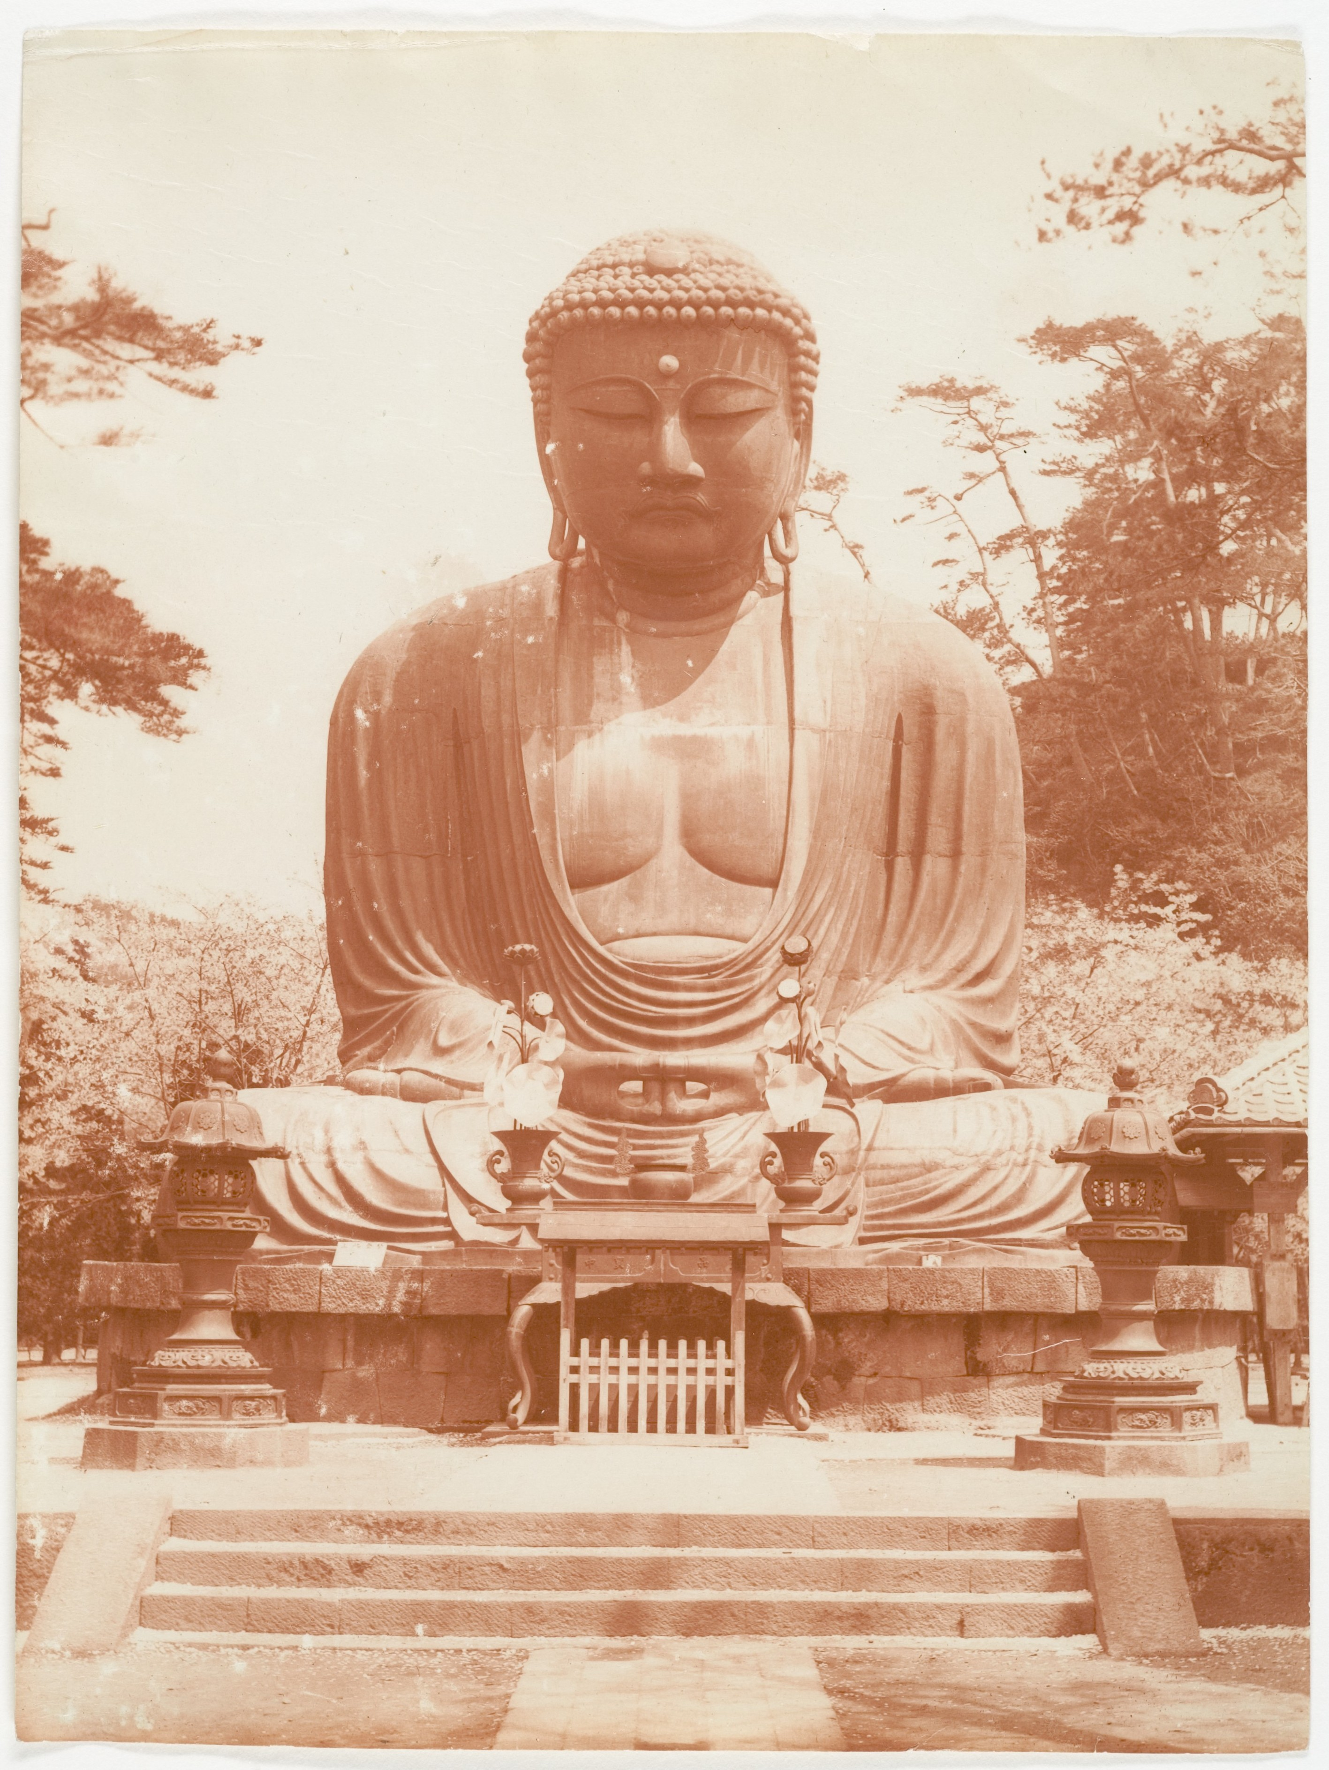
The Great Buddha (Daibutsu) at Kamakura
Great Buddha (Daibutsu), Kamakura - statue c. 1200s CE (taken c. 1900).
© More Lessons Less Planning | morelessonslessplanning.com
Notes:
Public-domain (CC0) photograph of the Great Buddha (Daibutsu) at the Kotoku-in temple, Kamakura, Japan (Wikimedia Commons; a c.1900 photograph by Adolph de Meyer donated by the Metropolitan Museum of Art, CC0). Use it purely as a reference image to make the previous slide's point concrete: Buddhism expressed in a monumental bronze statue far from its Indian birthplace. Describe it respectfully as a sacred image of a living tradition. Students are not asked to decode the image as evidence.

Slide 15
Key Takeaways
Buddhism began as a reform within the older Vedic tradition.
★
The Middle Way is the balanced path between self-indulgence and self-denial.
★
Four Noble Truths: suffering, its cause, its end, and the path.
★
Buddhism shares samsara and karma with Hinduism but reformed it.
★
© More Lessons Less Planning | morelessonslessplanning.com
Notes:
Let's recap what you now know about Buddhism, described academically. First, Buddhism began in ancient India as a reform within the older Vedic tradition, and it is traditionally founded by Siddhartha Gautama, who became known as the Buddha, 'the awakened one.' Second, he taught the Middle Way, the balanced path between extreme self-indulgence and extreme self-denial. Third, the heart of the teaching is the Four Noble Truths: life involves suffering (dukkha), suffering is caused by craving (tanha), suffering can end (nirvana), and the Eightfold Path is the way to that end. Fourth, Buddhism shares samsara and karma with the Hindu tradition it grew out of, but it diverged by rejecting the ritual authority of the Brahmin priests and the Vedas, and by teaching that anyone could follow the path. You also analyzed a passage from the Dhammapada. Throughout, we described what the tradition teaches with respect, never judging it as true or false.

