Slide 1
Bound Labor: How Servitude Became Slavery
US History - Unit 2: Colonial America
© More Lessons Less Planning | morelessonslessplanning.com
Notes:
Open by asking what a colony needs before it needs anything else: workers. Then say this lesson traces how the colony filled that need, and how the deal offered to workers changed completely between 1619 and 1705.

Slide 2
Learning Targets
Explain why English colonies first filled their labor needs from Europe.
★
Trace how new laws made slavery last for life and pass to children.
★
Explain how historians link Bacon's Rebellion to the laws that followed.
★
Read a 1705 Virginia law and identify what it made legal.
★
Describe how enslaved people resisted a system people chose to build.
★
© More Lessons Less Planning | morelessonslessplanning.com
Notes:
Read target four aloud. The Primary Source Spotlight and the final Part of the Activity both grade it directly.

Slide 3
Land Without Workers
Tobacco needed constant hand labor to plant, weed, and cure it.
England could not simply order colonists to cross an ocean and work for free.
Planters needed workers who would labor for years, not months.
Most poor English families could not pay their own way across the Atlantic.
Investors needed a system to move workers overseas and profit.
Key Concept: Tobacco was profitable only if someone else did the exhausting labor of growing it.
© More Lessons Less Planning | morelessonslessplanning.com
Notes:
Set the problem before the solution: land is not the scarce resource in early Virginia, labor is.

Slide 4
Paying for the Voyage
Indentured Servitude
A labor system in which a person works a fixed number of years to repay the cost of passage.
Indenture
The signed contract that bound a worker to a master for an agreed number of years.
Tip: 'Indenture' comes from the jagged cut once used to match the two halves of a contract.
© More Lessons Less Planning | morelessonslessplanning.com
Notes:
Both terms sit on the Activity Reference Guide. Make sure students can tell the SYSTEM (indentured servitude) apart from the DOCUMENT (an indenture).

Slide 5
The Reward Was Land
The headright system
Who actually profited
A headright: a grant of fifty colonial acres for a worker's ocean passage.
Paying for one worker earned fifty acres; for ten, five hundred.
The land went to whoever paid, not the worker who crossed.
Planters who paid many passages built large holdings.
A worker who finished the term still needed land of their own.
The system rewarded whoever had capital, not whoever did the labor.
Key Concept: The headright system paid land to whoever financed the voyage, not to the worker who made it.
© More Lessons Less Planning | morelessonslessplanning.com
Notes:
Push students past 'servants got land' - most did not. The fifty acres went to the person who paid the passage fee.

Slide 6
Life Under a Labor Contract
Freedom Dues
The corn, money, and goods a master owed a servant at the end of the contract.
✔
Room, food, and clothing
A master had to provide these for the length of the term, though enforcement varied widely.
✔
Access to court
A servant could sue a master in county court for abuse or for withheld freedom dues.
✔
A fixed end date
Most terms ran four to seven years, after which the servant was legally free.
✔
Remember: A servant's contract had an end date. That single fact matters on the slides ahead.
© More Lessons Less Planning | morelessonslessplanning.com
Notes:
This slide is the baseline students will compare against later, when the same four categories look completely different under the 1705 slave code.

Slide 7
Africans in Virginia Before the Codes
In 1619 an English ship sold about twenty captive Africans in Virginia.
Virginia law had not yet tied lifelong bondage to a person's race.
Some gained freedom, later owning land and even servants of their own.
A master could free an enslaved person through manumission.
Manumission: the formal legal act where an owner released a person from slavery.
Individual cases could turn out very differently from one another.
Did You Know: Anthony Johnson, a free Black Virginian, owned land and held servants of his own by the 1650s.
© More Lessons Less Planning | morelessonslessplanning.com
Notes:
This slide is the pivot point - status is not yet fixed by race in law. The next slide shows exactly how that changes.

Slide 8
The Law Turns a Corner: 1662 and 1667
1662: Status follows the mother
1667: Baptism no longer freed you
A child's status now followed the mother, not the father.
Hereditary meant passed from parent to child, not earned, chosen, or agreed to.
A child born to an enslaved mother was enslaved too.
A baptized Christian could still be held in bondage.
An act said baptism did not change enslaved status.
The law closed a path some had used toward freedom.
Note: Two laws, five years apart, each closed a path out of bondage that had existed before.
© More Lessons Less Planning | morelessonslessplanning.com
Notes:
Slow down here. These two laws are the legal machinery that makes slavery hereditary and permanent - everything after 1667 builds on them.

Slide 9
1676: A Rising of the Landless
Bacon's Rebellion: in 1676 colonists and servants attacked the government.
Nathaniel Bacon, a wealthy planter, led the rebels against Governor Berkeley.
The rebels burned Jamestown and briefly forced the governor to flee.
Enslaved and free Black Virginians fought alongside poor white colonists.
The rebellion collapsed after Bacon died of dysentery later that same year.
Warning: The rebellion's causes were tangled - frontier conflict with Native nations, land hunger, and anger at the governor all played a part.
© More Lessons Less Planning | morelessonslessplanning.com
Notes:
Do not let students flatten this into 'poor people vs. rich people.' Name the frontier war with Native nations as a real cause too, not just backdrop.

Slide 10
After the Rising: A New Labor Bargain
Many historians argue that Virginia's planters answered 1676 by widening the legal gap between poor white colonists and enslaved Africans.
— A widely held historians' interpretation, not a settled fact
Poor white colonists gained new legal privileges over enslaved people; the two groups that had once fought side by side were pulled apart by law.
Key Concept: This is an argument historians make about cause - not a fact this lesson proves outright.
© More Lessons Less Planning | morelessonslessplanning.com
Notes:
Model the difference between a historical argument and a proven fact. Students should be able to repeat the claim while also naming it as an interpretation.

Slide 11
Written Into Law: 1705
Slave Code
A body of colonial laws that fixed the status of enslaved people and controlled their lives.
Chattel
Property that can be bought, sold, and passed down to heirs, like livestock or tools.
Note: The 1705 act pulled decades of earlier rules into one consolidated slave code.
© More Lessons Less Planning | morelessonslessplanning.com
Notes:
This is the legal capstone of the lesson. Everything from 1662, 1667, and the years after 1676 gets gathered here into a single statute.

Slide 12
Two Systems, Side by Side
Feature | Indentured Servitude | Slavery Under the 1705 Code
Length of service | A fixed term, usually four to seven years | For life
Passed to children | No - status ended with the servant | Yes - passed from parent to child at birth
Access to court | Could sue for abuse or unpaid freedom dues | Very limited under the 1705 code
Legal status | A person under contract | Treated as property that could be bought, sold, and inherited
Remember: One system had an end date built in. After 1705, the other did not.
© More Lessons Less Planning | morelessonslessplanning.com
Notes:
Have students read this table against slide six's checklist - same four categories, completely different answers.

Slide 13
How to Read a Law That Denies People
Name who wrote it
This is the language of enslavers and lawmakers, not of the people it describes.
✔
Watch for the people erased
A law that treats people as property still describes real people with real lives.
✔
Note the year and the place
A 1705 Virginia statute reflects one colony's choices at one moment, not a universal rule.
✔
Cross-check with other evidence
Court records, letters, and the archaeological record can confirm or complicate what a law claims.
✔
Tip: Ask who benefited from this law being written the way it was.
© More Lessons Less Planning | morelessonslessplanning.com
Notes:
This is a source-analysis skill slide - it prepares students for the Primary Source Spotlight in the Activity, which excerpts the 1705 statute itself.

Slide 14
Refusing the System
Everyday resistance
Open resistance
What the word covers
Slowing down work on purpose.
Breaking tools or feigning illness.
Preserving language and family ties.
Running away, alone or in groups.
Sabotaging crops or equipment.
Planning uprisings, at real risk.
Resistance: many ways enslaved people opposed bondage, daily and in the open.
No single act ended the system.
They never simply accepted it.
Did You Know: Colonial slave codes existed largely because lawmakers feared organized resistance.
© More Lessons Less Planning | morelessonslessplanning.com
Notes:
Close this slide by returning to the essential-question thread: the system was built and chosen, and it was resisted from the start.

Slide 15
The Paper That Bound a Servant
Most contracts were pre-printed forms with blanks for names and dates.
A merchant filled in the servant's name, county, and age by hand.
The form named the term of years, the destination, and the ship.
Both sides signed, or made their mark, at the foot of the page.
A surviving 1684 contract preserves what this paperwork looked like.
Note: The next slide is a real servant contract from 1684.
© More Lessons Less Planning | morelessonslessplanning.com
Notes:
Give students thirty seconds on the next slide before explaining anything. Ask what they notice is printed versus handwritten.

Slide 16
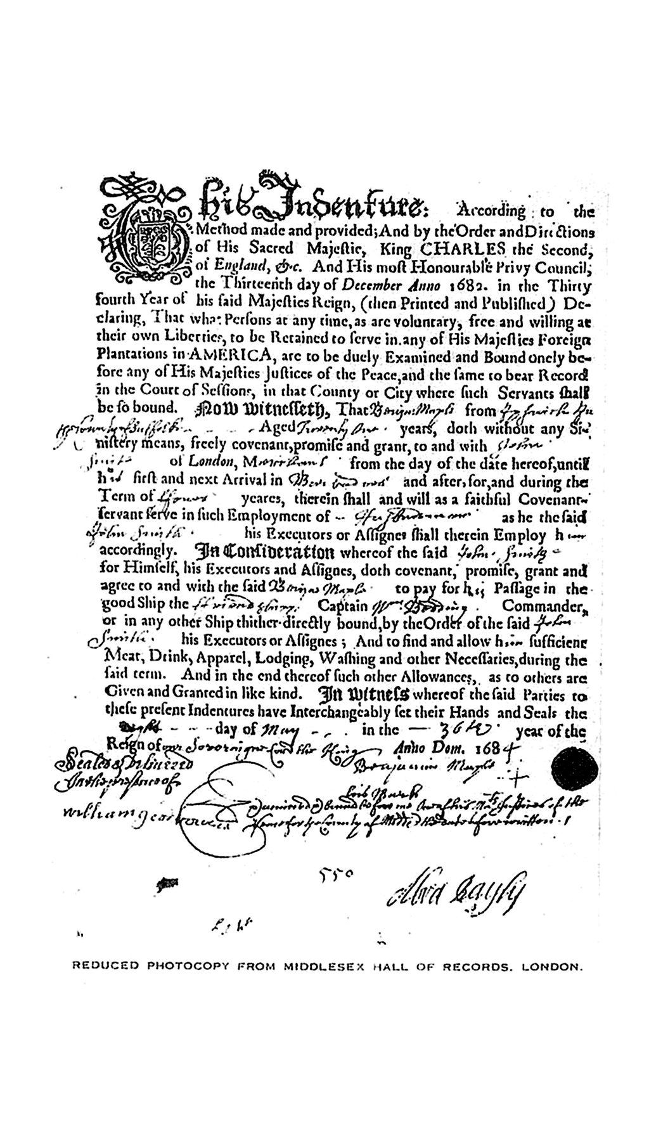
A Contract from 1684
A 1684 servant contract: the terms were printed, the names written in.
© More Lessons Less Planning | morelessonslessplanning.com
Notes:
Give the class silent time with the document first. Ask what looks pre-printed and what looks hand-filled before naming any of it.
Reference labels (point to these chart features when teaching): Pre-printed form text; Handwritten details

Slide 17
Key Takeaways
In 1619, Virginia law had not yet fixed a person's status by race.
★
A labor contract gave planters workers and paid land to financiers.
★
1662 and 1667 made bondage hereditary and ended the baptism escape.
★
Historians argue planters widened the legal gap after 1676.
★
The 1705 slave code classified enslaved people as legal property.
★
Enslaved people resisted this system from its earliest years.
★
© More Lessons Less Planning | morelessonslessplanning.com
Notes:
Close by returning to the essential question: this system was built, chosen, and defended by people in law - and it was resisted by people from the start.

