Slide 1
Bonds: Lending to Governments & Companies
A bond is a loan to a government or company: you are the LENDER, earn fixed interest each year, and are repaid at maturity.
© More Lessons Less Planning | morelessonslessplanning.com
Notes:
Open with the big idea and the contrast with the last toolkit. Where a STOCK (TK53) makes you an OWNER of a company, a BOND makes you a LENDER to one. A bond is a loan you make to a government or a company: you hand over your money, and in return the borrower must pay you fixed interest each year and return your money on a set date. When you buy a bond you become the bondholder - the lender - and the government or company that sold it is the ISSUER, the borrower who owes you. The fixed yearly interest a bond pays is called the COUPON (interest) payment, the amount you lent (and get back) is the FACE VALUE, and the date the bond ends and you get your face value back is the MATURITY. Students follow Maria Delgado, a first-time bond investor who buys one GreenLeaf Foods corporate bond with a $1,000 face value - lending the company $1,000. The bond's 5% coupon rate pays a fixed $50 a year, and its 4-year maturity means Maria collects $50 x 4 = $200 in interest, then gets her $1,000 face value back. Because a bond pays fixed, predictable income, it is usually LOWER risk and LOWER return than a stock - the risk/return trade-off students compare in this lesson. This is the fourth toolkit of Unit 6: saving, compounding, and owning now add lending.

Slide 2
Learning Targets
Explain what a bond is and how lending differs from owning a stock
★
Identify a bond's parts: the face value, the coupon payment, and the maturity
★
Calculate a bond's yearly interest: COUPON PAYMENT = FACE VALUE x COUPON RATE
★
Compare bonds and stocks in risk and return, and say when a bond makes sense
★
© More Lessons Less Planning | morelessonslessplanning.com
Notes:
Read the four targets aloud. Tell students the lesson follows Maria Delgado, who buys one GreenLeaf Foods bond with a $1,000 face value and a 5% coupon, held to a 4-year maturity. Target 1 is the core idea: a BOND is a loan to a government or company, so buying one makes you a LENDER, not an owner like a stock. Target 2 is the parts of a bond: the FACE VALUE (what you lend and get back), the COUPON (interest) PAYMENT (the fixed yearly interest), and the MATURITY (the date you get your face value back). Target 3 is a light calculation - the labeled model COUPON PAYMENT = FACE VALUE x COUPON RATE - which for Maria is $1,000 x 5% = $50 a year. Target 4 is the comparison at the heart of the lesson: bonds versus stocks in risk and return - bonds are usually lower risk AND lower return, so a bond makes sense when you want steady, predictable income and less bounce. By the end, students can explain lending, name and calculate a bond's parts, and compare a bond to a stock.

Slide 3
What Is a Bond?
Bond
A BOND is a loan you make to a government or company; in return they pay you fixed interest and return your money on a set date - it makes you a lender, not an owner
Bond vs stock
A stock makes you an OWNER of a company; a bond makes you a LENDER to one - the issuer OWES you the money back, whether the company does well or not
Face value
The FACE VALUE is the amount printed on the bond - what you lend the issuer and what they return to you at maturity; Maria's bond has a $1,000 face value
Bondholder
The BONDHOLDER is the person who owns the bond and lends the money; Maria becomes a bondholder by lending GreenLeaf $1,000
Key Concept: A BOND is a loan to a government or company. You are the LENDER (bondholder); the FACE VALUE is what you lend and get back.
© More Lessons Less Planning | morelessonslessplanning.com
Notes:
Define the foundation of the whole lesson. A BOND is a loan you make to a government or a company: you lend them money, and in return they promise to pay you fixed interest each year and return your money on a set date. The single most important contrast is with the last toolkit: a STOCK makes you an OWNER of a company (you share in its profits and risk), while a BOND makes you a LENDER to one - the issuer OWES you your money back with interest, whether the company does great or just okay. This is why a bond feels more like a loan than a bet. Introduce the FACE VALUE (also called par): it is the amount printed on the bond - what you lend the issuer at the start and what they return to you at maturity. In our scenario, Maria Delgado's bond has a $1,000 face value, so she lends GreenLeaf Foods $1,000 and expects that same $1,000 back at the end. When Maria buys the bond she becomes a BONDHOLDER - the person who owns the bond and lends the money. Emphasize the lending frame over and over: a bondholder is a lender who will be paid back, not an owner sharing in profits.

Slide 4
You Are the Lender: The Issuer Owes You
The issuer is the borrower
You are the lender (bondholder)
The ISSUER is the government or company that sells the bond to borrow money
Maria's issuer is GreenLeaf Foods - it borrows her $1,000
Governments and companies issue bonds to raise money without giving up ownership
The issuer must pay you interest AND return your face value
As a lender, you do NOT own the company - you are owed money
You get paid before owners (shareholders) if the company struggles
Your return is fixed and promised, not a share of profits
The main risk is DEFAULT - the issuer failing to pay you back
Key Concept: The ISSUER (government or company) borrows your money; you are the LENDER who is owed fixed interest and your face value back.
© More Lessons Less Planning | morelessonslessplanning.com
Notes:
Build directly on the lending frame: every bond has two sides. On one side is the ISSUER - the government or company that sells the bond to borrow money. Maria's issuer is GreenLeaf Foods, which borrows her $1,000. Explain WHY issuers sell bonds: governments and companies issue bonds to raise money - to build roads, fund projects, or grow the business - without giving up ownership the way selling stock does; instead of new owners, they take on lenders they must repay. The issuer's promise is firm: it must pay you the interest AND return your face value at maturity. On the other side is you, the LENDER (bondholder). As a lender you do NOT own the company - you are simply owed money. That gives bonds an important safety feature: if the company struggles, bondholders (lenders) get paid before shareholders (owners), because a debt must be paid before owners see anything. Your return is fixed and promised in advance - a set interest payment - not a share of the profits that could be big or nothing. Introduce the main risk here as DEFAULT: the chance the issuer fails to make its payments or return the face value. Default is rare for strong governments and solid companies, which is why bonds are usually lower risk than stocks - but it is not zero, so who the issuer is matters a lot.

Slide 5
The Coupon (Interest) Payment
The coupon is the bond's fixed interest
The COUPON PAYMENT is a bond's fixed yearly interest. Labeled model: COUPON PAYMENT = FACE VALUE x COUPON RATE
✔
Maria's coupon payment
Maria's bond has a $1,000 face value and a 5% COUPON RATE, so the coupon payment is $1,000 x 5% = $50 each year
✔
Bonds are fixed income
FIXED INCOME means a set, predictable amount on a schedule; Maria's $50 comes every year no matter what the stock market does
✔
The rate is fixed at purchase
The coupon rate is locked in when you buy; a 5% coupon pays $50 a year on a $1,000 bond for the whole time you hold it
✔
Key Concept: COUPON PAYMENT = FACE VALUE x COUPON RATE = $1,000 x 5% = $50 a year. It is FIXED - the same predictable payment every year.
© More Lessons Less Planning | morelessonslessplanning.com
Notes:
Zoom in on how a bond pays you: the COUPON (interest) PAYMENT. The coupon is the fixed interest a bond pays each year, and it is the main way a bond makes you money. Teach the labeled model explicitly: COUPON PAYMENT = FACE VALUE x COUPON RATE. The COUPON RATE is the fixed yearly interest rate the bond pays, set as a percent of the face value. Work Maria's numbers: her bond has a $1,000 face value and a 5% coupon rate, so the coupon payment is $1,000 x 5% = $50 each year - that is the check GreenLeaf sends her every year for lending them the money. (The name 'coupon' comes from old paper bonds that had coupons you clipped and mailed in to collect each interest payment.) The key feature is that this is FIXED INCOME: fixed income means an investment that pays a set, predictable amount on a schedule, and bonds are the main example. Maria's $50 arrives every year no matter what the stock market does - unlike a stock's dividend, which a company can cut, or a capital gain, which depends on a price that bounces around. Stress that the coupon rate is locked in when you buy the bond: a 5% coupon pays $50 a year on a $1,000 bond for the whole time you hold it, so you know your income in advance. This predictability is exactly what makes bonds lower risk than stocks.

Slide 6
The Maturity Date
Maturity is the payback date
The MATURITY is the set date when the bond ends and the issuer returns the FACE VALUE - your original money - to you
✔
Maria's maturity
Maria's bond matures in 4 years; she collects $50 a year for 4 years = $200 in interest, then gets her $1,000 face value back
✔
You get your principal back
At maturity you get the face value back on top of all the coupons; the coupons are your earnings, the face value is your money returned
✔
Total earned over the bond's life
Bought at par, Maria's total earnings are the $200 in interest - a 20% total return over 4 years (5% a year), with her $1,000 returned intact
✔
Key Concept: At MATURITY the issuer returns your FACE VALUE. Maria: $50 x 4 = $200 in interest, then her $1,000 back - $200 earned, principal intact.
© More Lessons Less Planning | morelessonslessplanning.com
Notes:
Zoom in on how a bond ends: the MATURITY date. Maturity is the set date, chosen when the bond is issued, when the bond ends and the issuer returns your FACE VALUE - your original money - to you. Until then you collect the coupon each year; at maturity you get your principal back. Work Maria's timeline: her bond matures in 4 years, so she collects the $50 coupon each year for 4 years, which is $50 x 4 = $200 in interest, and then at maturity GreenLeaf returns her $1,000 face value. Make the two pieces clear and separate: the coupons ($200) are Maria's EARNINGS - the profit for lending - while the face value ($1,000) is her own money being returned, not extra profit. So her total earnings from the bond are the $200 in interest. Because she paid $1,000 (par) and got $1,000 back plus $200 in coupons, her total return is $200 on $1,000 = 20% over the 4 years, or 5% a year, with her original $1,000 returned intact. Contrast the certainty here with a stock: a bond has a KNOWN end date and a KNOWN payback amount, while a stock has no maturity and no promised buyback - you only get your money out by selling at whatever the price happens to be. Bonds with longer maturities usually pay a bit more interest because your money is tied up longer, but the idea is the same: hold to maturity and the issuer returns your face value.

Slide 7
Bonds vs Stocks: Risk and Return
Bonds: lower risk, lower return
Stocks: higher risk, higher return
You are a LENDER owed a fixed, promised payment (the coupon)
Income is predictable and paid before owners if trouble hits
Lower risk: the main danger is DEFAULT, rare for strong issuers
Lower return: Maria's 5% a year is steady but modest
You are an OWNER who shares in profits and growth (and losses)
Your return is uncertain - dividends can be cut, prices go up AND down
Higher risk: you can lose part or all of what you invested
Higher average return over the long run - but a bumpier ride
Key Concept: Bonds = lower risk, lower, fixed return (you lend). Stocks = higher risk, higher, uncertain return (you own). That is the trade-off.
© More Lessons Less Planning | morelessonslessplanning.com
Notes:
This is the comparison at the heart of the lesson: how bonds stack up against stocks (TK53) in risk and return. On the bond side: you are a LENDER, owed a fixed, promised payment - the coupon - so your income is predictable, and if the company runs into trouble, lenders get paid before owners. The main risk is DEFAULT (the issuer failing to pay), which is rare for strong governments and solid companies, so bonds are LOWER RISK. The trade-off is a LOWER RETURN: Maria's 5% a year is steady but modest - it will not shoot up if the company booms. On the stock side (recall from TK53): you are an OWNER who shares in the company's profits and growth, but your return is NOT promised - dividends can be cut and the stock price goes up AND down. That makes stocks HIGHER RISK (you can lose part or all of what you invested), but over the long run they have a HIGHER AVERAGE RETURN - the reward for taking on the bumpier ride. Sum up the core trade-off students should leave with: bonds give you lower risk and a lower, fixed return because you LEND; stocks give you higher risk and a higher, uncertain return because you OWN. Neither is 'better' - they fit different goals, which is exactly what the next slide's chart shows visually. Tell students the chart on the next slide puts this risk/return trade-off on a simple 1-10 scale so they can see it at a glance.

Slide 8
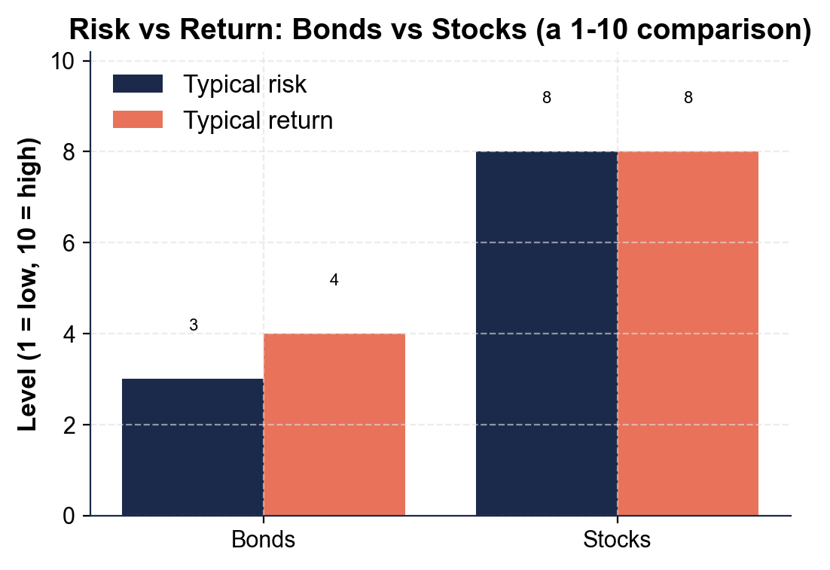
Risk vs Return: Bonds vs Stocks (a 1-10 comparison)
On a 1-10 scale, bonds sit low on both risk and return; stocks sit high on both.
© More Lessons Less Planning | morelessonslessplanning.com
Notes:
Have students read the grouped bar chart. It compares the TYPICAL risk and TYPICAL return of bonds versus stocks on a simple 1-to-10 scale (1 = low, 10 = high). For BONDS, the bars are low: a typical risk of 3 and a typical return of 4 - bonds are lower risk AND lower return. For STOCKS, the bars are high: a typical risk of 8 and a typical return of 8 - stocks are higher risk AND higher return. The picture makes the trade-off concrete: as you move from bonds to stocks, BOTH the risk bar and the return bar rise together - you cannot get the higher return of stocks without accepting the higher risk, and you cannot get the safety of bonds without accepting a lower return. That is the fundamental risk/return trade-off in investing. Remind students the 1-10 scale is a simple teaching illustration of the general pattern, not a precise measurement of any one bond or stock. This is the chart Activity Part 3 reads.
Reference labels (point to these chart features when teaching): Bonds: risk 3, return 4; Stocks: risk 8, return 8

Slide 9
Who Issues Bonds?
Government bonds
A GOVERNMENT BOND is issued by a government (such as a U.S. Treasury bond); backed by the government, they are usually the lowest-risk kind of bond
Corporate bonds
A CORPORATE BOND is issued by a company (like Maria's GreenLeaf Foods bond); they usually pay a bit more interest to make up for a bit more risk
Municipal bonds
A MUNICIPAL BOND is issued by a state or local government to fund things like schools and roads; the interest is often tax-free
Safer issuer = lower rate
The safer the issuer, the lower the coupon rate it needs to offer; riskier issuers must pay MORE interest to attract lenders
Key Concept: Governments (Treasury, municipal) and companies (corporate) all issue bonds. Safer issuers pay LESS; riskier ones pay MORE.
© More Lessons Less Planning | morelessonslessplanning.com
Notes:
Show students who actually issues bonds, so 'a government or company' becomes concrete. GOVERNMENT BONDS are issued by a national government; in the U.S. these are Treasury bonds (and related Treasury notes and bills). Because they are backed by the full faith of the government, they are usually the LOWEST-risk kind of bond - default is extremely rare - which is why they pay some of the lowest interest rates. CORPORATE BONDS are issued by companies, like Maria's GreenLeaf Foods bond. A company can run into trouble more easily than a national government, so corporate bonds carry a bit more risk and therefore usually pay a bit MORE interest than a government bond to make up for it. MUNICIPAL BONDS ('munis') are issued by state and local governments to fund public projects like schools, roads, and water systems; a common feature is that their interest is often free from federal (and sometimes state) taxes, which makes them attractive to some investors. Draw out the pattern that ties who-issues to the coupon rate: the SAFER the issuer, the LOWER the coupon rate it needs to offer, because lenders will accept less interest for more safety; the RISKIER the issuer, the MORE interest it must pay to convince people to lend. This is why a Treasury bond pays less than a shaky company's bond even in the same year - the extra interest is the reward (and warning) for extra risk. So who the issuer is tells you a lot about both the safety and the interest rate of a bond.

Slide 10
When Do Bonds Make Sense?
A bond fits when you want...
Smart ways people use bonds
Steady, predictable income - a fixed coupon you can count on
Lower risk - money you cannot afford to lose or need soon-ish
To balance out riskier stocks in your mix of investments
A known payback date (maturity) for a goal with a deadline
Mix bonds AND stocks so gains and safety balance each other
Lean more on bonds as a goal (like retirement) gets closer
Use safer government bonds for money you must protect
Remember: check the ISSUER - who owes you matters most
Key Concept: Bonds make sense for steady income, lower risk, and money you must protect. Most people hold BOTH bonds and stocks to balance the two.
© More Lessons Less Planning | morelessonslessplanning.com
Notes:
End the lesson by making the choice practical: when does a bond make sense? A bond fits when you want STEADY, PREDICTABLE INCOME - a fixed coupon you can count on arriving every year - rather than the uncertain payoff of a stock. It fits when you want LOWER RISK - for money you cannot afford to lose, or that you will need in a few years and cannot risk in a bouncing stock. It fits when you want to BALANCE OUT riskier stocks: holding some bonds alongside stocks smooths the ups and downs of a whole portfolio. And it fits a goal with a DEADLINE, because a bond's maturity gives you a known payback date. On the right, give students the smart ways people actually use bonds, tying the lesson together. First, MIX bonds AND stocks: most investors hold both so the growth of stocks and the safety of bonds balance each other - this is diversification across investment TYPES, the next level up from the diversification-across-stocks idea in TK53. Second, LEAN MORE ON BONDS as a big goal gets closer (a classic example is shifting money from stocks toward bonds as retirement approaches, so a market dip right before you need the money does less damage). Third, use SAFER GOVERNMENT BONDS for money you absolutely must protect. Fourth, always CHECK THE ISSUER - who owes you the money matters most, because a bond is only as safe as the government or company behind it. The takeaway: bonds are the steady, lower-risk lending side of investing, and most people use them together with stocks - not instead of them - to match their money to their goals.

Slide 11
Key Takeaways
A BOND is a loan to a government or company - you are a LENDER, not an owner
★
The ISSUER borrows your FACE VALUE and pays a fixed COUPON each year
★
COUPON PAYMENT = FACE VALUE x COUPON RATE: Maria's $1,000 x 5% = $50 a year
★
At MATURITY the issuer returns your face value; Maria earns $200 over 4 years
★
Bonds are lower risk AND lower return than stocks - that is the trade-off
★
© More Lessons Less Planning | morelessonslessplanning.com
Notes:
Read each takeaway and connect it to the learning targets. T1 (explain a bond) -> a BOND is a loan you make to a government or company, so buying one makes you a LENDER, not an owner like a stock - the issuer OWES you your money back with interest. T2 (parts of a bond) -> the ISSUER is the borrower who takes your FACE VALUE (the amount you lend) and pays a fixed COUPON (interest) payment each year for lending it. T3 (calculate the coupon) -> the labeled model COUPON PAYMENT = FACE VALUE x COUPON RATE gives Maria $1,000 x 5% = $50 a year - fixed income she can count on. T4 (maturity) -> at the MATURITY date the issuer returns your face value; Maria collects $50 x 4 = $200 in interest over her 4-year bond and gets her $1,000 back, a 20% total return with her principal intact. T4 (compare to stocks) -> bonds are LOWER RISK and LOWER RETURN than stocks because you lend (fixed, promised payments) instead of own (uncertain profits) - the risk/return trade-off, which is why most people hold both. The spine of the lesson: a bond is a loan with a fixed payment and a payback date, safer and steadier than a stock, and the fixed-income counterweight to the ownership of TK53. As the fourth toolkit of Unit 6, this adds LENDING to saving, compounding, and owning.

