Slide 1
Blitzkrieg and the Fall of France
Why the Bigger Army Lost in Six Weeks
© More Lessons Less Planning | morelessonslessplanning.com
Notes:
Ask how long students think it took Germany to defeat France in 1940. Most guess a year or more. The answer is six weeks, and that gap is the lesson.

Slide 2
Learning Targets
Explain what blitzkrieg combined: massed armor, air support, radio, and speed.
★
Explain why the Maginot Line was bypassed rather than broken in May 1940.
★
Trace the German advance from Sedan on May 13 to the English Channel on May 20.
★
Analyze an American ambassador's telegram describing the German breakthrough.
★
Explain why France lost to tempo and concentration rather than to numbers.
★
© More Lessons Less Planning | morelessonslessplanning.com
Notes:
Point at target five. The whole lesson is built to make that sentence something students can defend with evidence rather than repeat.

Slide 3
France in 1940: What Everyone Expected
France had one of the largest armies in Western Europe in May 1940.
French planners expected a slow war of trenches like 1914-1918.
They believed defense was stronger than attack.
Germany invaded France, Belgium, the Netherlands, and Luxembourg on May 10.
France signed an armistice six weeks later, on June 22, 1940.
Key Concept: The question is not why France was weak. It is why a strong army collapsed.
© More Lessons Less Planning | morelessonslessplanning.com
Notes:
Set the puzzle before explaining it. Students who believe France was simply weak will not understand anything that follows.

Slide 4
Four Words Before the Invasion
Blitzkrieg
A way of attacking built on speed and concentration, using armor, aircraft, and radio together to break through at one point
Combined arms
Tanks, aircraft, infantry, and artillery fighting as one team instead of operating separately
Maginot Line
The belt of French concrete forts along the German border, built after 1918 to stop another invasion
Ardennes
The hilly, wooded region in Belgium and Luxembourg that French planners judged too rough for large tank forces
Note: Blitzkrieg was not a secret weapon. It was ordinary weapons used together at one point.
© More Lessons Less Planning | morelessonslessplanning.com
Notes:
Say blitzkrieg out loud and then say combined arms out loud. The second word is what the first word actually means.

Slide 5
The Maginot Line
What It Was
What It Did Not Cover
A belt of concrete forts along the French border with Germany
Built through the 1930s at enormous cost
Designed so any attack there would be slow and expensive
The line stopped near the Belgian border
France would not fortify the frontier of an ally
The German breakthrough went around it, not through it
Did You Know: The Maginot Line was bypassed, not broken. Most forts held until the armistice.
© More Lessons Less Planning | morelessonslessplanning.com
Notes:
Students arrive believing the Maginot Line failed. It did exactly what it was built to do. The failure was in what it was not built to cover.

Slide 6
The Ardennes: The Gap Everyone Discounted
The Ardennes is hilly, wooded country in Belgium and Luxembourg.
French planners called it impassable for large tank forces.
Only weak French units were posted behind it.
Germany sent seven panzer divisions through it in May 1940.
The German column of vehicles stretched back more than 100 miles.
Key Concept: The gap was not a hole in the map. It was a hole in the plan.
© More Lessons Less Planning | morelessonslessplanning.com
Notes:
The Ardennes was not undefended because nobody noticed it. It was lightly defended because the French judged it unusable at scale, and that judgment was written into the plan.

Slide 7
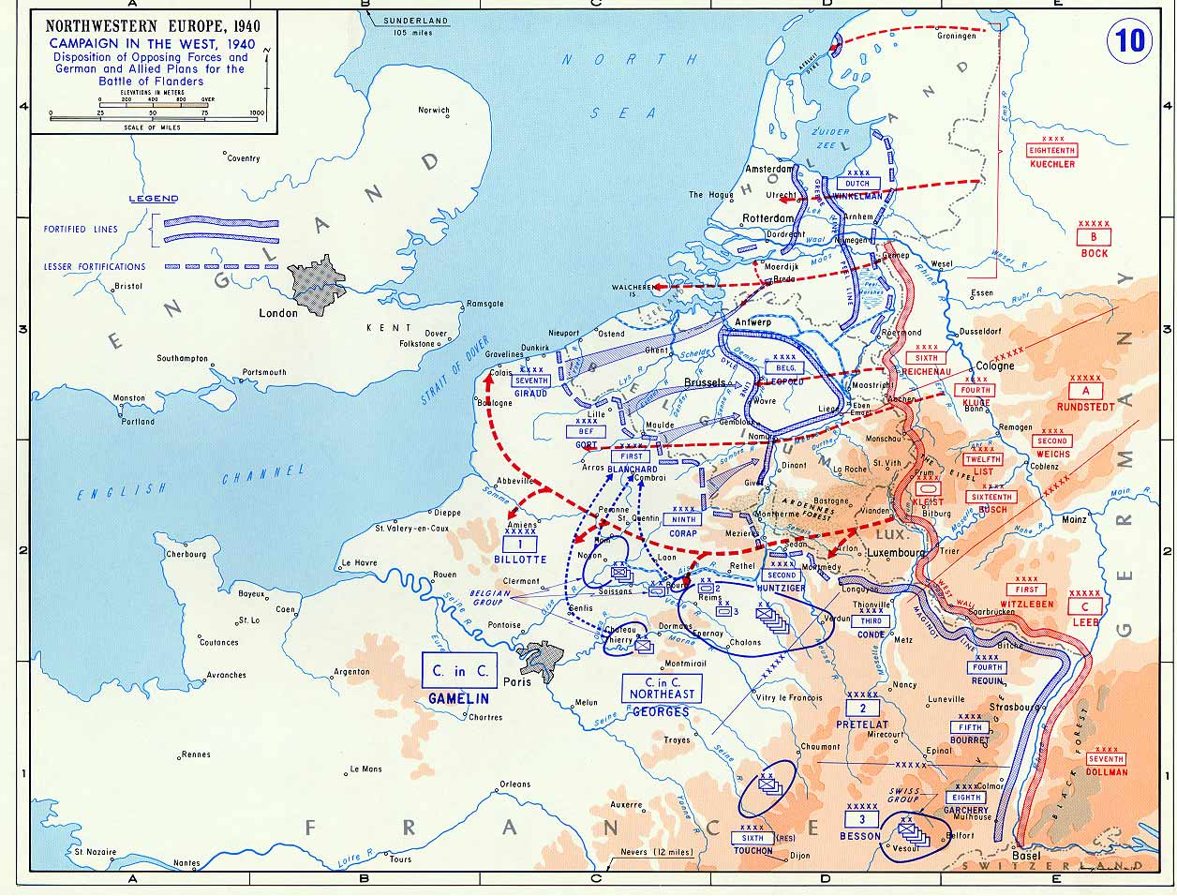
Allied and German Plans, May 1940
Note: U.S. Military Academy atlas map, 1940.
© More Lessons Less Planning | morelessonslessplanning.com
Notes:
Trace two things with a finger: the hatched Maginot Line running up the German border and stopping, and the red dashed German arrow that goes through the Ardennes and out to the Channel. The blue Allied arrows go the other way, north into Belgium.
Reference labels (point to these chart features when teaching): Maginot Line; Ardennes Forest

Slide 8
Three Words for the Machine
Sedan
The town on the Meuse River in France where German armor crossed on May 13, 1940 and broke the French line
Panzer division
A German unit that grouped tanks, motorized infantry, and artillery under one commander
Close air support
Aircraft attacking troops and guns on the battlefield in place of slow-moving artillery
Note: A panzer division was an organization chart before it was a weapon.
© More Lessons Less Planning | morelessonslessplanning.com
Notes:
The panzer division is the key idea here. Grouping the parts under one commander is what let them move at one speed.

Slide 9
What Blitzkrieg Actually Combined
Concentration
Air Instead of Artillery
Radio and Tempo
Tanks massed in panzer divisions at one narrow point
France spread most of its tanks along the whole front
Germany struck one place with everything it had
Stuka dive-bombers attacked French guns and bunkers
Aircraft moved forward as fast as the tanks did
Heavy artillery took hours or days to move up
Every German tank company could be reached by radio
Orders changed while the attack was still moving
French orders often arrived by messenger or telephone
Key Concept: Speed was the weapon. Every part of the system existed to keep moving.
© More Lessons Less Planning | morelessonslessplanning.com
Notes:
Ask which of the three cards a modern army could copy most easily. Radio is the cheap one, and it is the one France had least of.

Slide 10
The Numbers Were Not the Problem
2,400
3,000+
German tanks committed in the West
French tanks available in May 1940
Germany: Massed its tanks in ten panzer divisions and struck one point
France: Spread its tanks along the front to support the infantry
Fact: France did not lose for lack of tanks. It had more of them, but fewer modern aircraft.
© More Lessons Less Planning | morelessonslessplanning.com
Notes:
This is the slide the whole lesson rests on. If students accept that France had more tanks, they have to look for a different explanation.

Slide 11
May 10-15, 1940: Six Days
Date | What Happened | Why It Mattered
May 10 | Germany invades Belgium, the Netherlands, and Luxembourg | The best Allied armies march north to meet the attack
May 12 | Seven panzer divisions reach the Meuse River | The main German attack arrives where nobody expected it
May 13 | German troops cross the Meuse at Sedan | The French line is broken at its weakest point
May 14 | Stukas and armor break up French counter-attacks | France cannot close the gap that has just been torn in its line
May 15 | The breach widens into open country | The French Premier telephones London for aircraft
Fact: The decisive break came on day four of a six-week campaign.
© More Lessons Less Planning | morelessonslessplanning.com
Notes:
Keep the table up a moment. The attack into Belgium was the diversion, and the Allies walked into it on day one.

Slide 12
May 13: The Meuse at Sedan
How Germany Crossed
Why France Could Not Recover
Stukas bombed French gun positions for hours
Infantry crossed the Meuse in rubber boats
Engineers built bridges for the tanks by nightfall
French artillery crews had been driven from their guns
Counter-attacks were ordered too late to arrive together
Reserves were far away and moving on foot or by rail
Did You Know: The German bridgehead at Sedan was built and reinforced in a single day.
© More Lessons Less Planning | morelessonslessplanning.com
Notes:
The left column is the combined-arms slide in action. Air, infantry, and engineers each did a job the tanks could not do alone.

Slide 13
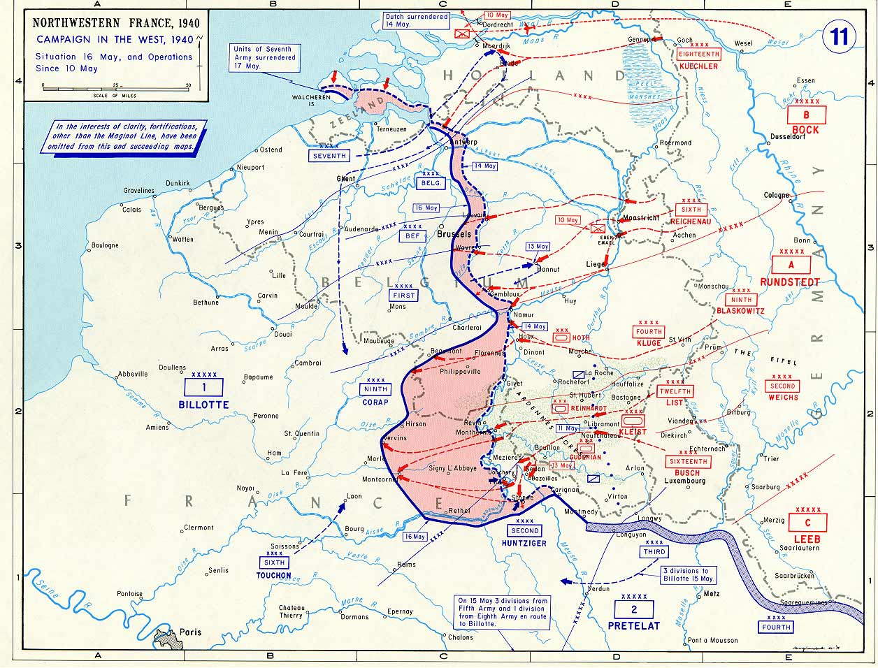
The Breakthrough, 16 May 1940
Note: U.S. Military Academy atlas map, 16 May 1940.
© More Lessons Less Planning | morelessonslessplanning.com
Notes:
The shaded wedge running west from Sedan is the breakthrough. This is the situation on 16 May, one day after the telegram students will read in Activity Part 4.
Reference labels (point to these chart features when teaching): Sedan on the Meuse; German salient

Slide 14
The Race to the Channel
German armor turned west instead of south toward Paris.
The panzer divisions covered more than 150 miles in a week.
They reached the English Channel near Abbeville on May 20.
The Allied armies in Belgium were cut off from the rest of France.
More than a million Allied soldiers were trapped in the north.
Key Concept: Cutting an army off from its supply is faster than destroying it in battle.
© More Lessons Less Planning | morelessonslessplanning.com
Notes:
Turning west rather than driving on Paris is the decision that wins the campaign. Ask students why the capital was the wrong target.

Slide 15
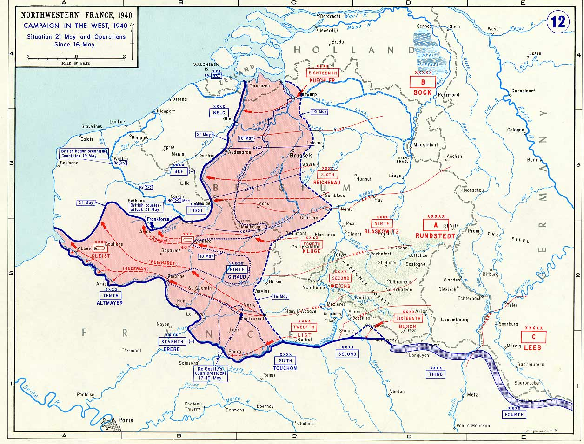
The Channel Reached, 21 May 1940
Note: U.S. Military Academy atlas map, 21 May 1940.
© More Lessons Less Planning | morelessonslessplanning.com
Notes:
Put this beside the previous map in your head. Five days separate them, and in those five days the wedge reached the sea and split the Allied armies in two.
Reference labels (point to these chart features when teaching): Abbeville on the coast; Armies cut off

Slide 16
Dunkirk, May 26 to June 4
The pocket closes
The trapped armies fall back on the port of Dunkirk
✔
The armor halts (May 24)
German tanks stop for three days to rest and secure their flanks
✔
The evacuation runs
Warships and civilian craft lift troops from the beaches and the mole
✔
The equipment stays
About 338,000 troops reach Britain, leaving their heavy weapons behind
✔
Note: Dunkirk saved soldiers, not an army. Almost every vehicle and gun was abandoned.
© More Lessons Less Planning | morelessonslessplanning.com
Notes:
The halt order is one of the most argued-about decisions of the war. Present it as a decision, not a mystery, and move on.

Slide 17
Three Words for the Collapse
Salient
A bulge pushed into an enemy line, exposed on both sides but hard to cut off once it keeps moving
Encirclement
Surrounding an enemy force by cutting it off from supply and retreat instead of destroying it head-on
Armistice
An agreement to stop fighting; France signed one with Germany on June 22, 1940
Note: A salient is exactly what the German breakthrough looked like from May 13 onward.
© More Lessons Less Planning | morelessonslessplanning.com
Notes:
Point back at the two maps when you teach salient. Students have already seen one grow; now it gets a name.

Slide 18
Why the French Command Could Not Keep Up
Orders Took Too Long
The Map Was Always Wrong
Decisions Came Too Late
French headquarters had no radio link to many units
Written orders travelled by motorcycle courier
An order could take a day or more to reach the front
By the time a report arrived, the panzers had moved on
Commanders planned against positions that no longer existed
Counter-attacks were ordered piece by piece
Units arrived separately and were beaten separately
Key Concept: Germany was not making better decisions. It was making them faster.
© More Lessons Less Planning | morelessonslessplanning.com
Notes:
This is the abstract idea students find hardest and remember longest. Use a relay-race image: it does not matter how fast you run if the baton arrives late.

Slide 19
June 1940: The End
Date | Event | Result
June 4 | The Dunkirk evacuation ends | About 338,000 Allied troops are safe in Britain without equipment
June 5 | Germany attacks south across the Somme | The remaining French armies face the panzers alone
June 10 | Italy declares war on France | France now fights on a second front in the south
June 14 | German troops enter Paris | The French government has already left the city
June 22 | France signs an armistice at Compiegne | Germany occupies the north and the Atlantic coast
Fact: Six weeks, May 10 to the June 22 armistice - and about 60,000 French and 27,000 German soldiers killed, plus thousands of civilians.
© More Lessons Less Planning | morelessonslessplanning.com
Notes:
Note how little of the campaign is left after Dunkirk. The decisive work was done in the first ten days.

Slide 20
Tempo and Concentration, Not Numbers
What France Had
What Germany Did With Less
More tanks than Germany committed in the West
A large trained army and strong border forts
A plan built for the war it expected to fight
Massed its armor at one point instead of spreading it
Replaced slow artillery with aircraft over the battlefield
Moved faster than French orders could be written
Key Concept: France was beaten by tempo and concentration, not by numbers.
© More Lessons Less Planning | morelessonslessplanning.com
Notes:
This is the sentence students must be able to defend in Activity Part 5. Have them read the callout aloud together before moving on.

Slide 21
What the Ambassador Saw, May 15, 1940
The French counter-attacks against the German hernia in the Sedan region had not succeeded . . . On the contrary, the hernia was growing hour by hour.
— William C. Bullitt, U.S. Ambassador to France, telegram of May 15, 1940
A hernia is a bulge that tears through a wall. Bullitt is describing the salient at Sedan.
Remember: You will read a longer passage from this same telegram in Activity Part 4.
© More Lessons Less Planning | morelessonslessplanning.com
Notes:
Read the quotation aloud once. Then ask what a doctor's word for a rupture is doing in a diplomatic telegram, and what it tells you about how the breakthrough looked from Paris.

Slide 22
Key Takeaways
Blitzkrieg was combined arms plus speed, not a secret weapon.
★
The Maginot Line was bypassed through the Ardennes, not broken.
★
The Meuse crossing at Sedan on May 13 decided the campaign in four days.
★
The drive to the Channel cut the Allied armies in two by May 20.
★
France had more tanks and still lost: Germany concentrated and moved faster.
★
© More Lessons Less Planning | morelessonslessplanning.com
Notes:
Ask which takeaway students will use in Activity Part 5. Committing to one out loud makes the written response much easier to start.

