Slide 1
Big Tech Antitrust - Google Apple Amazon Meta
How the U.S. government is suing the four biggest tech companies on Earth - and what the 2024 Google search verdict actually means.
© More Lessons Less Planning | morelessonslessplanning.com
Notes:
Open with the headline: in August 2024 a federal judge ruled that Google illegally maintained a search monopoly - the biggest tech antitrust verdict since Microsoft in 2001. At the same time the DOJ is suing Apple, the FTC is suing Amazon, and the FTC is suing Meta. Today we look at all four cases through the four features of monopoly from TK 22.

Slide 2
Learning Targets
Apply MONOPOLY four features to Google, Apple, Amazon, Meta
★
Define NETWORK EFFECTS and why digital platforms scale fast
★
Read 3 charts; write a Final Recommendation Memo for the DOJ
★
© More Lessons Less Planning | morelessonslessplanning.com
Notes:
Read the three targets aloud. Target 1 reuses the TK 22 four-features model and stretches it across four companies. Target 2 is the new digital-monopoly concept (network effects). Target 3 is the synthesis - the Final Recommendation Memo at the end of the activity.

Slide 3
Four Big Tech Antitrust Cases at Once
The Four Active Cases (Updated 2024)
What All Four Have in Common
U.S. v. GOOGLE search - filed 2020, RULING August 5 2024 (Google lost)
U.S. v. APPLE - filed March 2024, walled garden + App Store
FTC v. AMAZON - filed September 2023, self-preferencing
FTC v. META - filed December 2020, Instagram + WhatsApp
Each company dominates a digital platform market
Each uses NETWORK EFFECTS to lock users in
Each accused of conduct that EXCLUDES competitors
Each case argues the company is a MONOPOLY under Sherman Section 2
Big Idea: this is the biggest antitrust moment in 25 years - the U.S. is suing all four dominant tech platforms simultaneously.
© More Lessons Less Planning | morelessonslessplanning.com
Notes:
Walk the four cases. Stress that the August 2024 Google ruling is the FIRST major Big Tech verdict - and the government won. Frame the other three cases as inheriting momentum from the Google ruling.

Slide 4
Recap - What Is a Monopoly?
MONOPOLY (from TK 22)
A market structure with ONE seller, no close substitutes for the product, and high barriers preventing new firms from entering
The Four Features
(1) One seller, (2) No close substitutes, (3) High barriers to entry, (4) Price-maker firm - exactly the model we used for Ticketmaster in TK 25
Why it matters here
The DOJ and FTC argue each Big Tech company meets the monopoly definition in its core market - we test that claim today
Big Idea: the TK 22 monopoly model works for Big Tech the same way it worked for Ticketmaster - what changes is the barrier to entry.
© More Lessons Less Planning | morelessonslessplanning.com
Notes:
One-slide recap. Stress that the four-features model is unchanged. What changes in Big Tech is the BARRIER (network effects instead of venue exclusivity contracts).

Slide 5
What Is NEW - Network Effects + Two-Sided Markets
Network effects
A product gets MORE valuable as MORE users join - Facebook with 0 friends is useless; with 100+ it is powerful; Google search is more accurate with more queries
Two-sided markets
Platforms connect TWO groups (users + developers; buyers + sellers) - Apple App Store iPhone users want apps and developers want users; both sides reinforce each other
Self-reinforcement
The leader gets stronger over time as data accumulates and barriers grow - opposite of textbook prediction that competition erodes monopoly rents
Big Idea: network effects + two-sided markets create barriers to entry that get STRONGER over time - the opposite of the textbook prediction.
© More Lessons Less Planning | morelessonslessplanning.com
Notes:
Define network effects. Define two-sided markets. Stress that in classical economics, barriers to entry EVENTUALLY erode. In digital platforms with network effects, barriers GET STRONGER as the platform grows - this is the structural challenge.

Slide 6
Big Tech Market Shares - The Picture
Dominance in Core Markets
What These Shares Mean
GOOGLE: ~90% U.S. general search market
APPLE: ~50% U.S. smartphone OS via iOS
AMAZON: ~38% U.S. e-commerce
META: ~70% U.S. social-network users (FB+IG+WhatsApp)
All four meet monopoly thresholds in their CORE market
Defense will argue narrow market definition
DOJ/FTC argue these ARE the relevant markets
Image on next slide visualizes the four shares
Big Idea: each Big Tech company has 38-90% share in its core market - monopoly-level by any standard antitrust threshold.
© More Lessons Less Planning | morelessonslessplanning.com
Notes:
Walk the four headline shares. Stress these are CORE market shares - each company has lower share in adjacent markets. The market-definition fight from TK 25 returns: DOJ/FTC want narrow definitions where shares are monopoly-level; defense wants broad definitions.

Slide 7
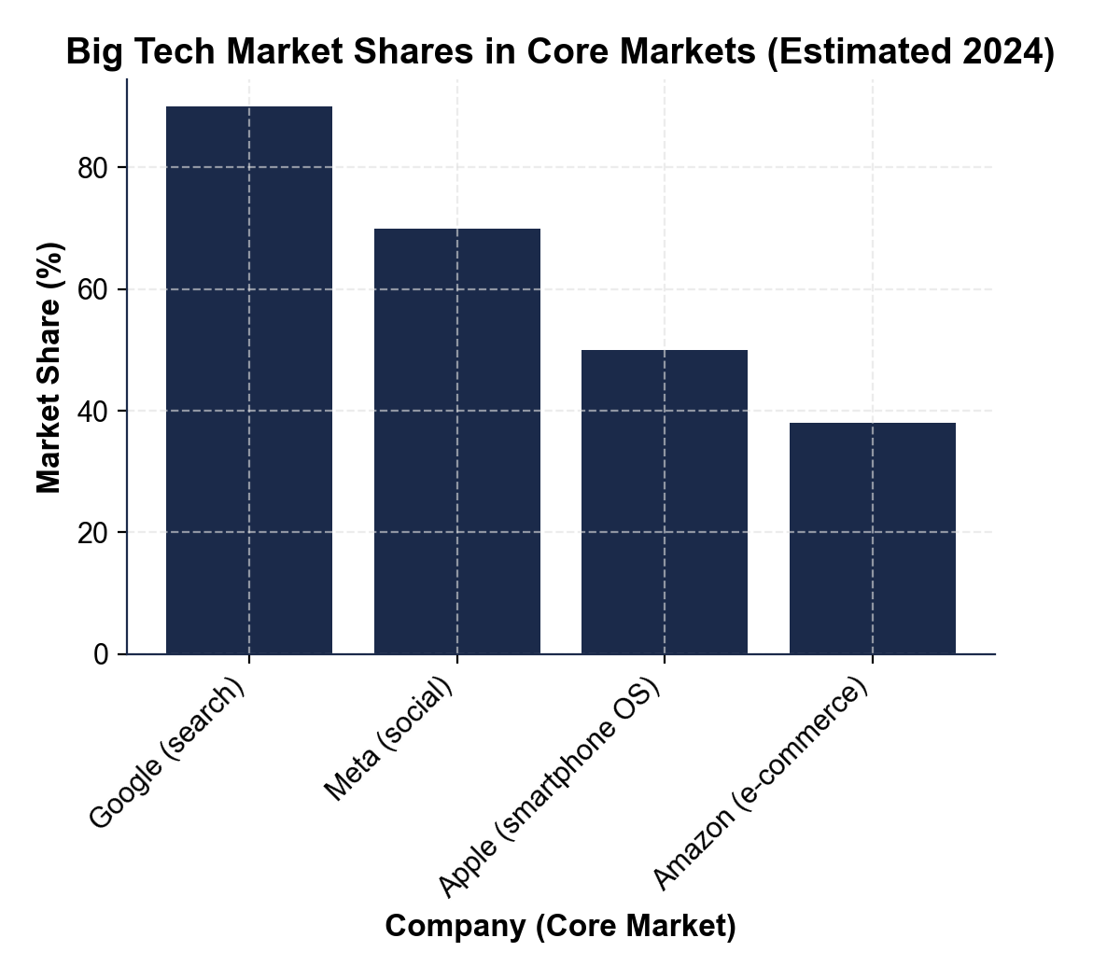
Big Tech Market Shares - Visualized
Each Big Tech company dominates its core market at 38-90% share.
© More Lessons Less Planning | morelessonslessplanning.com
Notes:
Display the chart full-bleed. Have students read each bar aloud. Anchor the shares - these are the numbers used in the DOJ/FTC complaints to argue Feature 1 (one seller) of monopoly is met.
Reference labels (point to these chart features when teaching): Chart 1

Slide 8
Case 1 - U.S. v. Google Search (2024 Verdict)
The August 5 2024 Ruling
What Google Did
JUDGE: Amit Mehta, U.S. District Court D.D.C.
RULING: Google illegally maintained search monopoly
VIOLATION: Sherman Act Section 2 (monopolization)
REMEDIES PHASE: ongoing - decision expected 2025
Paid Apple ~$20 billion/year to be Safari default search
Paid Samsung + Mozilla similar default-search contracts
Locked rival search engines (Bing, DuckDuckGo) out of distribution
Court: this conduct EXCLUDED competitors
Big Idea: Google did not get its 90% share through a better product alone - it PAID for distribution that excluded competitors.
© More Lessons Less Planning | morelessonslessplanning.com
Notes:
Walk the August 2024 ruling. Stress this is the FIRST major Big Tech verdict. The court found Google's default-search payments to Apple, Samsung, and Mozilla illegally excluded competitors. Remedies phase is 2025.

Slide 9
Why Google Won the Search Monopoly
Network effects in search
More users -> more queries -> more data -> better results -> more users. Google's lead got bigger over time.
Default-search distribution payments
$20+ billion/year to Apple for Safari default; payments to Samsung and Mozilla too - locks rivals out of phone and browser distribution
Two-sided market reinforcement
More users attract more advertisers; more advertiser revenue funds more search infrastructure; reinforces the position
Key Point: Network effects + default-search payments = the durable barrier Google built to keep its 90% share.
© More Lessons Less Planning | morelessonslessplanning.com
Notes:
Walk the three reasons Google won the search monopoly. Stress that network effects ALONE would not lock in 90% share - the default-search payments are what made the lock-in durable.

Slide 10
Case 2 - U.S. v. Apple (March 2024) - The Walled Garden
The DOJ Apple Suit (Filed March 21 2024)
What the DOJ Alleges Apple Did
DOJ + 16 state AGs filed in D. NJ
Charge: monopolization of smartphone market
Conduct: walled garden, App Store control, iMessage lock-in
Apple takes 15-30% commission on all App Store purchases
Blocks third-party app stores on iPhone (only App Store allowed)
Degrades cross-platform messaging (green bubbles to Android)
Restricts super-apps + cloud streaming + smartwatches
Locks developers and users into the Apple ecosystem
Big Idea: Apple's walled garden = network effects PLUS contractual lock-in PLUS API restrictions on competitors.
© More Lessons Less Planning | morelessonslessplanning.com
Notes:
Walk the DOJ Apple suit. Stress the central allegation: Apple uses the iPhone walled garden to lock developers + users in and exclude rival app stores, rival messaging, rival smartwatches.

Slide 11
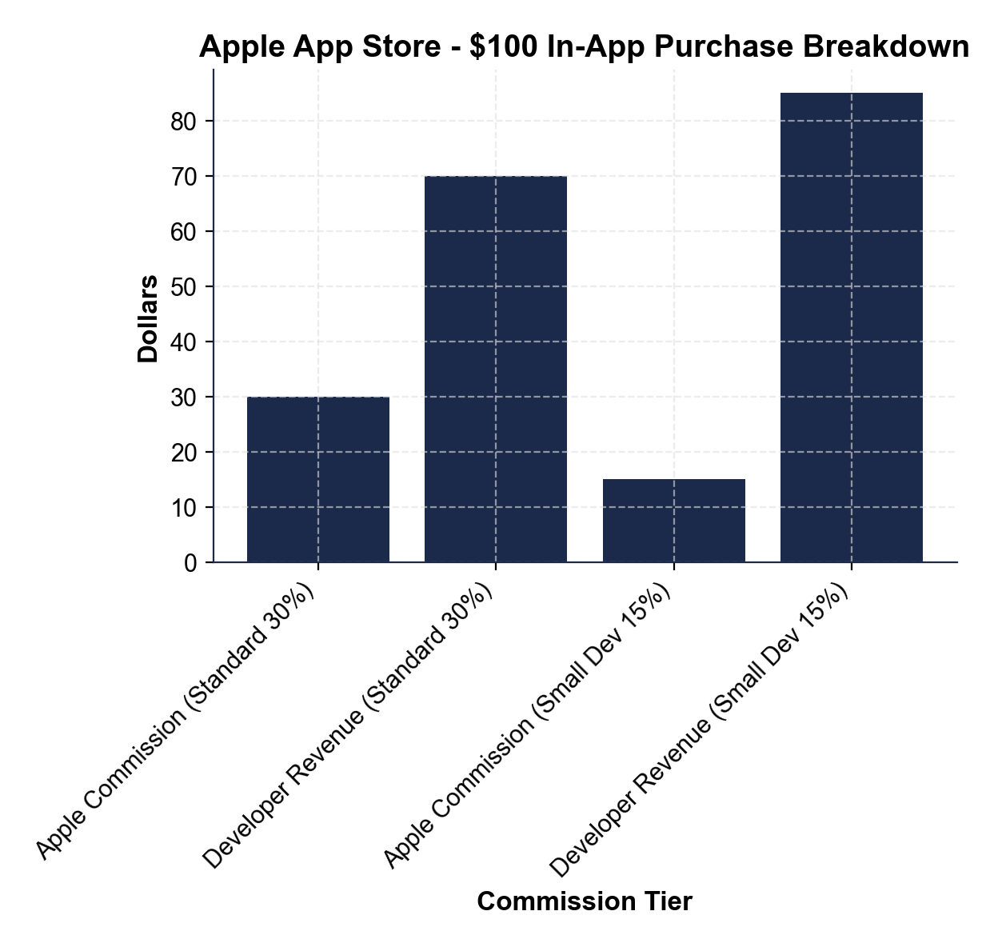
Apple App Store - The 30% Cut
Apple takes 15-30% of every in-app purchase - $30 on every $100.
© More Lessons Less Planning | morelessonslessplanning.com
Notes:
Display the chart. Walk the two bars: standard 30% rate (developer keeps $70) and small-developer 15% rate (developer keeps $85). This is the economic engine of the App Store and the central issue in Epic v. Apple and EU DMA enforcement.
Reference labels (point to these chart features when teaching): Chart 2

Slide 12
Case 3 - FTC v. Amazon (Sept 2023) - Self-Preferencing
FTC Amazon suit (Sept 26 2023)
FTC + 17 state AGs filed in W.D. Wash; charge: monopolization of online superstore market under Sherman Section 2
Buy Box self-preferencing
Amazon Buy Box algorithm favors Amazon Basics over rival third-party seller products on the SAME marketplace - central self-preferencing allegation
Seller punishment + bundling
Amazon punishes sellers who list cheaper on Walmart or eBay; forces sellers to use Fulfilled-By-Amazon for Prime eligibility - locks sellers in
Consumer harm theory
These practices RAISE consumer prices (sellers cannot offer lower prices elsewhere without retaliation) and reduce competition across platforms
Big Idea: Amazon uses its dominance as a buyer/host of third-party sellers to PREFERENCE its own products and PUNISH sellers who compete.
© More Lessons Less Planning | morelessonslessplanning.com
Notes:
Walk the FTC Amazon suit. Stress that Amazon is BOTH a retailer (selling Amazon Basics) AND a marketplace (hosting third-party sellers). The conflict of interest is the central FTC allegation.

Slide 13
Case 4 - FTC v. Meta - Killer Acquisitions
The FTC Meta Suit (Filed December 2020)
What the FTC Alleges Meta Did
FTC + 46 state AGs filed in D.D.C.
Charge: anticompetitive acquisitions under Clayton Act Section 7
Targets: Instagram acquisition (2012, $1 billion) + WhatsApp (2014, $19 billion)
FTC demands DIVESTITURE - force Meta to spin off both
Bought Instagram in 2012 to eliminate a rising photo-sharing rival
Bought WhatsApp in 2014 to eliminate a rising messaging rival
Internal Zuckerberg emails describe Instagram as a 'threat'
Both = KILLER ACQUISITIONS to prevent future competition
Big Idea: the FTC argues Meta's acquisitions were ILLEGAL killer acquisitions - bought to eliminate competition, not for the products.
© More Lessons Less Planning | morelessonslessplanning.com
Notes:
Walk the FTC Meta suit. Stress this is a Clayton Act Section 7 case (anticompetitive merger), not Sherman Section 2 (monopolization). The FTC argues the 2012 Instagram and 2014 WhatsApp acquisitions should be UNDONE.

Slide 14
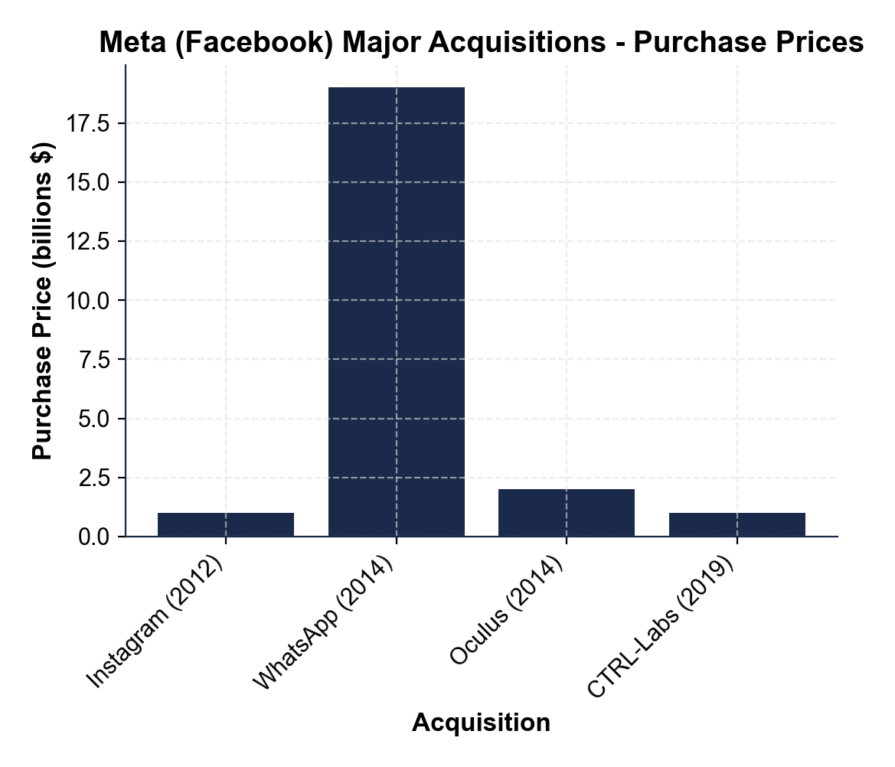
Meta Acquisitions - The Killer Pattern
Meta bought Instagram + WhatsApp + Oculus + CTRL-Labs over a decade.
© More Lessons Less Planning | morelessonslessplanning.com
Notes:
Display the chart. Walk the four bars: Instagram 2012 ($1B), WhatsApp 2014 ($19B), Oculus 2014 ($2B), CTRL-Labs 2019 ($1B). The Instagram and WhatsApp bars are the FTC's killer-acquisition targets.
Reference labels (point to these chart features when teaching): Chart 3

Slide 15
Why Big Tech Is Different - Digital Network Effects
Marginal cost is near zero
Adding one more user costs Google or Meta almost nothing - no factory expansion, no inventory; classical entry-erosion logic does not apply
Data is the moat
Google's search results are better than Bing's because Google has 8x more queries; data accumulates and the gap WIDENS
Network effects + low marginal cost
Combination produces winner-take-all markets - one firm wins the entire market, not a small share
Why classical antitrust struggles
Traditional remedies (price caps, breakups) were built for industrial monopolies; digital monopolies need new tools (interoperability, data portability)
Big Idea: digital network effects create monopolies that CLASSICAL antitrust remedies were not designed to fix.
© More Lessons Less Planning | morelessonslessplanning.com
Notes:
Walk the four bullets. Stress this is the THEORETICAL difference between Big Tech monopolies and the Standard Oil / AT&T era monopolies. Classical antitrust assumed entry would erode monopoly rents; Big Tech is the case where entry does NOT erode them.

Slide 16
Possible Remedies - Three Approaches
Structural (Breakup)
Force divestiture - Meta sells Instagram + WhatsApp; Google sells Chrome; Apple separates the App Store. Hardest to win but stickiest. The FTC Meta theory.
Behavioral (Conduct Rules)
Force the firm to change conduct - no self-preferencing, no exclusive defaults, no killer acquisitions. Easier to win but often fail (TK 25 Ticketmaster consent decree).
Interoperability + Data Portability
Force the firm to let competitors connect (messaging interop) and let users export their data. The EU Digital Markets Act approach. New for U.S. cases.
Big Idea: the right remedy depends on which feature you are attacking - share (breakup), conduct (behavioral), or lock-in (interoperability).
© More Lessons Less Planning | morelessonslessplanning.com
Notes:
Walk the three remedy approaches. Stress that no single remedy fits all four cases. Google search needs interoperability + ban on default-search payments. Meta needs structural. Amazon needs behavioral + interoperability.

Slide 17
The EU Digital Markets Act - A Different Approach
The EU DMA (Effective 2023-2024)
Why It Matters for U.S. Cases
Designates 6 GATEKEEPERS - Alphabet/Apple/Amazon/ByteDance/Meta/Microsoft
Forces interoperability, third-party app stores, data portability
Bans self-preferencing on platforms by default
Penalty: up to 10% of global annual revenue
EU forces what U.S. courts are still litigating
Apple already allows third-party app stores in EU (not U.S.)
EU sets the precedent for U.S. remedies in 2025-2027
Forces a global Big Tech compliance standard
Big Idea: the EU DMA imposes BY LAW what the U.S. DOJ/FTC is still trying to win in court - watching the EU experiment first.
© More Lessons Less Planning | morelessonslessplanning.com
Notes:
Walk the EU DMA. Stress that the EU has already DONE what the U.S. is litigating. Apple allows third-party app stores in the EU but not the U.S. The EU experiment shows what each remedy would look like in practice.

Slide 18
Big Tech Vocabulary (1 of 3)
Network effects
A product gets MORE valuable as MORE users join - the durable barrier to entry in every Big Tech case
Platform
A digital business connecting two or more sides of a market - App Store connects developers + users, Amazon connects sellers + buyers
Walled garden
A platform that controls the user experience end-to-end and restricts other companies (Apple is the canonical example) - the DOJ Apple case targets this
Key Point: network effects + platform + walled garden = the digital monopoly toolkit.
© More Lessons Less Planning | morelessonslessplanning.com
Notes:
Drill these three terms. The next slides have self-preferencing + killer acquisition + interoperability.

Slide 19
Big Tech Vocabulary (2 of 3)
SELF-PREFERENCING - platform favors own products (Amazon Basics; Google Shop)
KILLER ACQUISITION - dominant buys rising rival (Instagram 2012, WhatsApp 2014)
DEFAULT SEARCH - pre-installed search engine (Google paid Apple $20B/yr)
Aug 2024 ruling: default-search payments illegally maintained search monopoly
Key Point: self-preferencing, killer acquisitions, default-search payments - three specific conducts the U.S. now targets.
© More Lessons Less Planning | morelessonslessplanning.com
Notes:
Drill these three terms. They appear in the Final Memo.

Slide 20
Big Tech Vocabulary (3 of 3)
Gatekeeper
EU DMA designation for a major Big Tech platform - 6 designated (Alphabet, Apple, Amazon, ByteDance, Meta, Microsoft)
Interoperability
When competing services can communicate with each other - your iPhone can text Android; iMessage to WhatsApp; email to any email account; EU DMA mandates this
Sherman Act (1890)
Federal antitrust statute that bans monopolization (Section 2) and contracts in restraint of trade (Section 1) - underlies U.S. v. Google and U.S. v. Apple
Clayton Act (1914)
Federal antitrust statute that blocks anti-competitive mergers (Section 7) - underlies FTC v. Meta challenge to Instagram and WhatsApp acquisitions
Key Point: gatekeeper + interoperability + remedy type - the new language of Big Tech remedies.
© More Lessons Less Planning | morelessonslessplanning.com
Notes:
Drill these three terms. They appear in the Final Memo when students recommend a remedy.

Slide 21
Key Takeaways
FOUR active Big Tech cases - Google, Apple, Amazon, Meta
Google lost search monopoly case in August 2024
Network effects = the new durable barrier
New remedies: interoperability + data portability + choice screens
EU Digital Markets Act = a structural alternative
Big Idea: the four-features model still works for Big Tech - the new barrier is network effects.
© More Lessons Less Planning | morelessonslessplanning.com
Notes:
Synthesize the lesson. The four-features model still applies. Network effects are the new entry barrier. New remedies (interoperability, data portability) are emerging alongside classical breakup.

