Slide 1
Ashoka and the Edicts of a Warrior King
How a conqueror who won the bloodiest war of his life chose to rule by dharma instead of the sword.
© More Lessons Less Planning | morelessonslessplanning.com
Notes:
Opening slide. Ashoka was a powerful Mauryan emperor who won a brutal war against the kingdom of Kalinga around 261 BCE. The scale of the killing horrified him. Instead of celebrating, he expressed remorse, adopted Buddhism, and promised to rule by dharma - moral law - rather than by force. Students will learn how we know this: from Ashoka's own edicts carved in stone.

Slide 2
Learning Targets
Explain who Ashoka was and how big the Mauryan Empire became.
★
Describe how the Kalinga War changed Ashoka's heart.
★
Define dharma and explain conquest by dharma, not the sword.
★
Explain why the edicts are our main evidence for Ashoka's reign.
★
© More Lessons Less Planning | morelessonslessplanning.com
Notes:
Read the four learning targets. Today combines a dramatic story - a warrior king who changes his ways - with a history skill: reading a primary source and asking who wrote it, when, and why we should trust it.

Slide 3
Who Was Ashoka?
Ashoka
A Mauryan emperor (ruled about 268-232 BCE) who renounced violence after the Kalinga War and ruled by dharma.
Mauryan Empire
The empire, founded by Chandragupta Maurya, that Ashoka ruled at its greatest size across most of India.
Key Concept: ASHOKA ruled the MAURYAN EMPIRE, the largest empire in ancient India, at its greatest size.
© More Lessons Less Planning | morelessonslessplanning.com
Notes:
Ashoka was one of the most powerful rulers of ancient India. He ruled the MAURYAN EMPIRE - the empire founded by his grandfather Chandragupta Maurya - and expanded it to its greatest size, covering most of the Indian subcontinent. Early in his reign Ashoka was an ambitious and often ruthless conqueror. His transformation is what makes him famous.

Slide 4
The Kalinga War
A brutal conquest
Around 261 BCE Ashoka invaded and conquered the independent kingdom of Kalinga on India's east coast.
✔
Terrible losses
By Ashoka's own count, about 100,000 were killed, 150,000 were deported, and many more died.
✔
How we know
These numbers come from Ashoka's own edict, so they are his claim, not a modern measurement.
✔
Did You Know? The huge death and deportation figures for the KALINGA WAR come from Ashoka's own edict - his own count.
© More Lessons Less Planning | morelessonslessplanning.com
Notes:
Around 261 BCE Ashoka fought the KALINGA WAR - a war to conquer the independent kingdom of Kalinga on India's east coast. It was the bloody war whose terrible slaughter changed him. By Ashoka's own count, about 100,000 people were killed, 150,000 were deported, and many more died of hunger and disease. These figures come from Ashoka's own edict, so historians treat them as his own claim rather than an exact modern measurement.

Slide 5
A Change of Heart
Before Kalinga
After Kalinga
An ambitious conqueror.
Expanded the empire by force.
Measured success by land won.
Felt deep remorse for the suffering.
Turned to Buddhism and non-violence.
Promised to rule by dharma.
Key Concept: REMORSE is deep regret; the suffering of Kalinga filled Ashoka with remorse and changed how he ruled.
© More Lessons Less Planning | morelessonslessplanning.com
Notes:
Seeing the suffering he had caused, Ashoka felt REMORSE - deep regret or sorrow over the death and misery of the Kalinga War. This was the turning point of his life. Before Kalinga he measured success by land conquered; after Kalinga he turned away from war, embraced non-violence, and promised to rule by dharma. It is rare for a victorious king to openly say he was sorry for winning.

Slide 6
Ashoka Turns to Buddhism
Buddhism
The religion based on the teachings of the Buddha, which Ashoka adopted after the Kalinga War.
Ahimsa
Non-violence, or not harming living things; a principle Ashoka embraced and promoted.
Note: Ashoka adopted BUDDHISM and embraced AHIMSA - non-violence - reducing hunting, animal sacrifice, and cruelty.
© More Lessons Less Planning | morelessonslessplanning.com
Notes:
After Kalinga, Ashoka adopted BUDDHISM - the religion based on the teachings of the Buddha. A central idea he embraced was AHIMSA, meaning non-violence or not harming living things. Ashoka acted on it: he cut back on hunting and animal sacrifice, promoted kindness to people and animals, and built wells, rest houses, and medical care for humans and animals along his roads. His new faith reshaped how he governed.

Slide 7
What Is Dharma?
Dharma
Moral law or righteous conduct; a code of kindness, honesty, and non-violence Ashoka urged on people of all religions.
For everyone
Ashoka did not force Buddhism on all; his dharma asked people of every faith to be kind, honest, and tolerant.
Key Concept: DHARMA means moral law or righteous conduct - Ashoka urged it on people of ALL religions, not just Buddhists.
© More Lessons Less Planning | morelessonslessplanning.com
Notes:
DHARMA (also spelled dhamma) means moral law or righteous conduct. For Ashoka it was a broad ethical code - kindness, honesty, self-control, respect for elders, and non-violence. Importantly, Ashoka's dharma was NOT the same as forcing everyone to become Buddhist. He urged people of ALL religions to follow dharma and to respect one another's faiths. Dharma was meant to be shared moral guidance for the whole empire.

Slide 8
Conquest by Dharma, Not the Sword
Conquest by the sword
Conquest by dharma
Win land through war.
Measured in territory taken.
Leaves death and resentment.
Win respect through righteousness.
Measured in people's trust.
Spread by example, not force.
Key Concept: CONQUEST BY DHARMA means winning respect through righteousness, not the sword - Ashoka's idea of true victory.
© More Lessons Less Planning | morelessonslessplanning.com
Notes:
Ashoka announced a new goal: CONQUEST BY DHARMA. Instead of winning land by the sword, he said the only true conquest was winning people's respect and trust through righteousness - by ruling justly and setting a good example. He largely stopped waging wars of expansion. He even sent MISSIONARIES to other lands to spread Buddhist teachings peacefully, treating that as a higher kind of victory than any battle.

Slide 9
Messages Carved in Stone
Edicts
Ashoka carved messages on rocks and tall stone pillars across the empire.
✔
Our main evidence
These edicts are the main evidence historians have for Ashoka's reign and beliefs.
✔
Pillars
Polished stone pillars carried edicts and were often topped by carved animals.
✔
Key Concept: Ashoka's EDICTS - messages carved on rocks and pillars - are the MAIN evidence we have for his reign.
© More Lessons Less Planning | morelessonslessplanning.com
Notes:
Ashoka spread his message through EDICTS - announcements carved on rocks and on tall, polished stone pillars set up across the empire. In them he explained dharma, expressed his remorse over Kalinga, and told people how to live well. These edicts are the MAIN evidence historians have for Ashoka's reign, because few other records survive. The pillars were often topped by beautifully carved animals - the next slide shows the most famous one.

Slide 10
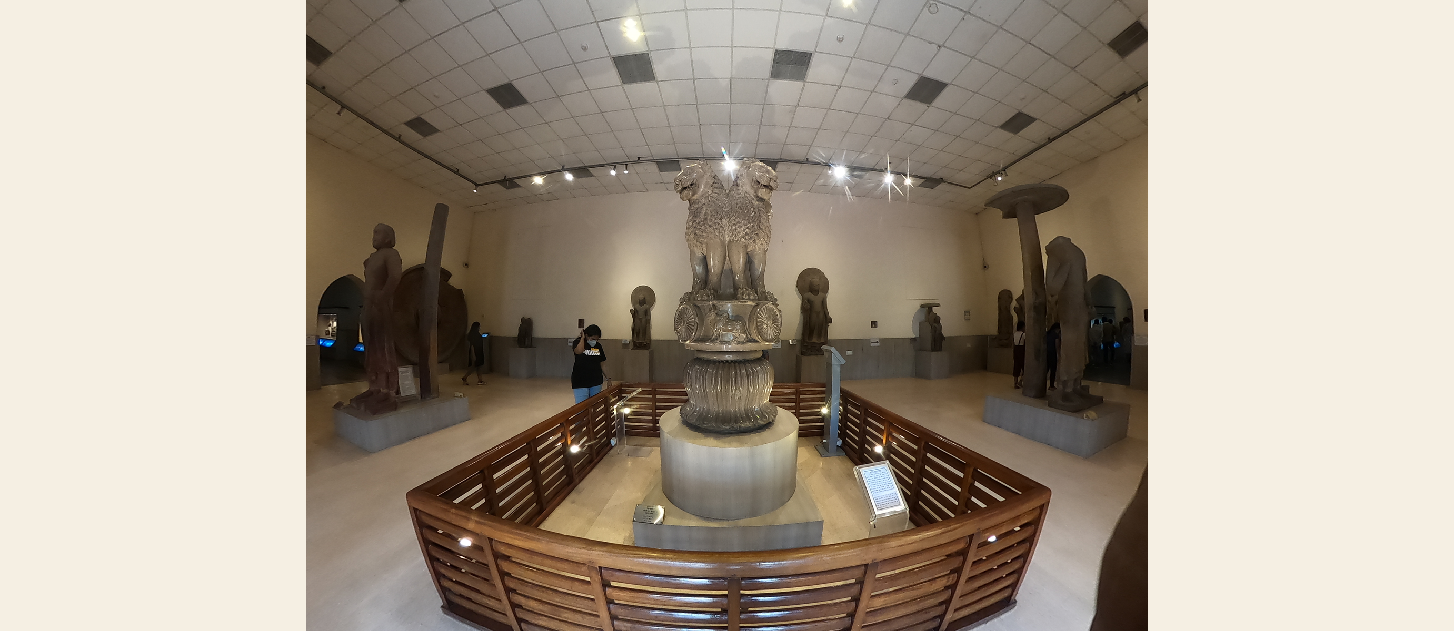
The Lion Capital of Ashoka (Sarnath)
The Lion Capital of Ashoka, now in the Sarnath Museum - India's national emblem.
© More Lessons Less Planning | morelessonslessplanning.com
Notes:
Public-domain (CC0) photograph of the Lion Capital of Ashoka displayed in the Sarnath Museum. This four-lion sculpture once topped one of Ashoka's pillars and is today India's national emblem; the wheel below the lions (the Ashoka Chakra) appears on India's flag. Point it out as a surviving piece of Ashoka's edict-pillars.
Reference labels (point to these chart features when teaching): Four lions; Wheel of dharma

Slide 11
Ashoka's Legacy
Lion Capital
The four-lion sculpture from his pillar at Sarnath is now India's national emblem.
✔
Missionaries
Ashoka sent missionaries to other lands, helping Buddhism spread across Asia.
✔
A model ruler
He is remembered as a rare ruler who chose mercy, tolerance, and welfare over conquest.
✔
Did You Know? The LION CAPITAL is India's national emblem, and its wheel - the Ashoka Chakra - is on India's flag.
© More Lessons Less Planning | morelessonslessplanning.com
Notes:
Ashoka's legacy outlived his empire. The LION CAPITAL - the four-lion sculpture that topped his pillar at Sarnath - is today India's national emblem, and the wheel beneath it appears on India's flag. Ashoka also sent MISSIONARIES - people who spread the teachings of Buddhism - to other lands, including Sri Lanka, helping Buddhism grow into a major world religion. He is remembered as one of history's rare rulers who chose mercy, tolerance, and the welfare of his people over endless conquest.

Slide 12
Key Takeaways
Ashoka ruled the Mauryan Empire at its greatest size across most of India.
★
The slaughter of the Kalinga War filled him with remorse and changed him.
★
He adopted Buddhism and ahimsa and chose conquest by dharma, not the sword.
★
His edicts and the Lion Capital are our main evidence for his reign.
★
© More Lessons Less Planning | morelessonslessplanning.com
Notes:
Recap the four takeaways. The big ideas: Ashoka was a mighty conqueror whom the Kalinga War transformed; he ruled by dharma and non-violence instead of force; and we know his story mainly from his own edicts carved in stone.

