Slide 1
America Enters the War
How submarine warfare, a secret telegram, and $2.3 billion in loans ended American neutrality
© More Lessons Less Planning | morelessonslessplanning.com
Notes:
Open with the lesson question: the United States spent nearly three years insisting it was neutral, so what finally changed? Preview the arc: what neutrality meant on paper, how the submarine war at sea kept killing Americans, how trade and loans quietly tied the country to the Allies, what the Zimmermann Telegram proposed, and how Wilson made his case to Congress on April 2, 1917.

Slide 2
Learning Targets
Explain what American neutrality meant and why it was hard to keep.
★
Describe unrestricted submarine warfare and the sinking of the Lusitania.
★
Explain what the Zimmermann Telegram proposed and why it alarmed Americans.
★
Describe how American trade and loans tied the United States to the Allies.
★
Analyze Wilson's April 1917 war message and what U.S. entry meant for the war.
★
© More Lessons Less Planning | morelessonslessplanning.com
Notes:
Read the five targets aloud. Flag target 5: students will read Wilson's actual April 2, 1917 war message to Congress in the Primary Source Spotlight, not a summary of it.

Slide 3
Neutral in Name: America, 1914-1916
In August 1914 President Wilson declared American neutrality.
Neutrality means taking no side and joining neither alliance.
Wilson urged Americans to stay impartial in thought and action.
Millions of German and Irish Americans opposed helping Britain.
But American factories and banks kept trading across the Atlantic.
Key Concept: Neutrality is a legal position - it does not mean a country is uninvolved.
© More Lessons Less Planning | morelessonslessplanning.com
Notes:
When war broke out in Europe in August 1914, President Wilson declared American neutrality. Neutrality means taking no side and joining neither alliance. Wilson went further and urged Americans to stay impartial in thought and action - a hard request in a nation of immigrants, where millions of German Americans and Irish Americans openly opposed helping Britain. But neutrality was a legal position, not a wall. American factories and banks kept trading across the Atlantic, and that trade is where the trouble began.

Slide 4
The U-Boat War at Sea
Britain's Blockade at the Surface
Germany's Answer Below the Waves
The Royal Navy blockaded Germany with surface warships.
Ships were stopped and searched, but crews usually survived.
Britain seized contraband - war supplies bound for the enemy.
Germany's weapon was the U-boat, an undersea raider.
A surfaced U-boat was fragile and easily rammed or shelled.
So U-boats struck from below, without warning.
Did You Know: U-boat comes from Unterseeboot - German for undersea boat.
© More Lessons Less Planning | morelessonslessplanning.com
Notes:
Both sides tried to cut off the other's supplies, but they used opposite tools. Britain had the world's largest surface fleet, so the Royal Navy blockaded Germany with surface warships: ships were stopped and searched, cargo judged, and contraband - war supplies bound for the enemy - was seized. Crews usually survived. Germany could not match that fleet, so its weapon was the U-boat, an undersea raider. A surfaced U-boat was fragile and easily rammed or shelled by even a lightly armed merchant ship, so U-boats struck from below, without warning. That single tactical fact created the legal and moral crisis that followed.

Slide 5
The Lusitania, May 7, 1915
A German U-boat torpedoed the liner Lusitania off Ireland.
Nearly 1,200 passengers and crew died, including 128 Americans.
Germany said the ship carried rifle cartridges as contraband.
Americans saw civilians killed without warning.
Wilson sent strong protests but did not ask for war.
Note: The Lusitania did not bring America into the war - it shifted opinion for two years.
© More Lessons Less Planning | morelessonslessplanning.com
Notes:
On May 7, 1915 a German U-boat torpedoed the British liner Lusitania off the coast of Ireland. Nearly 1,200 passengers and crew died, including 128 Americans. Germany said the ship carried rifle cartridges as contraband, and the manifest did list munitions - but what Americans saw was civilians killed without warning. Wilson sent strong protests but did not ask for war. Keep the sequence precise: the Lusitania did not bring America into the war in 1915. It shifted American opinion, and that shift is what made 1917 possible.

Slide 6
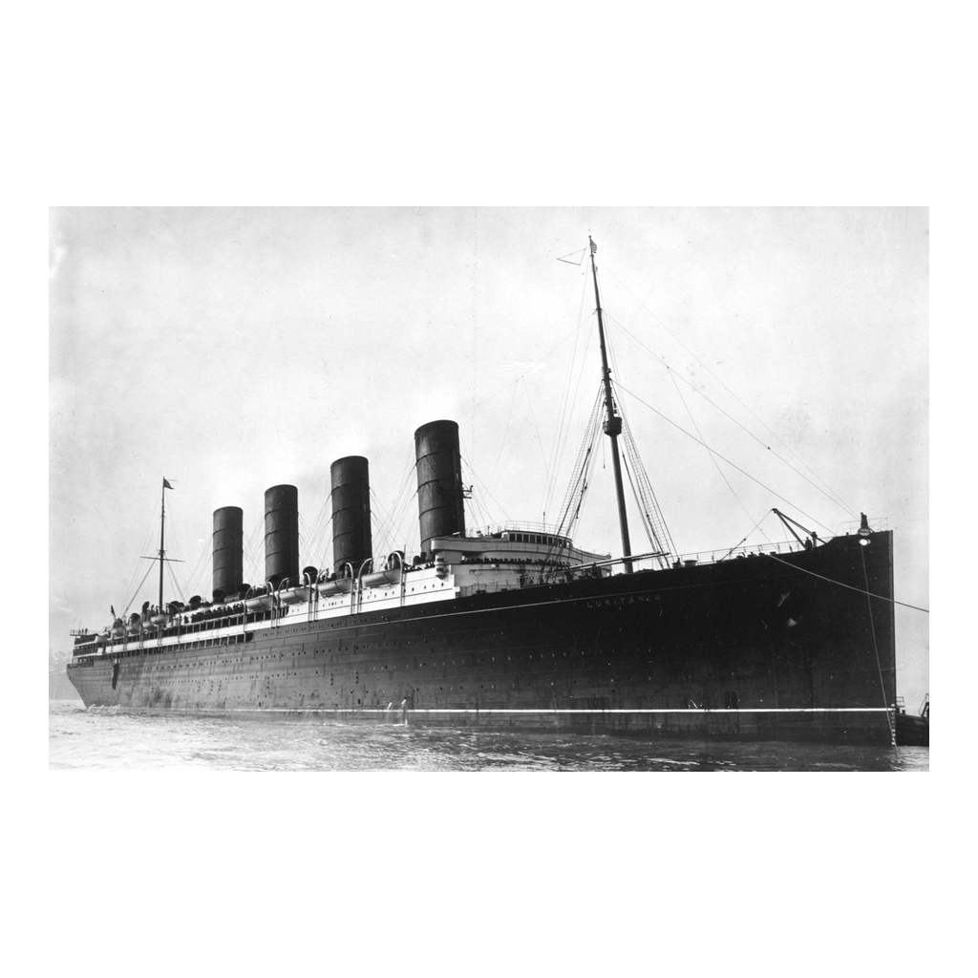
The Lusitania in Port
RMS Lusitania entering port, photographed between 1907 and 1913
© More Lessons Less Planning | morelessonslessplanning.com
Notes:
This Library of Congress photograph shows the Lusitania entering port sometime between 1907 and 1913, years before the sinking. Use it to make the scale concrete: this was a four-funnel express liner carrying almost two thousand people, not a warship. That is precisely why the sinking landed the way it did in American newspapers.

Slide 7
Warnings and Promises, 1915-1916
The Arabic Pledge, 1915
The Sussex Pledge, 1916
Why Berlin Agreed
Another liner sunk; Americans among the dead
Germany promised no surprise attacks on liners
Protests won a limit, not an end
A French ferry torpedoed; Americans injured
Germany pledged to warn ships before sinking
The promise held about nine months
Germany feared American entry into the war
The U-boat fleet was still small in 1916
Delay bought time to build more submarines
Key Concept: Each pledge bought peace by promising to fight the war a different way.
© More Lessons Less Planning | morelessonslessplanning.com
Notes:
Between the Lusitania and 1917, two American protests produced two German promises. After the liner Arabic was sunk in August 1915 with Americans among the dead, Germany promised no surprise attacks on liners - the Arabic Pledge. After the French ferry Sussex was torpedoed in 1916 and Americans were injured, Germany pledged to warn ships before sinking them: the Sussex Pledge, which held about nine months. Berlin agreed because Germany feared American entry into the war, the U-boat fleet was still small in 1916, and delay bought time to build more submarines. Each pledge bought peace by promising to fight the war a different way - never by stopping.

Slide 8
Money and Munitions: Tied to the Allies
What America Sent | How Much
Trade with the Allies, 1914-1916 | Rose from about $825 million to $3.2 billion
Trade with Germany, 1914-1916 | Fell from about $169 million to nearly nothing
Private loans to the Allies | About $2.3 billion by April 1917
Private loans to Germany | About $27 million
Reason for the gap | Britain's blockade cut Germany off from U.S. ports
Tip: Neutral on paper, the U.S. economy was deeply invested in an Allied victory.
© More Lessons Less Planning | morelessonslessplanning.com
Notes:
Follow the money, because this is the quiet cause students usually miss. American trade with the Allies rose from about $825 million to $3.2 billion between 1914 and 1916, while trade with Germany fell from about $169 million to nearly nothing. American banks lent the Allies about $2.3 billion by April 1917, against about $27 million to Germany. The reason for the gap is not sympathy but geography and sea power: Britain's blockade cut Germany off from U.S. ports. Still, the effect was real - neutral on paper, the U.S. economy was deeply invested in an Allied victory, and an Allied defeat would have meant enormous American losses.

Slide 9
January 1917: Germany Gambles
On January 31, 1917 Germany announced unrestricted submarine warfare.
Any ship in the war zone would be sunk without warning.
Germany knew this could bring America into the war.
The bet: starve Britain into surrender in about five months.
Wilson broke off diplomatic relations on February 3, 1917.
Key Concept: Germany chose to risk American entry rather than lose slowly at sea.
© More Lessons Less Planning | morelessonslessplanning.com
Notes:
On January 31, 1917 Germany announced unrestricted submarine warfare, abandoning the Sussex Pledge. Any ship in the war zone would be sunk without warning - neutral, passenger, or merchant. German commanders knew this could bring America into the war; they made the bet anyway, calculating they could starve Britain into surrender in about five months, before American troops could arrive in force. Wilson broke off diplomatic relations on February 3, 1917. This is the decision point: Germany chose to risk American entry rather than lose slowly at sea.

Slide 10
The Zimmermann Telegram
What the Message Said
How America Found Out
Sent in January 1917 by foreign secretary Arthur Zimmermann.
It proposed a German alliance with Mexico if the U.S. entered the war.
Mexico was offered Texas, New Mexico, and Arizona.
British code-breakers in Room 40 intercepted and decoded it.
Britain passed the decoded text to Washington in February.
It was published March 1, 1917; Zimmermann admitted it was real.
Did You Know: Zimmermann confirmed the telegram himself, ending claims it was a British forgery.
© More Lessons Less Planning | morelessonslessplanning.com
Notes:
In January 1917 German foreign secretary Arthur Zimmermann sent a coded telegram proposing a German alliance with Mexico against the United States if America entered the war. In return, Mexico was offered Texas, New Mexico, and Arizona - territory Mexico lost to the United States in the nineteenth century. British code-breakers in Room 40 intercepted and decoded it, and Britain passed the decoded text to Washington in February. It was published on March 1, 1917. Many Americans initially suspected a British forgery designed to drag them in - until Zimmermann confirmed the telegram himself. That admission removed the last doubt, and it turned the American Southwest into a region with a direct stake in a European war.

Slide 11
April 2, 1917: Wilson Goes to Congress
Wilson addressed a joint session of Congress on April 2, 1917.
He called submarine warfare a warfare against mankind.
He argued that armed neutrality had become impracticable.
He said the world must be made safe for democracy.
He asked Congress to declare Germany's course to be war.
Note: Students read this war message in the Activity's Primary Source Spotlight.
© More Lessons Less Planning | morelessonslessplanning.com
Notes:
On the evening of April 2, 1917 Wilson addressed a joint session of Congress. His argument had three moves. First, the facts: ships of every kind sunk without warning, so the present German submarine warfare against commerce is a warfare against mankind. Second, the options: he had tried arming merchant ships, but armed neutrality had become impracticable because a submarine cannot be defended against by conventional means. Third, the purpose: the world must be made safe for democracy - framing the war as a defense of self-government rather than a quarrel over cargo. He then asked Congress to declare Germany's course to be war. Students read this address themselves in the Primary Source Spotlight.

Slide 12
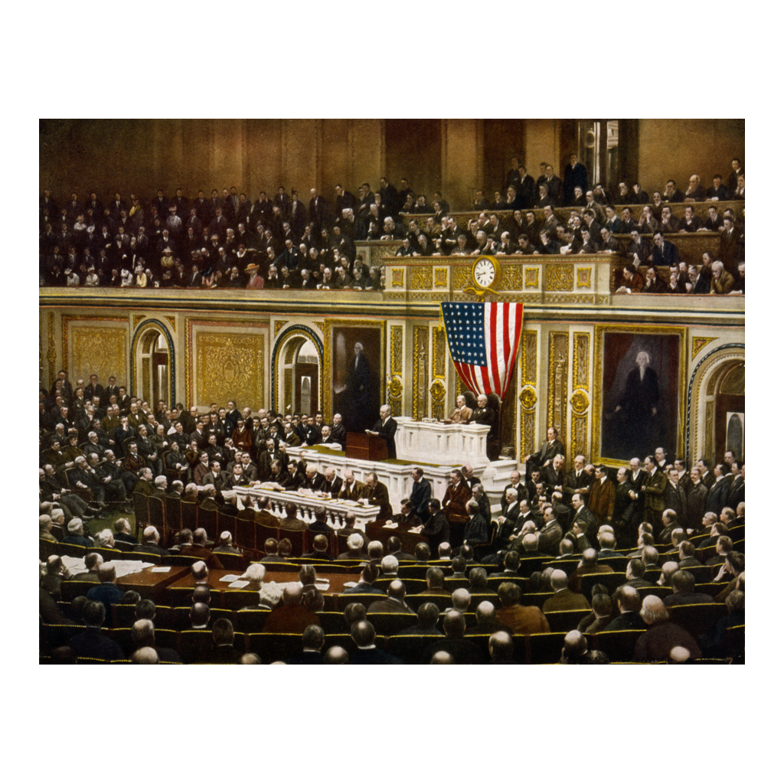
Wilson Before the Joint Session
Wilson's war message to Congress, April 2, 1917 (period color print)
© More Lessons Less Planning | morelessonslessplanning.com
Notes:
This is a contemporary color print held by the Library of Congress under the title "For the freedom of the world," published in 1917-18. It shows the moment itself: Wilson at the rostrum of the House chamber delivering the war message to a joint session on April 2, 1917. Point out the packed chamber - senators, representatives, the cabinet, and the Supreme Court were all present - and the flag hung beneath the clock. Worth naming out loud that this is a published print rather than a news photograph: it was made and sold to celebrate the moment, which is itself a small lesson in how sources are produced. The address being delivered in this image is the one students read an excerpt from in the Primary Source Spotlight.

Slide 13
From Message to Declaration
April 2, 1917
Wilson delivers the war message to a joint session of Congress.
✔
April 4, 1917
The Senate votes 82 to 6 in favor of war.
✔
April 6, 1917
The House votes 373 to 50; Wilson signs the declaration of war.
✔
The dissenters
Jeannette Rankin, the first woman in Congress, votes no.
✔
May 18, 1917
The Selective Service Act begins the wartime draft.
✔
Did You Know: About 4.7 million Americans served in the war; roughly 2.8 million were drafted.
© More Lessons Less Planning | morelessonslessplanning.com
Notes:
Walk the timeline. On April 2, 1917 Wilson delivers the war message to a joint session of Congress. On April 4 the Senate votes 82 to 6 in favor of war. On April 6 the House votes 373 to 50, and Wilson signs the declaration of war that day. The votes were lopsided but not unanimous: Jeannette Rankin of Montana, the first woman in Congress, votes no - one of fifty-six members of Congress who voted against. On May 18 the Selective Service Act begins the wartime draft, because an army of roughly 130,000 regulars could not fight a European war.

Slide 14
What American Entry Meant
Money and Supplies
Ships and Convoys
Fresh Soldiers
U.S. government loans replaced private credit
Food, steel, and munitions flowed to the Allies
Britain and France avoided financial collapse
The U.S. Navy joined the convoy system
Merchant losses to U-boats fell sharply
The Atlantic supply line held
American Expeditionary Forces sailed under Pershing
About 2 million Americans in France by late 1918
Fresh troops offset the collapse of Russia
Key Concept: American entry changed the arithmetic of the war before it changed the battlefield.
© More Lessons Less Planning | morelessonslessplanning.com
Notes:
American entry mattered in three ways, and the first two mattered before a single American soldier fought. Money and supplies: U.S. government loans replaced private credit, food, steel, and munitions flowed to the Allies, and Britain and France avoided financial collapse in 1917. Ships and convoys: the U.S. Navy joined the convoy system, merchant losses to U-boats fell sharply, and the Atlantic supply line held - which is exactly what Germany's five-month gamble needed to break. Fresh soldiers: the American Expeditionary Forces sailed under General John J. Pershing, about 2 million Americans reached France by late 1918, and those fresh troops offset the collapse of Russia, which left the war after its 1917 revolutions. American entry changed the arithmetic of the war before it changed the battlefield.

Slide 15
Reference Guide: Neutrality and the War at Sea
Neutrality
A nation's policy of taking no side in a war and joining neither alliance.
Unrestricted submarine warfare
Germany's policy of sinking any ship in the war zone without warning, including neutral and passenger ships.
U-boat
A German submarine; the name comes from Unterseeboot, meaning undersea boat.
Lusitania
The British passenger liner torpedoed by a German U-boat on May 7, 1915, killing 128 Americans.
Sussex Pledge
Germany's 1916 promise to warn merchant and passenger ships before sinking them.
Tip: These five terms cover American neutrality and the submarine war at sea.
© More Lessons Less Planning | morelessonslessplanning.com
Notes:
These are the five terms for the first half of the lesson. Neutrality is the policy of taking no side in a war and joining neither alliance. Unrestricted submarine warfare is Germany's policy of sinking any ship in the war zone without warning, including neutral and passenger ships. A U-boat is a German submarine; the name comes from Unterseeboot, meaning undersea boat. The Lusitania was the British passenger liner torpedoed by a German U-boat on May 7, 1915, killing 128 Americans. The Sussex Pledge was Germany's 1916 promise to warn merchant and passenger ships before sinking them.

Slide 16
Reference Guide: The Break and the Declaration
Zimmermann Telegram
A January 1917 German message offering Mexico an alliance and three American states if the U.S. entered the war.
Contraband
War supplies a warring nation may seize when a neutral ships them to its enemy.
Belligerent
A nation officially at war - the opposite of a neutral.
War message
Wilson's April 2, 1917 address asking Congress to declare war.
American Expeditionary Forces
The U.S. army sent to fight in Europe under General Pershing.
Tip: These five terms cover the break with Germany and the April 1917 declaration.
© More Lessons Less Planning | morelessonslessplanning.com
Notes:
These are the five terms for the second half of the lesson. The Zimmermann Telegram is a January 1917 German message offering Mexico an alliance and three American states if the U.S. entered the war. Contraband is war supplies a warring nation may seize when a neutral ships them to its enemy. A belligerent is a nation officially at war - the opposite of a neutral. The war message is Wilson's April 2, 1917 address asking Congress to declare war. The American Expeditionary Forces were the U.S. army sent to fight in Europe under General Pershing.

Slide 17
Key Takeaways
America was legally neutral from 1914 but economically tied to the Allies.
★
Unrestricted submarine warfare killed Americans and made neutrality costly.
★
The Lusitania shifted opinion in 1915; the 1917 U-boat campaign forced action.
★
The Zimmermann Telegram made the threat feel close to home.
★
Wilson's April 1917 war message turned the U.S. from neutral into belligerent.
★
© More Lessons Less Planning | morelessonslessplanning.com
Notes:
Close by putting the causes in order of weight rather than of date. Ask students which mattered most: the submarine campaign that killed Americans, the economic ties that made an Allied defeat costly, or the Zimmermann Telegram that made the threat local. Then push further - Wilson framed the war as making the world safe for democracy. Was that the reason, or the justification? That question is the Activity's final verdict.

