Slide 1
Amazon Warehouses: Working Conditions Investigation
Productivity quotas, injury data, and the JFK8 union win
© More Lessons Less Planning | morelessonslessplanning.com
Notes:
Open with the question: how did one Staten Island warehouse become the first successful Amazon union in U.S. history?

Slide 2
Learning Targets
Describe working conditions and quotas in Amazon fulfillment centers
★
Trace the JFK8 (Staten Island) unionization win of April 1, 2022
★
Evaluate Amazon's response and how to read disputed injury data
★
© More Lessons Less Planning | morelessonslessplanning.com
Notes:
Read the three targets aloud. Target 3 is the highest-order task and frames Activity Part 5.

Slide 3
Setting the Stage - Why Amazon's Warehouses Are Under Scrutiny
WHAT HAPPENED
WHY IT MATTERS
Amazon is the 2nd-largest U.S. private employer
Workers report 10-hour shifts under productivity quotas
Injury rates ~2x non-Amazon warehousing average
JFK8 Staten Island unionized April 1, 2022
1.5+ million U.S. Amazon employees as of 2024
Sets the floor for modern warehouse labor norms
Algorithmic management is spreading across industries
JFK8 = first successful Amazon union in U.S. history
Key Concept: Amazon's labor practices set the floor for modern warehouse work. JFK8 was the first crack in its union-free streak.
© More Lessons Less Planning | morelessonslessplanning.com
Notes:
Frame the lesson: Amazon is too big to ignore. Its labor practices shape warehouse norms across the U.S. economy.

Slide 4
Inside a Fulfillment Center - What 'JFK8' Means
Fulfillment center
Amazon's name for its warehouse. Each is named after the nearest airport code + a number. JFK8 is the 8th fulfillment center tied to JFK airport.
JFK8
The Staten Island, NY fulfillment center that unionized April 1, 2022. ~8,300 workers when the union vote happened. ~1 million sq ft.
LDJ5
Also on Staten Island, across the street from JFK8. ~1,500 workers. Voted NO on the union in May 2022 (62% NO).
ALB1
Albany, NY fulfillment center. ~400 workers. Voted NO on the union in October 2022 (67% NO).
Tip: Center codes use the nearest airport - JFK (NYC), LDJ (LGA aux), ALB (Albany), ONT (Ontario CA). Number = which center at that hub.
© More Lessons Less Planning | morelessonslessplanning.com
Notes:
Define what a 'fulfillment center' is and decode the JFK8/LDJ5/ALB1 codes students will hear repeatedly.

Slide 5
The Rate - How UPH and TOT Work
~300
Auto
items/hour scan rate (UPH)
termination - no manager review
TOT (time off task): Tracks any time NOT scanning. Includes bathroom breaks.
The pressure: Workers skip bathroom breaks to avoid TOT triggers.
Why it matters: The Rate is the #1 grievance in organizing drives.
Did You Know? Amazon's system can auto-terminate a worker for sustained TOT without a manager review. The algorithm is the manager.
© More Lessons Less Planning | morelessonslessplanning.com
Notes:
Lock down what The Rate is and how TOT enforces it. Algorithmic management = the system, not a human, sets and enforces the quota.

Slide 6
The Injury Data Debate - Two Framings
THE UNION FRAMING
AMAZON'S COUNTER-FRAMING
Amazon recordable rate ~2x industry average
OSHA Form 300A logs analyzed by SOC (2023)
Ergonomic injuries from repetitive lifting/scanning
DART rate (lost workdays) also higher at Amazon
'General warehousing' is the wrong comparison group
Amazon classifies MORE incidents as recordable
Cites year-over-year safety improvements internally
Compares to peer e-commerce, not general warehouses
Tip: BOTH framings are partly true. The chart on the next slide shows the raw gap; the slide after that shows Amazon's methodology dispute.
© More Lessons Less Planning | morelessonslessplanning.com
Notes:
Set up the injury data carefully. Present BOTH the union framing (rate gap) AND Amazon's counter (methodology dispute). The chart slide shows the data; the slide after shows Amazon's response.

Slide 7
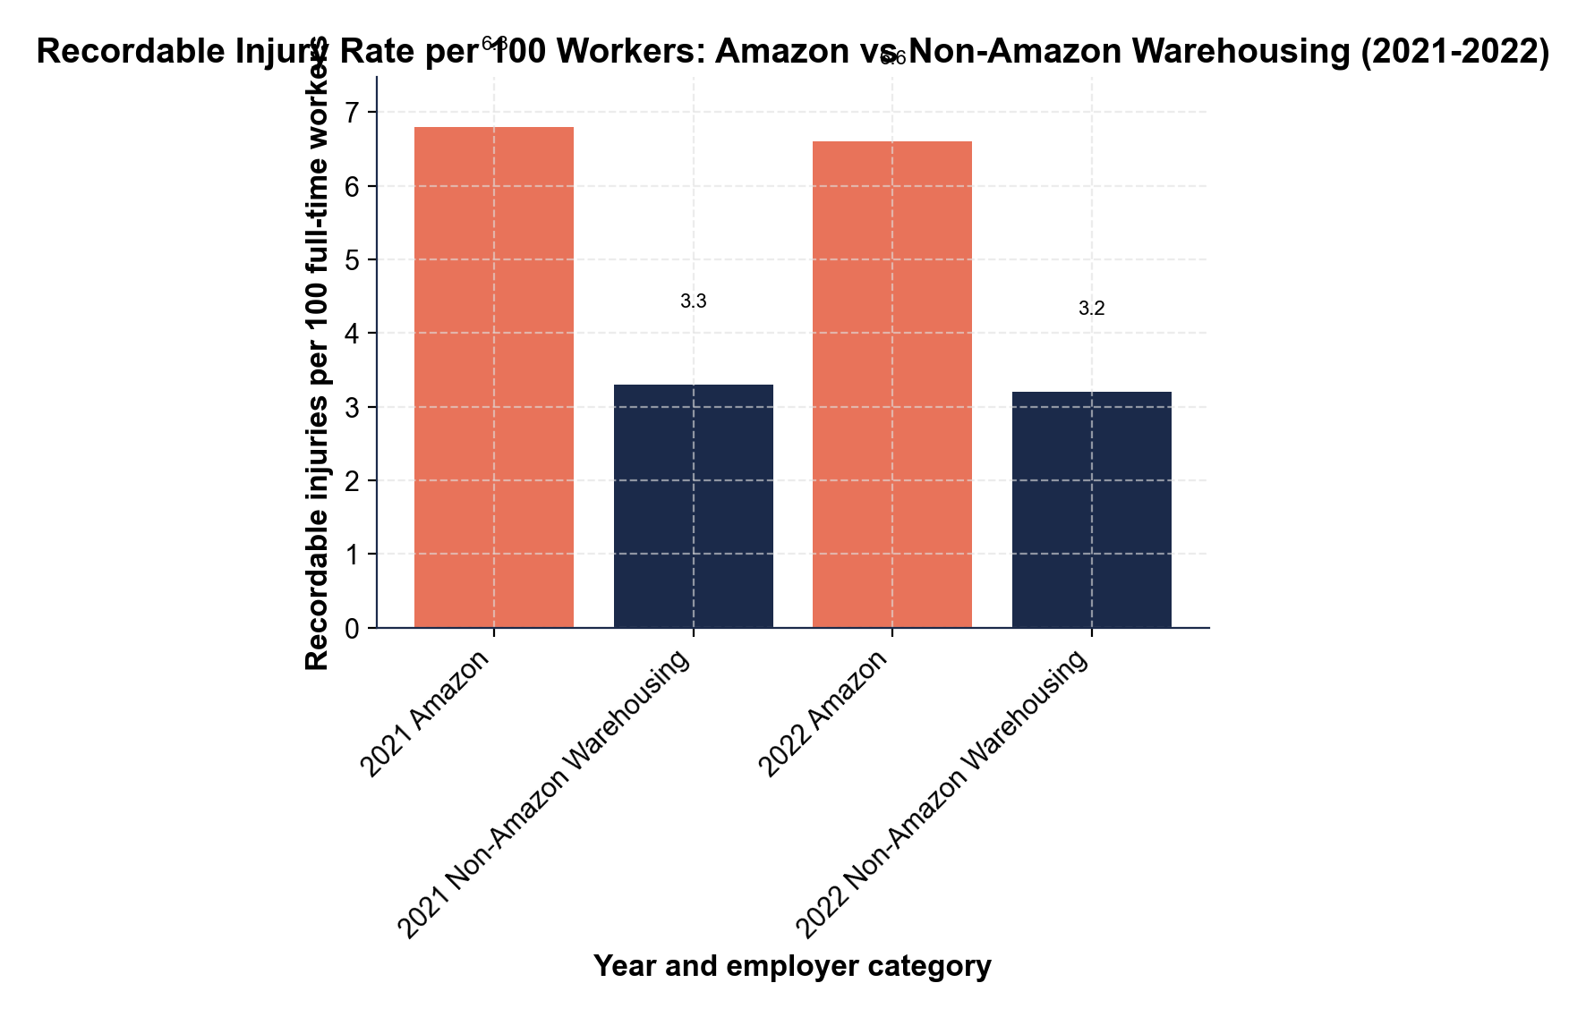
Chart 1 - Amazon vs Industry Injury Rates
2021 Amazon: 6.8 per 100. Non-Amazon 2021: 3.3. Roughly double.
© More Lessons Less Planning | morelessonslessplanning.com
Notes:
Stimulus chart 1. Bar chart of Amazon vs non-Amazon warehousing recordable injury rates 2021-2022. Amazon coral; non-Amazon navy. Students will use these values in Activity Part 3.
Reference labels (point to these chart features when teaching): Amazon 2022: 6.6/100; Non-Amazon 2022: 3.2/100

Slide 8
Reading Chart 1 - What the Gap Means
2021 Amazon: 6.8 recordable injuries per 100 workers
2021 Non-Amazon warehousing: 3.3 per 100 - less than half
2022 Amazon: 6.6 per 100 - small year-over-year improvement
2022 Non-Amazon: 3.2 per 100 - the gap remained ~2x
Source: OSHA Form 300A + BLS SOII data (2022)
Key Concept: Amazon's rate is roughly DOUBLE non-Amazon warehousing in both years. Whether the gap is FAIR is the methodology dispute.
© More Lessons Less Planning | morelessonslessplanning.com
Notes:
Read the chart values aloud. The 2x gap is the headline; Amazon disputes it on methodology grounds (next slide).

Slide 9
Amazon's Counter-Argument - The Methodology Dispute
AMAZON SAYS
AMAZON CITES
STILL DEBATED
Wrong comparison group ('general warehousing')
Peer = e-commerce/fulfillment, not all warehousing
We classify MORE as recordable (more rigorous)
Year-over-year DART rate declines
$1 billion+ invested in safety equipment 2019-2023
Internal injury rate by site shows improvement
OSHA 300A is the federal standard for comparison
Stricter reporting can mask quota-driven injuries
Independent audits would settle it - none agreed to
Warning: BOTH framings have evidence. The 2x rate gap is real on OSHA's metric. Amazon's methodology dispute is also real. You decide.
© More Lessons Less Planning | morelessonslessplanning.com
Notes:
Present Amazon's full counter-argument fairly. This is the data-literacy moment - students must hold both framings at once.

Slide 10
Chris Smalls and the ALU - How JFK8 Got Organized
WHO STARTED IT
HOW HE ORGANIZED
Chris Smalls - fired Amazon JFK8 worker (March 2020)
Fired after organizing a COVID safety walkout
Founded the Amazon Labor Union (ALU) in 2021
ALU = INDEPENDENT - no Teamsters, no SEIU backing
Set up tables outside the JFK8 bus stop
Cooked food for night-shift workers
Used TikTok + GoFundMe instead of union staff
Filed for NLRB election October 2021
Did You Know? Smalls organized JFK8 with NO support from any established U.S. union. The ALU raised most of its budget through small online donations.
© More Lessons Less Planning | morelessonslessplanning.com
Notes:
The Smalls origin story is part of why JFK8 won. Independent worker-led organizing was the key strategic choice.

Slide 11
The JFK8 Vote - April 1, 2022
2,654
2,131
YES (~55%) - JFK8 unionized
NO (~45%)
Vote date: April 1, 2022 - FIRST Amazon union in U.S. history
Workforce: ~8,300 workers eligible to vote
Bargaining unit: ALU certified after 25+ Amazon objections
Key Concept: 55% to 45% is a clear win - but not a landslide. Amazon's well-funded anti-union campaign almost worked.
© More Lessons Less Planning | morelessonslessplanning.com
Notes:
Lock down the date (April 1, 2022) and the vote (2,654 YES vs 2,131 NO). This is the load-bearing fact for the rest of the lesson.

Slide 12
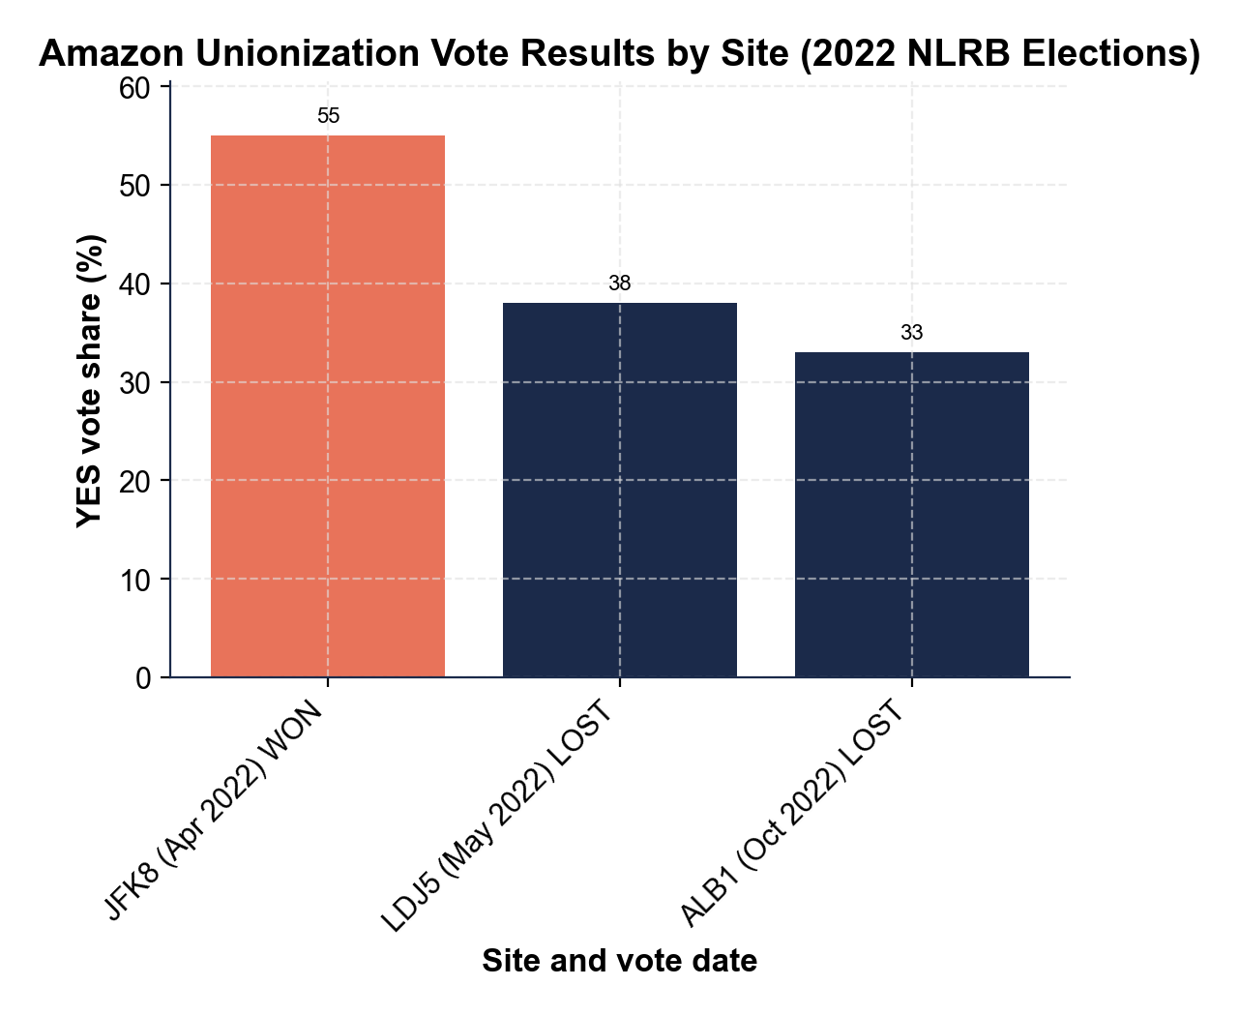
Chart 2 - Amazon Unionization Vote Results by Site
JFK8: 55% YES (WON). LDJ5: 38% YES. ALB1: 33% YES.
© More Lessons Less Planning | morelessonslessplanning.com
Notes:
Stimulus chart 2. Bar chart of three 2022 Amazon NLRB votes. JFK8 coral (WON); LDJ5 and ALB1 navy (LOST). Students will use these values in Activity Part 3.
Reference labels (point to these chart features when teaching): JFK8 WON: 55% YES; LDJ5/ALB1 LOST

Slide 13
Reading Chart 2 - Why JFK8 Won Where Others Lost
JFK8 (Apr 2022): 55% YES - first Amazon union ever
LDJ5 (May 2022): 38% YES - LOST by 24 percentage points
ALB1 (Oct 2022): 33% YES - LOST by 34 percentage points
JFK8 = OUTLIER. The next 2 votes both lost decisively.
Differentiator: Smalls + ALU built JFK8-specific worker network
Tip: A 22-point gap separates JFK8 (55% YES) from ALB1 (33% YES). Site-specific organizing strength - not industry momentum - made JFK8 different.
© More Lessons Less Planning | morelessonslessplanning.com
Notes:
Read the chart values aloud. JFK8 is the outlier; LDJ5 and ALB1 lost decisively in 2022. Each site needs its own organizing campaign.

Slide 14
Amazon's Response - NLRB Challenges and Consultants
Filed 25+ NLRB objections to overturn the JFK8 vote
All objections rejected after months of legal review
Spent ~$14.2 million on union avoidance consultants in 2022 (LM-10)
Has NOT signed a contract with ALU as of late 2024
Closed several union-friendly Quebec warehouses in 2025
Warning: Winning the VOTE is step 1. Getting Amazon to sign a contract is step 2 - and that fight is still ongoing in 2025.
© More Lessons Less Planning | morelessonslessplanning.com
Notes:
Amazon's response: legal challenges + consultants + delay tactics. Contract negotiation with the ALU is still pending.

Slide 15
What JFK8 Means for Modern Labor
WHAT JFK8 PROVED
WHAT IT DID NOT PROVE
STILL TO BE SEEN
Amazon CAN be unionized at a single site
Worker-led + independent unions can win
TikTok + GoFundMe can replace union staff funding
Industry-wide momentum (LDJ5 + ALB1 both lost)
Amazon will negotiate (no contract signed yet)
Other Amazon sites will copy the JFK8 strategy
Will ALU get a first contract before 2026?
Will Teamsters/SEIU back future Amazon votes?
Will OSHA mandate quota disclosure rules?
Key Concept: JFK8 cracked the union-free record but did NOT change Amazon's overall labor model. The follow-through fight is the harder one.
© More Lessons Less Planning | morelessonslessplanning.com
Notes:
Set up the activity Part 5 synthesis question. JFK8 proved unionization is possible but the bargaining fight + industry-wide effect is still open.

Slide 16
Looking Ahead - Other Sites Still Organizing
We just made history. The next thing is the contract.
— Chris Smalls, after the April 1, 2022 JFK8 vote
Tip: The Smalls quote is the lesson - the VOTE was the easy part. Getting Amazon to a CONTRACT is the harder, longer fight.
© More Lessons Less Planning | morelessonslessplanning.com
Notes:
Where things stand now. JFK8 is still negotiating its first contract. Other sites still organizing with mixed results.

Slide 17
Vocabulary Glossary 1 - Workplace and Quotas
Fulfillment center
Amazon's term for its warehouse facility (JFK8, LDJ5, ALB1). Code = nearest airport + number.
Time off task (TOT)
Automated tracking of any time NOT scanning. Includes bathroom breaks. Sustained TOT can auto-terminate.
OSHA recordable injury
Workplace injury needing time off, restricted duty, or medical treatment beyond first aid. Tracked on Form 300A.
DART rate
Days Away, Restricted, or Transferred - a BLS injury metric. A subset of recordable injuries. Amazon cites YoY declines.
Tip: These four terms cover the WORKPLACE side of the lesson - what Amazon warehouses look like and how injuries get measured.
© More Lessons Less Planning | morelessonslessplanning.com
Notes:
Vocabulary glossary part 1. Covers the workplace + injury-reporting vocabulary so students can pop the Reference Guide and Synthesis Brief.

Slide 18
Vocabulary Glossary 2 - Union and Legal Terms
NLRB
National Labor Relations Board - federal agency supervising union elections. Conducted the JFK8 vote April 1, 2022.
Union election
Formal NLRB-supervised vote where workers decide whether to be represented by a union. 30% to file; simple majority wins.
Union avoidance consultant
Paid consultants employers hire to discourage unionizing. Legal but must be reported via DOL Form LM-10. Amazon: ~$14.2M in 2022.
Collective bargaining
Legally protected process where a union negotiates wages, benefits, and conditions for ALL workers at once - backed by the NLRA of 1935.
Tip: These four terms cover the LEGAL + UNION side - the process Chris Smalls and the ALU used to get recognized at JFK8 on April 1, 2022.
© More Lessons Less Planning | morelessonslessplanning.com
Notes:
Vocabulary glossary part 2. Covers the legal + union vocabulary so students can pop the Reference Guide and write the synthesis brief on regulation.

Slide 19
Key Takeaways - Synthesis
Takeaway 1: Amazon's injury rate is ~2x non-Amazon warehousing (OSHA data)
Takeaway 2: JFK8 won April 1, 2022 - first Amazon union (55% YES)
Takeaway 3: LDJ5 + ALB1 BOTH LOST - JFK8 is an outlier, not a trend
Algorithmic management (The Rate, TOT) is spreading beyond Amazon
The fight now is the CONTRACT - Amazon has not signed one yet
Key Concept: JFK8 proved Amazon CAN be unionized at one site. It did NOT prove Amazon WILL be unionized broadly. The contract fight continues.
© More Lessons Less Planning | morelessonslessplanning.com
Notes:
Synthesis. Three takeaways frame the activity Part 5 brief. JFK8 was a crack in the union-free streak, not a wall coming down.

