Slide 1
Alliances and the Causes of WWI
How a treaty system, an arms race, and an assassination pulled Europe into war
© More Lessons Less Planning | morelessonslessplanning.com
Notes:
Open with the lesson question: how did a single assassination in the Balkans draw five of the six great powers into war within weeks? Preview the arc: the alliance system, militarism, nationalism, the assassination, the July Crisis, and the alliance chain reaction of August 1914.

Slide 2
Learning Targets
Explain how the alliance system divided Europe into two competing blocs by 1914.
★
Describe the mutual-defense terms of the Triple Alliance and the Triple Entente.
★
Analyze how militarism and nationalism raised tension among the great powers.
★
Explain how Franz Ferdinand's assassination triggered the July Crisis.
★
Evaluate how alliances turned a regional crisis into a continental war.
★
© More Lessons Less Planning | morelessonslessplanning.com
Notes:
Read the targets aloud. Targets 1-2 build the diplomatic structure (alliances), target 3 builds the underlying tensions (militarism, nationalism), targets 4-5 build the crisis and its outcome. Students will need all five for the Part 5 verdict.

Slide 3
Europe in 1900: A Continent of Great Powers
By 1900, six major powers competed for influence across Europe.
Britain, France, Germany, Austria-Hungary, Russia, and Italy led the continent.
Each power built its economy, empire, and military to rival the others.
No single treaty bound all six powers together as one system - yet.
Smaller Balkan states had far less say over their own national affairs.
Key Concept: A Great Power is a nation with enough military and economic strength to shape events.
© More Lessons Less Planning | morelessonslessplanning.com
Notes:
By 1900, six major European powers - Britain, France, Germany, Austria-Hungary, Russia, and Italy - competed for economic, colonial, and military influence. Each built up its economy, its overseas empire, and its armed forces to keep pace with the others. No single treaty yet bound all six together, but smaller states, especially in the Balkans, had far less control over their own affairs than the great powers did.

Slide 4
The Alliance System: A Network of Promises
The Idea
The Effect by 1914
A treaty promising mutual defense
Meant to deter attack, not invite it
Built on written, binding commitments
Nearly every power tied to a bloc
One member's conflict risked all
Local disputes became less local
Key Concept: An alliance system is a network of mutual-defense treaties among nations.
© More Lessons Less Planning | morelessonslessplanning.com
Notes:
An alliance system is a network of mutual-defense treaties: each signatory promises to support its partners militarily if one of them is attacked. European leaders saw alliances as a way to deter attack by raising its cost - an aggressor would face not one country but several. By 1907, nearly every great power belonged to one alliance bloc or the other, which meant a conflict involving any single member carried the risk of drawing in that member's partners as well.

Slide 5
The Triple Alliance, 1882
Germany, Austria-Hungary, and Italy signed the Triple Alliance in 1882.
Each signatory promised military help if another was attacked unprovoked.
Germany's Chancellor Bismarck built the alliance to keep France isolated.
The treaty's precise terms stayed formally confidential for decades.
The full text is the Primary Source Spotlight in your Activity packet.
Key Concept: The Triple Alliance bound Germany, Austria-Hungary, and Italy to mutual defense.
© More Lessons Less Planning | morelessonslessplanning.com
Notes:
In 1882, Germany, Austria-Hungary, and Italy signed the Triple Alliance, a treaty binding each signatory to send military help if one of the others was attacked without direct provocation on its part. German Chancellor Otto von Bismarck built the alliance partly to keep France diplomatically isolated after France's defeat in the Franco-Prussian War. The treaty's precise wording stayed formally confidential for decades, though its general purpose was widely understood. Students read the actual treaty text in the Primary Source Spotlight.

Slide 6
The Triple Entente, 1894-1907
France and Russia signed a military alliance in 1894.
Britain and France settled colonial disputes in the 1904 Entente Cordiale.
Britain and Russia reached a similar understanding in 1907.
Together these three agreements formed the Triple Entente.
Unlike the Triple Alliance, no single treaty bound all three at once.
Note: Entente means understanding - a looser partnership than a single binding treaty.
© More Lessons Less Planning | morelessonslessplanning.com
Notes:
France and Russia signed a formal military alliance in 1894. Britain and France resolved long-standing colonial disputes in the 1904 Entente Cordiale, and Britain and Russia reached a similar understanding in 1907. Together, these three separate agreements formed what historians call the Triple Entente. Unlike the Triple Alliance, no single treaty bound all three powers at once - the Entente was a set of linked bilateral agreements rather than one unified pact.

Slide 7
Family Ties and National Alliances
Kinship
Nationhood
Wilhelm II, George V, Nicholas II: cousins
All linked through Europe's royal families
Frequent family visits, letters
Each ruled a separate great power
Each nation had its own alliance
Kinship did not cancel treaty duty
Note: Family ties did not decide alliance blocs - Wilhelm II ended up opposing both cousins.
© More Lessons Less Planning | morelessonslessplanning.com
Notes:
Europe's ruling families were closely related. Kaiser Wilhelm II of Germany, King George V of Britain, and Tsar Nicholas II of Russia were all related through Europe's royal families. George V was a first cousin of Wilhelm II through Queen Victoria and a first cousin of Nicholas II through their Danish mothers; Wilhelm II and Nicholas II were more distant cousins to each other. Despite these personal ties, each monarch led a separate great power with its own alliance commitments, and family relationships did not override national treaty obligations. The next slide shows a 1913 photograph of two of the three cousins together; no widely published photograph of all three standing together is known.

Slide 8
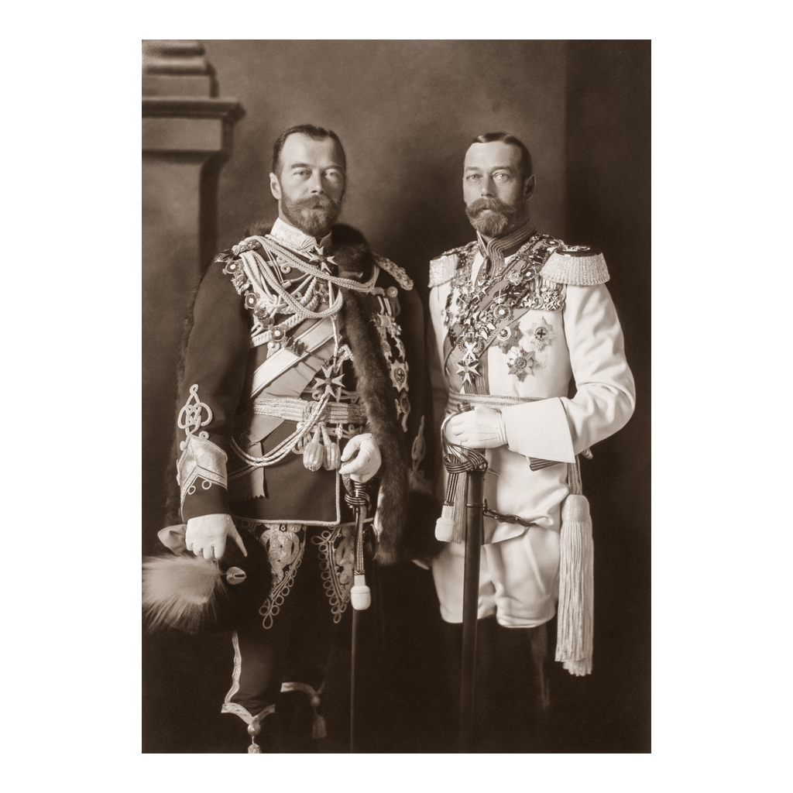
Two of the Royal Cousins, 1913
Tsar Nicholas II and King George V, Berlin, 1913
© More Lessons Less Planning | morelessonslessplanning.com
Notes:
A formal 1913 photograph of Tsar Nicholas II of Russia and King George V of Britain, two of the three related monarchs, taken during a family gathering in Berlin. Present it as a documentary photograph of the personal relationship between these two cousins, not as evidence about any specific policy decision. No confirmed photograph shows all three cousins (Wilhelm II, George V, Nicholas II) standing together.

Slide 9
Militarism: The Arms Race
29
17
British dreadnought battleships by 1914
German dreadnought battleships by 1914
Naval race: Britain and Germany competed to build dreadnoughts
Army growth: Continental powers expanded standing armies sharply
War planning: General staffs drew detailed mobilization timetables
Public mood: Military strength became a mark of national prestige
Key Concept: Militarism glorifies military strength as a tool of national policy.
© More Lessons Less Planning | morelessonslessplanning.com
Notes:
Militarism describes a policy of building up armed forces and treating military strength as a mark of national prestige. Britain and Germany competed directly to build dreadnought battleships, a new class of warship, while continental powers expanded their standing armies. Military general staffs drew up detailed mobilization timetables in advance, and public opinion increasingly treated military strength itself as a measure of a nation's standing.

Slide 10
Nationalism and Imperial Rivalry
Nationalism means strong pride in and devotion to one's own nation.
Pan-Slavism encouraged Slavic peoples to look toward Russia for support.
Pan-Germanism encouraged German-speaking peoples to unite under one banner.
Colonial competition in Africa and Asia added friction among the powers.
Nationalist movements inside multiethnic empires threatened their stability.
Key Concept: Nationalism places national interest above cooperation with other nations.
© More Lessons Less Planning | morelessonslessplanning.com
Notes:
Nationalism is strong pride in and devotion to one's own nation, often placing national interest above cooperation with other nations. Pan-Slavism encouraged Slavic peoples across the Balkans to look toward Russia, a fellow Slavic power, for support. Pan-Germanism encouraged German-speaking peoples to see themselves as one nation. Colonial competition in Africa and Asia added ongoing friction among the great powers, and nationalist movements inside multiethnic empires like Austria-Hungary threatened those empires' internal stability.

Slide 11
The Balkans: Powder Keg of Europe
The Balkans held a mix of ethnic groups under competing empires.
Austria-Hungary formally annexed Bosnia-Herzegovina in 1908.
Serbia hoped to unite South Slavic peoples, alarming Austria-Hungary.
Two Balkan Wars in 1912-1913 redrew borders and raised tensions further.
Historians often call the region the 'powder keg of Europe' before 1914.
Note: A 'powder keg' is a situation where a small spark could trigger a much larger explosion.
© More Lessons Less Planning | morelessonslessplanning.com
Notes:
The Balkans held a mix of ethnic groups living under competing empires, mainly the Ottoman and Austro-Hungarian empires. Austria-Hungary formally annexed Bosnia-Herzegovina in 1908, angering Serbia, which hoped to unite South Slavic peoples in its own region. Two Balkan Wars in 1912 and 1913 redrew borders and raised tensions further among Serbia, its neighbors, and Austria-Hungary. Historians often call the region the 'powder keg of Europe' in the years before 1914.

Slide 12
The Assassination at Sarajevo, June 28, 1914
June 28, 1914
Archduke Franz Ferdinand visited Sarajevo, Bosnia, with his wife Sophie.
✔
A Planned Confrontation
A Serbian nationalist group planned to confront the royal motorcade.
✔
A Wrong Turn
A driver's wrong turn brought the motorcade near Gavrilo Princip.
✔
The Assassination
Franz Ferdinand and Sophie were assassinated that morning in Sarajevo.
✔
Austria-Hungary's Response
Austria-Hungary held Serbia's government responsible for the killing.
✔
Key Concept: A trigger is the immediate event that sets off a crisis, not the underlying cause behind it.
© More Lessons Less Planning | morelessonslessplanning.com
Notes:
On June 28, 1914, Archduke Franz Ferdinand, heir to the Austro-Hungarian throne, visited Sarajevo with his wife Sophie. A Serbian nationalist group had planned to confront the royal motorcade. After an earlier attempt that day failed, a driver's wrong turn unexpectedly brought the motorcade close to Gavrilo Princip, one of the group's members, and Franz Ferdinand and Sophie were assassinated at about 10:45 that morning. Austria-Hungary held Serbia's government responsible for the killing, which set off the July Crisis.

Slide 13
The July Crisis: Five Weeks to War
Date | Event
July 23 | Austria-Hungary sends Serbia an ultimatum with strict demands
July 25 | Serbia accepts most, but not all, of the ultimatum's terms
July 28 | Austria-Hungary declares war on Serbia
July 29-30 | Russia begins mobilizing its army in support of Serbia
July 31 | Germany demands that Russia halt its mobilization
Key Concept: The July Crisis is the five-week diplomatic crisis before general war broke out.
© More Lessons Less Planning | morelessonslessplanning.com
Notes:
The July Crisis unfolded over five weeks. On July 23, Austria-Hungary sent Serbia an ultimatum with strict demands, including a role for Austro-Hungarian officials in Serbia's own investigation. Serbia accepted most, but not all, of the terms on July 25. Austria-Hungary declared war on Serbia on July 28. Russia, bound to Serbia by Slavic solidarity and its own strategic interests, began mobilizing on July 29-30, and Germany demanded on July 31 that Russia halt its mobilization.

Slide 14
The Alliance Dominoes Fall
Aug 1
Germany declares war on Russia, honoring its alliance with Austria-Hungary.
✔
Aug 3
Germany declares war on France, Russia's partner in the Triple Entente.
✔
Aug 4
German forces move through Belgium on the way toward France.
✔
Aug 4
Britain declares war on Germany, bound to France by the Entente and to Belgium by an 1839 treaty.
✔
Within a Week
Five of the six great powers were at war; Italy stayed neutral in 1914.
✔
Key Concept: Mobilization is the process of assembling and readying armed forces for war.
© More Lessons Less Planning | morelessonslessplanning.com
Notes:
Once Russia mobilized, the alliance system moved quickly. Germany declared war on Russia on August 1, honoring its alliance with Austria-Hungary. Germany declared war on France, Russia's Triple Entente partner, on August 3, and German forces moved through Belgium on the way toward France. Britain, bound to France by the Entente and to Belgium by treaty, declared war on Germany on August 4. Within one week of Russia's mobilization, five of the six great powers were formally at war through these linked alliance ties. Italy, the third Triple Alliance signatory, declared neutrality on August 3, 1914, arguing that the treaty bound it only in a defensive war; Italy entered the war on the Entente side in May 1915.

Slide 15
Reading the Triple Alliance: Mutual Defense in Writing
the two other Contracting Parties shall be bound to lend help and assistance with all their forces to the Party attacked
— Treaty of the Triple Alliance, Article II, 1882
This is the actual mutual-defense wording from the 1882 treaty text you will read in the Primary Source Spotlight.
Key Concept: An alliance treaty converts a promise into a written, binding obligation.
© More Lessons Less Planning | morelessonslessplanning.com
Notes:
This is the actual operative language from Article II of the 1882 Triple Alliance: if Italy were attacked without provocation, Germany and Austria-Hungary were bound to lend help and assistance with all their forces. Language like this converts a diplomatic promise into a written, binding obligation. In the Activity, students read a longer excerpt of the treaty and analyze how this kind of clause could turn a two-country conflict into a war among several signatories.

Slide 16
What Caused World War I? Five Factors Together
1
2
3
Militarism
Alliances
Nationalism
Arms race raised tension and wartime readiness.
Mutual-defense treaties linked nations' fates.
National pride fueled rivalry and unrest.
4
5
Imperialism
Assassination
Colonial competition added friction.
Franz Ferdinand's death triggered the crisis.
Key Concept: No single factor alone explains the war - it took all five working together.
© More Lessons Less Planning | morelessonslessplanning.com
Notes:
Historians typically group the causes of World War I into five connected factors: militarism, the alliance system, nationalism, imperialism, and the assassination of Franz Ferdinand. No single factor alone explains the outbreak of the war - the arms race raised readiness, the alliance system linked nations' fates, nationalism fueled rivalry, imperial competition added friction, and the assassination supplied the immediate trigger that activated all of it at once.

Slide 17
Reference Guide: The Alliance System
Alliance system
A network of mutual-defense treaties that commits each signatory to support its partners if attacked.
Triple Alliance
The 1882 treaty binding Germany, Austria-Hungary, and Italy to mutual defense.
Triple Entente
Informal partnership among France, Russia, and Britain formed 1894-1907.
Militarism
A policy of building up armed forces and glorifying military strength as national policy.
Nationalism
Strong pride in one's own nation, placing national interest above cooperation with others.
Note: Keep this slide projected while students complete the Activity Reference Guide.
© More Lessons Less Planning | morelessonslessplanning.com
Notes:
This reference slide gives the five exact definitions for the alliance-system half of the vocabulary: alliance system, the Triple Alliance, the Triple Entente, militarism, and nationalism. Keep it projected while students complete Part 1 of the Activity.

Slide 18
Reference Guide: Crisis and War
Mobilization
The official process of assembling and readying a nation's armed forces for war.
July Crisis
The five-week crisis between Franz Ferdinand's June 28, 1914 assassination and war in August 1914.
Ultimatum
A final set of demands backed by the threat of serious consequences if rejected.
Franz Ferdinand
Heir to the Austro-Hungarian throne; his June 28, 1914 assassination triggered the July Crisis.
Central Powers
The WWI coalition of Germany, Austria-Hungary, and their wartime allies.
Note: Keep this slide projected while students complete the Activity Reference Guide.
© More Lessons Less Planning | morelessonslessplanning.com
Notes:
This reference slide gives the five exact definitions for the crisis-and-war half of the vocabulary: mobilization, the July Crisis, an ultimatum, Franz Ferdinand, and the Central Powers. Keep it projected while students complete Part 1 of the Activity.

Slide 19
Key Takeaways
The alliance system split Europe into two competing blocs by 1914.
★
The Triple Alliance (1882) and Triple Entente (1894-1907) bound signatories.
★
Militarism and nationalism raised tension well before Sarajevo.
★
Franz Ferdinand's June 28, 1914 assassination triggered the July Crisis.
★
Alliance commitments turned a Balkan dispute into a five-power war.
★
© More Lessons Less Planning | morelessonslessplanning.com
Notes:
Close by returning to the causal chain: alliance system, militarism and nationalism, the assassination, the July Crisis, and the alliance chain reaction that produced a continental war by early August 1914.

