Slide 1
Alexander the Great and His Empire
Trace how a young Macedonian king conquered the Persian Empire and spread Greek culture across the ancient world.
© More Lessons Less Planning | morelessonslessplanning.com
Notes:
Opening slide. In just over a decade, Alexander the Great led his Macedonian army from Greece to the Indus River, toppling the Persian Empire and spreading Greek culture across three continents. Students will trace his rise, his conquests, and what happened to his empire after his death.

Slide 2
Learning Targets
Trace Alexander's rise from Philip II and Aristotle to his own kingship.
★
Sequence his conquest of Persia: Granicus, Issus, and Gaugamela.
★
Explain how his conquests spread Greek culture (the Hellenistic world).
★
Describe how his empire split among the Diadochi after his death.
★
© More Lessons Less Planning | morelessonslessplanning.com
Notes:
Read the four learning targets. Today follows Alexander from a well-trained prince to the conqueror of Persia, then asks what his empire left behind.

Slide 3
The Rise of Macedonia
Macedonia
The kingdom north of Greece that Alexander ruled and led against Persia.
✔
Philip II
Alexander's father, king of Macedonia, who built a powerful army.
✔
Phalanx
A tight formation of soldiers packed together holding very long spears.
✔
Key Concept: PHILIP II of MACEDONIA built a powerful army whose PHALANX of long spears crushed its enemies.
© More Lessons Less Planning | morelessonslessplanning.com
Notes:
MACEDONIA was a kingdom just north of Greece. Its king, PHILIP II, built one of the finest armies of the ancient world and brought the Greek city-states under his control. The heart of that army was the PHALANX - a tight block of soldiers packed shoulder to shoulder, each holding a very long spear called a sarissa, so the front bristled with points like a hedgehog. When Philip was assassinated in 336 BCE, his son Alexander inherited this powerful, battle-ready army.

Slide 4
A King in Training
Alexander the Great
The king of Macedonia who conquered Persia and spread Greek culture (356-323 BCE).
Aristotle
The famous Greek philosopher who tutored Alexander as a young man.
Key Concept: ALEXANDER THE GREAT was tutored by the philosopher ARISTOTLE and became king of Macedonia at age 20.
© More Lessons Less Planning | morelessonslessplanning.com
Notes:
As a boy, the future ALEXANDER THE GREAT was tutored by ARISTOTLE, the famous Greek philosopher, who taught him science, politics, and a deep love of Greek culture and the poems of Homer. Alexander became king of Macedonia in 336 BCE at just twenty years old. He was ambitious, brave to the point of recklessness, and determined to lead his father's army against the mighty Persian Empire. Alexander lived from 356 to 323 BCE.

Slide 5
Alexander Invades Persia
Persian Empire
The huge empire, ruled by Darius III, that Alexander set out to conquer.
Darius III
The king of Persia whom Alexander would defeat at Issus and Gaugamela.
Key Concept: In 334 BCE Alexander crossed into the PERSIAN EMPIRE of DARIUS III and won his first battle at the Granicus River.
© More Lessons Less Planning | morelessonslessplanning.com
Notes:
In 334 BCE Alexander led his army across into Asia to attack the PERSIAN EMPIRE, the largest empire the world had yet seen, ruled by King DARIUS III. Alexander won his very first battle at the Granicus River in 334 BCE, defeating the Persian forces guarding the coast. That victory opened the door to the rest of the empire and showed his soldiers that the great Persian army could be beaten.

Slide 6
Face to Face at Issus
At the Battle of Issus in 333 BCE, Alexander met King Darius III himself.
Alexander charged straight toward Darius in the middle of the fighting.
Darius panicked and fled the battlefield, and his army collapsed.
The next slide shows a famous mosaic of this very moment.
Key Concept: At the Battle of Issus (333 BCE), Alexander charged Darius III, who fled - a moment captured in the Alexander Mosaic.
© More Lessons Less Planning | morelessonslessplanning.com
Notes:
In 333 BCE, Alexander met Darius III in person at the Battle of Issus. Alexander led his cavalry in a direct charge toward Darius himself. Seeing the attack bearing down on him, Darius panicked, turned his chariot, and fled the battlefield - and once their king ran, the Persian army fell apart. This dramatic moment was later captured in a famous Roman mosaic found at Pompeii. The next slide shows that Alexander Mosaic.

Slide 7
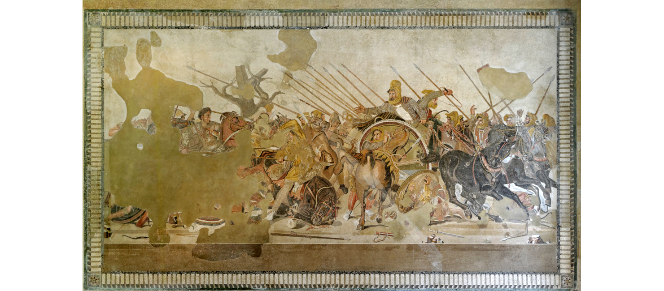
The Alexander Mosaic
Alexander charges as Darius III flees in his chariot at the Battle of Issus.
© More Lessons Less Planning | morelessonslessplanning.com
Notes:
Real public-domain photograph of the Alexander Mosaic from the House of the Faun in Pompeii (Naples National Archaeological Museum). On the left, Alexander charges on horseback with his lance; on the right, the crowned Darius III turns to flee in his chariot. Give students a moment to find both kings before discussing.
Reference labels (point to these chart features when teaching): Alexander on horseback; Darius III in his chariot

Slide 8
The Decisive Battle: Gaugamela
Gaugamela
The 331 BCE battle where Alexander decisively defeated Darius III and won Persia.
Result
Darius fled again and was later killed; the Persian Empire belonged to Alexander.
Key Concept: At GAUGAMELA in 331 BCE Alexander decisively defeated Darius III and won control of the Persian Empire.
© More Lessons Less Planning | morelessonslessplanning.com
Notes:
The decisive battle came at GAUGAMELA in 331 BCE. Though Darius III had a much larger army, Alexander punched a gap in the Persian line and drove a wedge of cavalry straight at the king. Just as at Issus, Darius fled. This time the victory was total: the Persian Empire now belonged to Alexander. Darius was soon killed by his own officers while running, and Alexander declared himself the new ruler of Persia.

Slide 9
One of History's Largest Empires
Alexander's empire stretched from Greece and Egypt to the Indus River.
He founded new cities, many named Alexandria, along the way.
In India his exhausted soldiers refused to go farther, and he turned back.
It was one of the largest empires the ancient world had ever seen.
Key Concept: Alexander's empire reached from Greece and Egypt to the Indus River - but his soldiers refused to march farther into India.
© More Lessons Less Planning | morelessonslessplanning.com
Notes:
At its height, Alexander's empire stretched from Greece and Egypt in the west all the way to the Indus River in the east - one of the largest empires the ancient world had ever seen. Along the way he founded dozens of new cities, many named Alexandria after himself; the greatest, in Egypt, became a famous center of learning. Alexander wanted to push even farther into India, but at the Hyphasis River his exhausted soldiers refused to go on, and he was forced to turn back. He did not conquer India itself.

Slide 10
Spreading Greek Culture
Hellenistic
Describing the blend of Greek and local cultures that spread across Alexander's empire.
How it spread
Greek language, art, and ideas mixed with Persian, Egyptian, and Indian ways of life.
Key Concept: Alexander's conquests created the HELLENISTIC world - a blend of Greek and local cultures across three continents.
© More Lessons Less Planning | morelessonslessplanning.com
Notes:
Alexander's greatest lasting effect was not conquest but culture. As his army and settlers moved east, Greek language, art, coins, and ideas spread across the empire and blended with Persian, Egyptian, and Indian ways of life. Historians call this new blended culture HELLENISTIC, from Hellas, the Greek word for Greece. For centuries afterward, Greek became a common language of trade and learning from Egypt to Central Asia, and cities like Alexandria carried Greek science and philosophy far beyond Greece itself.

Slide 11
Death and the Diadochi
Diadochi
Alexander's rival generals who divided his empire into kingdoms after his death.
The break-up
With no strong heir, the generals fought and split the empire into three main kingdoms.
Key Concept: After Alexander died in 323 BCE, his generals - the DIADOCHI - fought over and split his empire.
© More Lessons Less Planning | morelessonslessplanning.com
Notes:
Alexander died suddenly of a fever in Babylon in 323 BCE, at just thirty-two, leaving no strong heir to rule. His top generals, called the DIADOCHI (a Greek word meaning 'successors'), fought each other for control and eventually divided the empire into three main kingdoms - one in Egypt, one in Persia and the Middle East, and one in Macedonia and Greece. The empire did not survive as one piece, but the Hellenistic culture it spread lasted for centuries.

Slide 12
Key Takeaways
Alexander inherited Philip II's army and was tutored by Aristotle.
★
He beat Darius III at Granicus, Issus, and decisively at Gaugamela.
★
His empire reached from Greece and Egypt to the Indus River.
★
His conquests spread Hellenistic culture; the Diadochi later split the empire.
★
© More Lessons Less Planning | morelessonslessplanning.com
Notes:
Recap the four takeaways. The big idea: Alexander's conquests mattered most because they spread and blended Greek culture into a Hellenistic world that outlasted his empire.

