Slide 1
Aggression and Appeasement
Why the Democracies Said Yes
© More Lessons Less Planning | morelessonslessplanning.com
Notes:
Ask the class what they would do if a bully asked for something small. Most say give it up once. The lesson is about what happens on the fourth ask.

Slide 2
Learning Targets
Trace German expansion from the Rhineland in 1936 to Prague in March 1939.
★
Define appeasement and explain what its supporters expected it to achieve.
★
Identify the constraints that shaped the British and French decision.
★
Explain what the Munich Agreement decided and what it cost Czechoslovakia.
★
Evaluate the reasoning behind appeasement using evidence, not hindsight.
★
© More Lessons Less Planning | morelessonslessplanning.com
Notes:
Point at target five. The job today is to judge a decision by what leaders knew in 1938, not by what we know happened after.

Slide 3
Europe After Versailles
The Treaty of Versailles ended the First World War in 1919.
It took territory from Germany and capped its army at 100,000 men.
German troops were banned from the Rhineland along the French border.
Many Germans called the treaty a humiliation they had not earned.
Hitler came to power in 1933 promising to tear the treaty up.
Key Concept: Every demand in this lesson was framed as undoing the Treaty of Versailles.
© More Lessons Less Planning | morelessonslessplanning.com
Notes:
Students need the treaty first. Without it, none of Hitler's demands make sense as demands.

Slide 4
Four Words Before the Crisis
Treaty of Versailles
The 1919 settlement that took territory from Germany and capped the size of its army
League of Nations
The body created in 1920 to settle disputes peacefully, which had no army of its own
Collective security
The idea that countries stop an aggressor by promising to act against it together
Appeasement
Giving in to some of an aggressive country's demands in the hope of avoiding a war
Note: Collective security and appeasement are opposite answers to the same question.
© More Lessons Less Planning | morelessonslessplanning.com
Notes:
Have students say appeasement out loud. It is the one word the whole lesson turns on.

Slide 5
Hitler's Demands, Step by Step
Date | What Germany did | Allied response
March 1935 | Announced rearmament, breaking Versailles limits | Protests only
March 1936 | Marched troops into the Rhineland | Protests only
March 1938 | Annexed Austria in the Anschluss | Protests only
September 1938 | Demanded the Sudetenland | Munich Agreement
March 1939 | Took the rest of Czechoslovakia | Appeasement abandoned
Fact: Each step was larger than the last, and each one tested whether anyone would stop him.
© More Lessons Less Planning | morelessonslessplanning.com
Notes:
Keep this table on screen a moment. Students should notice the response column barely changes for three years.

Slide 6
March 1936: The Rhineland
What Germany Did
What Britain and France Did
Sent troops into the demilitarized Rhineland
Broke Versailles and the 1925 Locarno treaty Germany signed
Ordered the troops to retreat if France fought
Claimed the troops were inside Germany's own territory
France did not move without British support
Britain saw Germans entering their own territory
Both protested; neither used force
Did You Know: German commanders later admitted they would have withdrawn if France had marched.
© More Lessons Less Planning | morelessonslessplanning.com
Notes:
This is the cheapest moment to have stopped him, and it is the one students find hardest to forgive.

Slide 7
Three Steps in Three Words
Remilitarization of the Rhineland
Germany's move of troops back into the border zone Versailles had ordered kept empty, March 1936
Anschluss
The union of Austria with Germany in March 1938, which the Versailles treaty had forbidden
Sudetenland
The border region of Czechoslovakia where about three million German speakers lived
Tip: Say each word out loud. All three name a place or a moment you will meet again.
© More Lessons Less Planning | morelessonslessplanning.com
Notes:
Anschluss is pronounced AN-shloos. Students blank all three of these in the Guided Notes.

Slide 8
March 1938: Austria
The Takeover
The Justification
The Response
German troops entered Austria on March 12, 1938.
Austria was absorbed into Germany as a province.
Versailles had specifically forbidden this union.
Hitler said Austrians were Germans returning home.
Many Austrians welcomed the troops in the streets.
A vote held afterwards was neither free nor secret.
Britain and France sent formal protests only.
Italy, once Austria's protector, now stood aside.
Germany gained about 6.5 million people and Austria's army.
Warning: Crowds cheering in 1938 does not mean the vote that followed was a free choice.
© More Lessons Less Planning | morelessonslessplanning.com
Notes:
The justification card matters most. Hitler's claim was always that he was uniting German speakers.

Slide 9
The Sudeten Crisis, 1938
About three million German speakers lived in the Sudetenland.
The region held Czechoslovakia's border forts and arms factories.
Hitler demanded the region be handed to Germany.
Czechoslovakia had a defense treaty with France.
Through September 1938 Europe expected war within days.
Key Concept: Giving up the Sudetenland meant giving up the mountains and forts that defended the country.
© More Lessons Less Planning | morelessonslessplanning.com
Notes:
The next slide is a photograph from Washington in September 1938. It puts a face on the country being discussed.

Slide 10
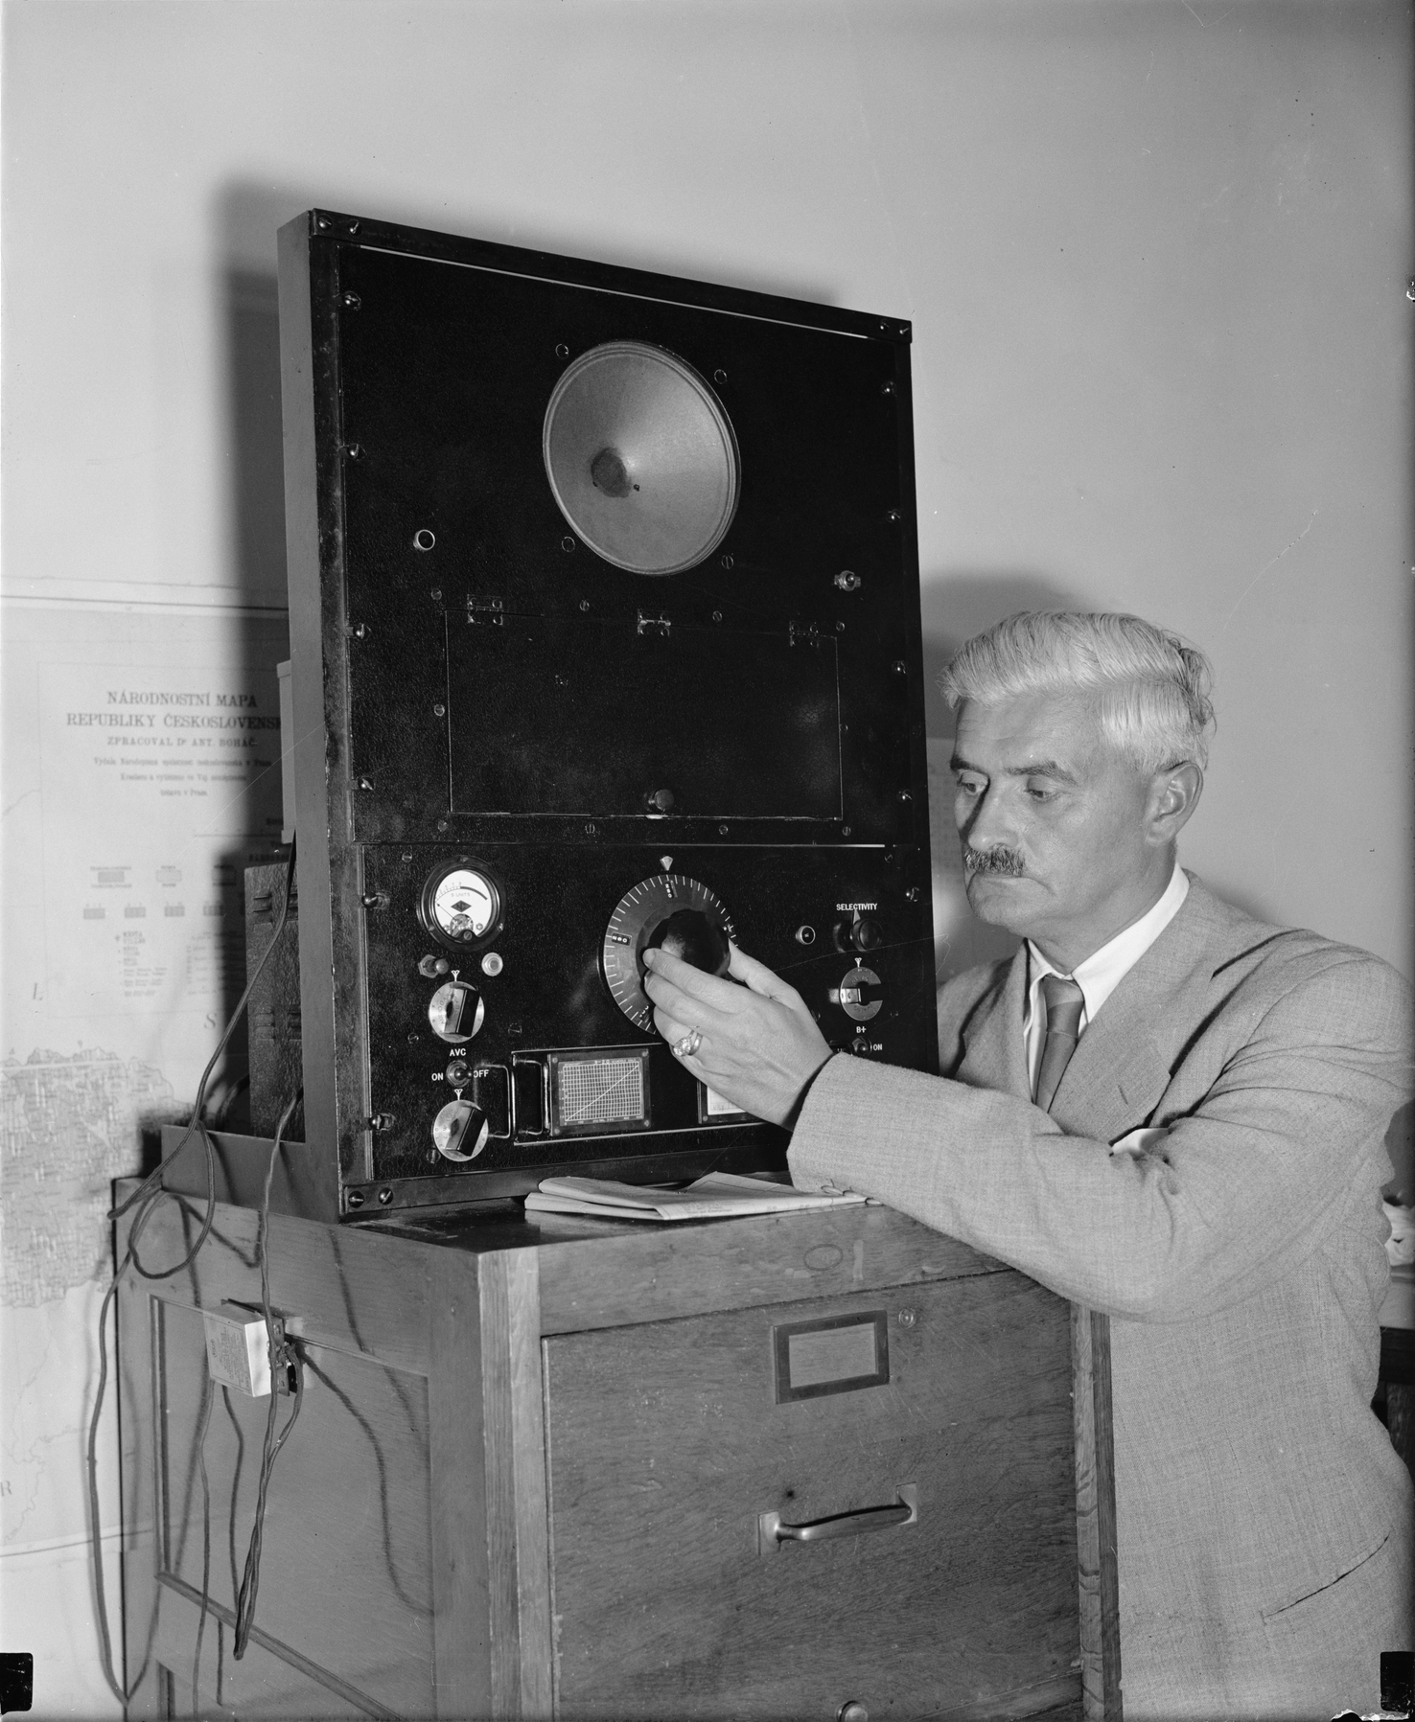
Washington, September 12, 1938
Note: Washington, 1938.
© More Lessons Less Planning | morelessonslessplanning.com
Notes:
This is Czechoslovakia's acting minister in Washington listening to a Hitler speech by radio. The printed map behind him is a nationality map of Czechoslovakia - the very argument the crisis was about.
Reference labels (point to these chart features when teaching): Map of Czechoslovakia; Listening by radio

Slide 11
Why Britain and France Held Back
Memory of 1914-18
The Rearmament Gap
Public Opinion
No Reliable Allies
Britain and France lost over 2 million dead.
Almost every family had lost someone.
Leaders had promised never to repeat it.
Britain began serious rearmament only from 1936.
Modern fighters and radar were not ready in 1938.
A year of delay meant more planes in the air.
Voters would not back a war over a distant border.
Many thought Versailles had treated Germany unfairly.
The United States was firmly isolationist.
The Soviet Union was distrusted and had no shared border.
Note: These were real constraints, not excuses. Judge the decision against what leaders knew in 1938.
© More Lessons Less Planning | morelessonslessplanning.com
Notes:
This is the heart of the lesson. Students should be able to argue the case for appeasement before they argue against it.

Slide 12
The Constraints in Numbers
2 million+
1936
British and French war dead, 1914-1918
Year Britain began serious rearmament
Fighters: Few modern Spitfires were in service in 1938
Radar: The Chain Home network was still being built
Allies: The United States was isolationist and would not fight
Fact: Britain had far more modern fighters in 1940 than it could have put up in 1938.
© More Lessons Less Planning | morelessonslessplanning.com
Notes:
The rearmament argument is the strongest defense of appeasement. Give it its full weight here.

Slide 13
Munich, September 29-30, 1938
Four powers met
Britain, France, Italy, and Germany negotiated at Munich
✔
Czechoslovakia waited outside
The country losing the territory was not allowed in the room
✔
The Sudetenland changed hands
German troops occupied the region in the first days of October
✔
Chamberlain flew home
He told cheering crowds the agreement had secured peace
✔
Note: The deal was signed in the early hours of September 30, and Czechoslovakia was told, not asked.
© More Lessons Less Planning | morelessonslessplanning.com
Notes:
Stress the second row. It is the detail students remember and it drives the Activity comparison chart.

Slide 14
Czechoslovakia Was Not in the Room
What Czechoslovakia Lost
Why It Accepted
The Sudetenland and its mountain defenses
About a third of its industry
Its border forts, handed over intact
France would not honor its defense treaty
Britain urged it to accept the terms
Fighting Germany alone was hopeless
Key Concept: A country can lose a war it never fought if its allies decide not to fight for it.
© More Lessons Less Planning | morelessonslessplanning.com
Notes:
Ask what a treaty is worth if it is not honored. That question carries into the next unit.

Slide 15
America Watches, September 1938
The United States was neutral and firmly isolationist.
The Neutrality Acts barred arms sales to countries at war.
Roosevelt had no power to promise military help.
He sent messages to the leaders in the crisis instead.
He asked them to keep negotiating rather than use force.
Note: Roosevelt could offer words in 1938. That is worth remembering when you read his message.
© More Lessons Less Planning | morelessonslessplanning.com
Notes:
Set up the primary source here. Students should understand how little power stood behind these words.

Slide 16
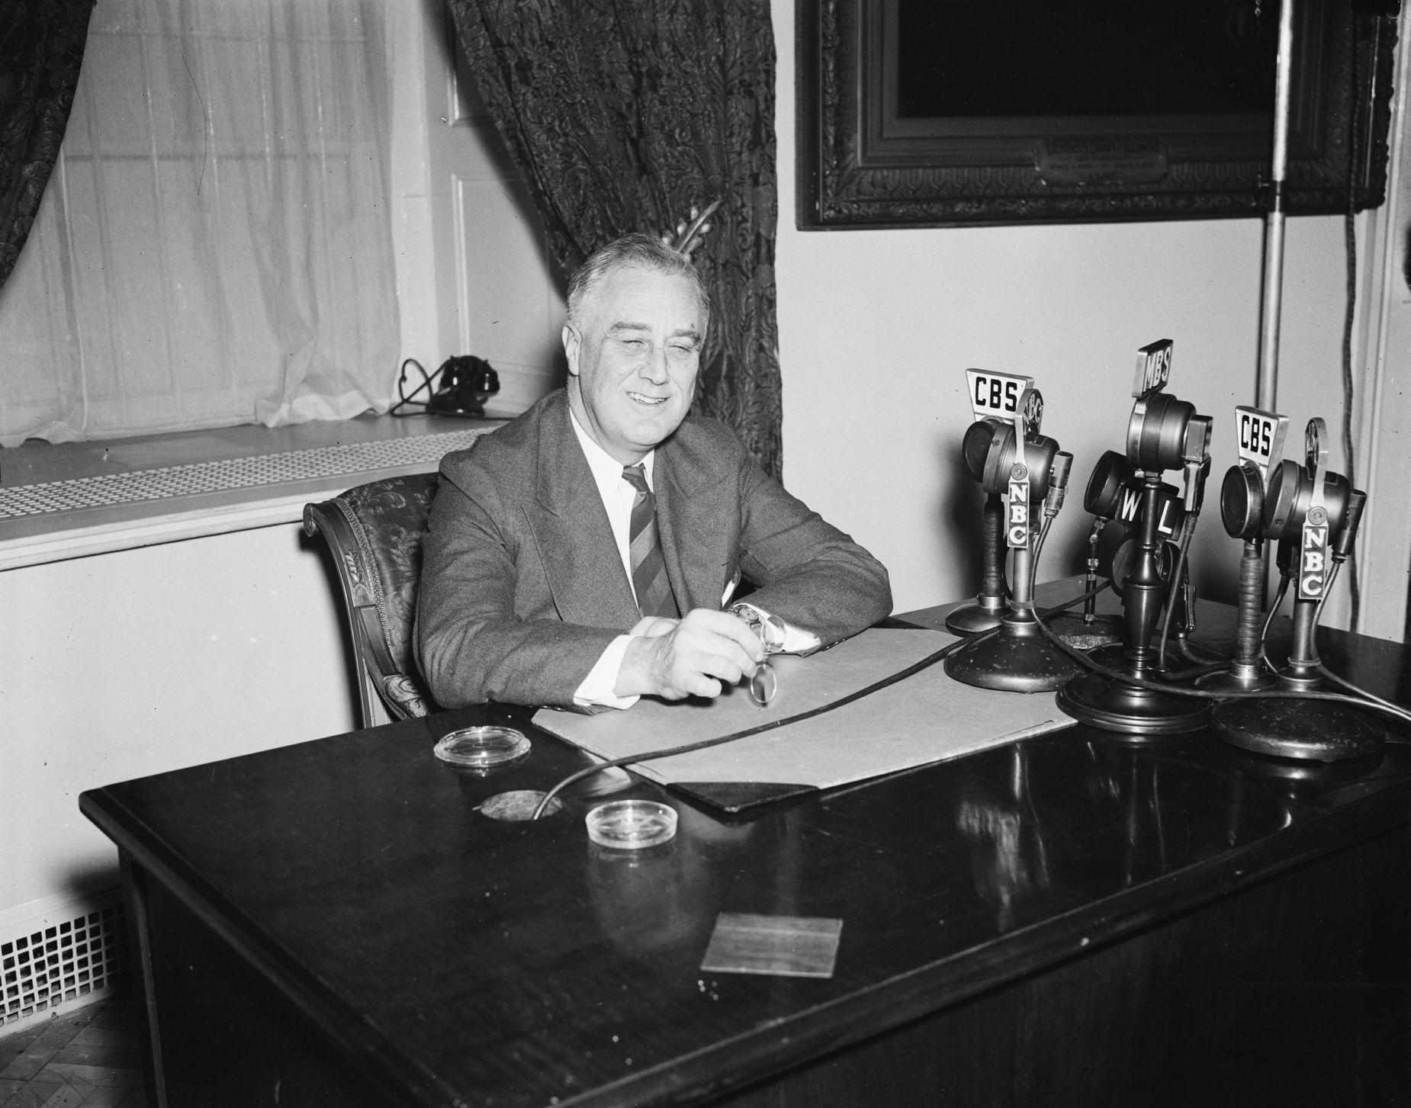
President Roosevelt at the White House Microphones, 1938
Note: White House, 1938.
© More Lessons Less Planning | morelessonslessplanning.com
Notes:
Say plainly that this is a 1938 photograph of Roosevelt at the White House microphones, not a picture of the September message itself, which was a telegram.
Reference labels (point to these chart features when teaching): Network microphones; Speaking from a desk

Slide 17
Roosevelt Appeals to the Leaders
There is no problem so difficult or so pressing for solution that it cannot be justly solved by the resort to reason rather than by the resort to force.
— Franklin D. Roosevelt, message of September 26, 1938
He sent the same appeal to Hitler, to Czechoslovakia, and to the British and French leaders.
Remember: You will read a longer passage from this same message in Activity Part 4.
© More Lessons Less Planning | morelessonslessplanning.com
Notes:
Read the sentence aloud once. Then ask what a president can actually do when he has no army he is willing to send.

Slide 18
March 1939: Appeasement Ends
German troops entered Prague on March 15, 1939.
Germany took the Czech lands that Munich had left alone.
The people taken were Czech, not German speakers.
Hitler's stated reason for every earlier demand collapsed.
Britain and France guaranteed Poland's independence weeks later.
Key Concept: March 1939 is the moment appeasement is abandoned, six months before the war begins.
© More Lessons Less Planning | morelessonslessplanning.com
Notes:
This is the turn. Once the claim about German speakers is gone, the policy has no argument left.

Slide 19
Three Words for What Followed
Munich Agreement
The September 1938 deal handing Germany the Sudetenland, agreed without Czechoslovakia
Rearmament
The rebuilding of a country's armed forces, which Britain and France began late in the 1930s
Isolationism
The belief that the United States should stay out of wars fought outside the Americas
Tip: These three words carry the rest of the story into the next lesson.
© More Lessons Less Planning | morelessonslessplanning.com
Notes:
Last vocabulary slide. Students blank all three in the Guided Notes and use them in Activity Part 2.

Slide 20
Key Takeaways
Every German demand from 1935 to 1938 was framed as undoing Versailles.
★
Appeasement was a decision made under real constraints, not simple cowardice.
★
Britain and France were rearming and believed they needed more time.
★
Munich gave Germany the Sudetenland and left Czechoslovakia defenseless.
★
March 1939 ended appeasement when Hitler took land with no German claim.
★
© More Lessons Less Planning | morelessonslessplanning.com
Notes:
Ask which takeaway students would defend in Activity Part 5. Picking a side out loud makes the paragraph easier.

